Slide 1
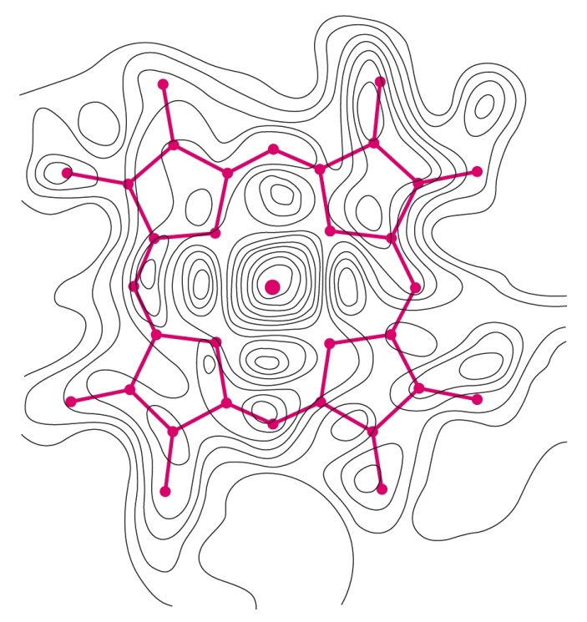
MYOGLOBIN AND HEMOGLOBIN
Svjetlana Kalanj Bognar (svjetlana.kalanj.bognar@mef.hr)

Slide 2
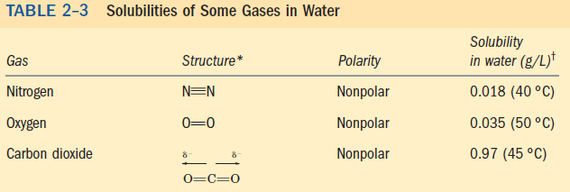



Myoglobin and hemoglobin, oxygen-binding proteins
evolutionary demands of multicellular organisms and aerobic metabolic processes
oxygen solubility!
Hemoglobin – binds and transports oxygen in blood (erythrocytes).
Myoglobin – oxygen-binding protein, in muscle tissue, particularly abundant in the muscles of diving mammals (oxygen storage).

Slide 3
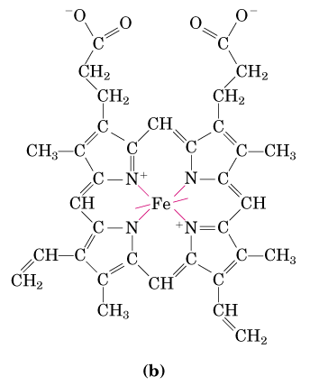
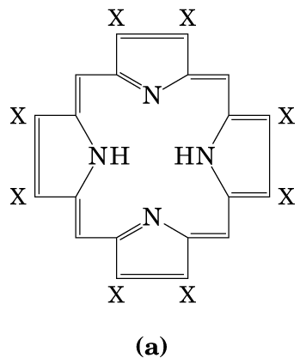
HEME IS THE PROSTHETIC GROUP ASSOCIATED WITH MYOGLOBIN AND HEMOGLOBIN.
HEME CONTAINS IRON ATOM WHICH ENABLES REVERSIBLE BINDING OF OXYGEN.
Prosthetic group is non-protein unit tightly attached to a complex protein structure, and required for specific function of that protein.
4 pyrrole rings are connected by methene bridges (=CH-); additional groups characteristic for heme porphyrin structure are 2 vinyl groups (-CH=CH₂), 2 propionate groups and 4 methyl groups.
Heme group is present in different heme proteins. (a) protoporhyrin IX, organic ring structure containing four pyrrole rings;
(b) Iron atom bound to the heme in ferrous (Fe²⁺) state which binds oxygen reversibly.

Slide 4
Different hemoproteins contain heme as a prosthetic group!

Slide 5
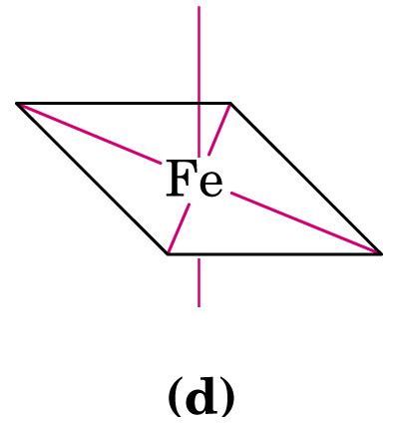
Iron atom in heme of myoglobin and hemoglobin has 6 coordination bonds:
4 to nitrogen atoms and 2 perpendicular to flat porphyrin ring system.
What prevents the oxidation of Fe²⁺?
Nitrogen atoms have electron-donating character and prevent conversion of heme iron from Fe²⁺ to Fe³⁺ state.

Slide 6
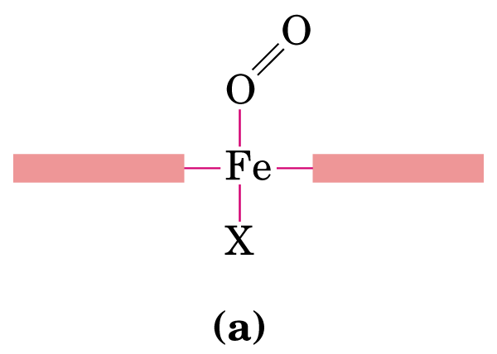
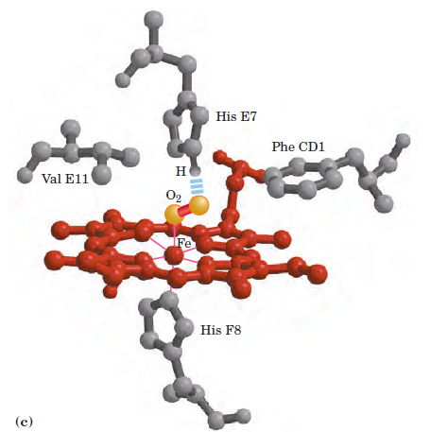
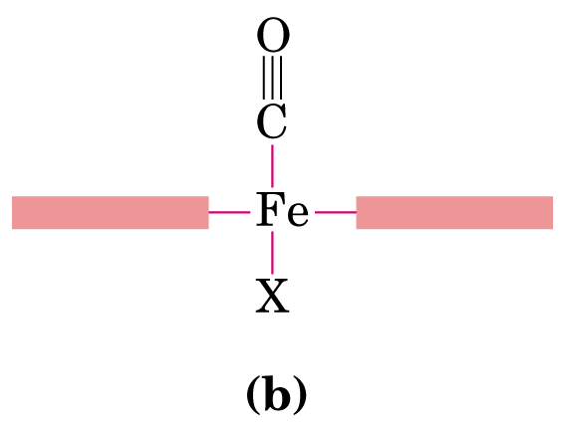
What is the oxygen affinity of free heme molecules in a water solution?
Polypeptide environment influences the function of a prosthetic group!
Steric effects on binding of ligand to the heme of myoglobin. CO binds to free heme 20000 times better than oxygen, but 200 times better in myoglobin heme (steric hindrance and the role of distal histidine, CO cannot bind linearly!).

Slide 7

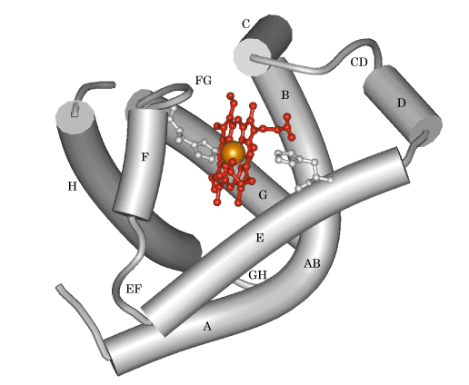
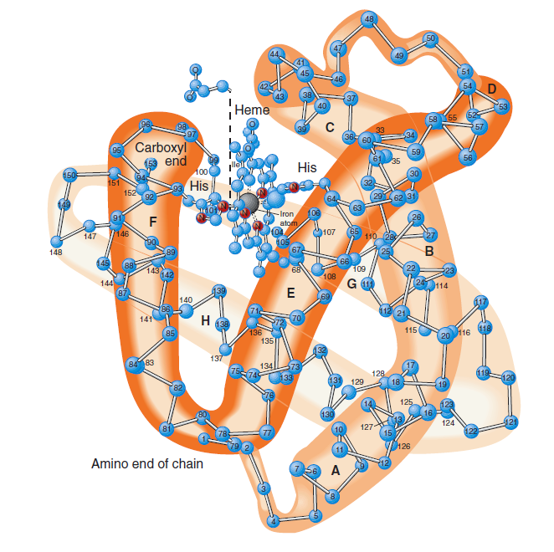
Myoglobin structure was resolved by John Kendrew in 1957, using method of X-ray crystallography - for analysis, Kendrew used the myoglobin derived from muscular tissue of sperm whale.
COOH
NH₂
MYOGLOBIN (M_{r} 16700; Mb) – typical globin;153 amino acid residues, 78% of them in eight α-helical segments (A-H) connected by bends.

Slide 8
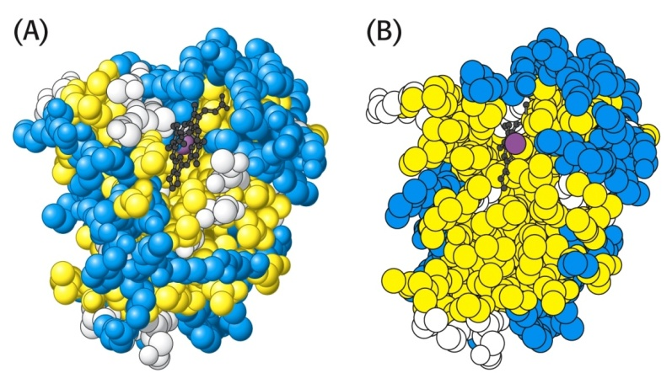
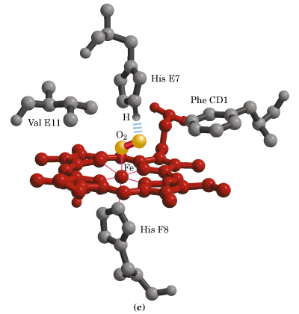
What are the expected properties of amino acid residues in the interior and the outer part of the globular myoglobin molecule?
Hydrophobic amino acids in the interior of the myoglobin structure (in yellow).
distal histidine
Almost all amino acid residues in the interior of myglobin molecule are nonpolar (leucine, valine, methionine, phenylalanine). Histidine residues are the only charged amino acid residues in the interior of myoglobin structure.
proximal histidine

Slide 9
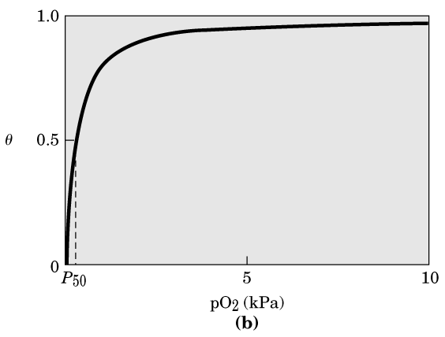
MYOGLOBIN IS OXYGEN STORAGE MOLECULE
Graphical representation of ligand binding on the example of binding of oxygen to myoglobin
– hyperbolic curve.
(partial pressure of O₂ in the air above the solution expressed in kilopascals, kPa).

Slide 10
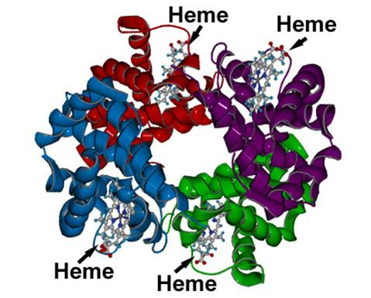
HEMOGLOBIN STRUCTURE was revealed in 1959 by Max Perutz and coworkers.
Adult hemoglobin (HbA)
Mr 64500, Hb
4 polypeptide chains
4 heme prosthethic groups
4 oxygen-binding sites
α₂β₂ tetramer
(2 α chains - 141 amino acid residues; 2 β chains - 146 amino acid residues)
Oxygen saturation of Hb in arterial blood – 96%
Oxygen saturation of Hb in venous blood – 64%
In tissues, hemoglobin releases up to one third of the transported oxygen.

Slide 11
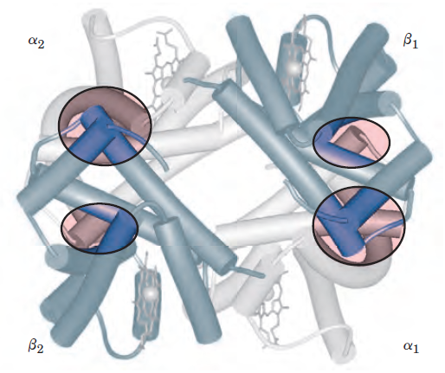
4 subunits (polypeptide chains) in hemoglobin structure are held together by interactions between hemoglobin subunits.
Types of these interactions are hydrophobic, hydrogen bonds, ionic pairs.
Ionic pairs are formed between between oppositely charged amino acid side chains in polypeptide chains of hemoglobin, and are involved in structural changes of hemoglobin during its oxygenation/de-oxygenation.

Slide 12
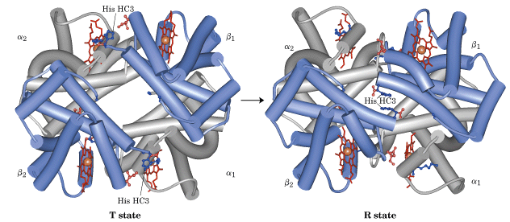
Structural changes of hemoglobin on binding oxygen:
T state, deoxygenated Hb (tense, taut, low affinity state) and R state, oxygenated Hb (relaxed, high affinity state)/ T → R transition

Slide 13
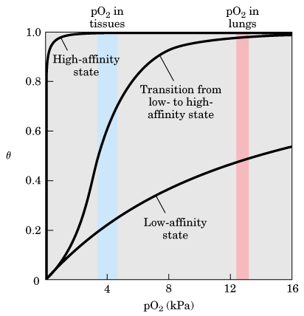
What is advantage of hemoglobin for its function as oxygen-transporter in blood red cells?
Hb
A binding curve of hemoglobin oxygen affinity:
sigmoid binding curve reflects cooperative binding of oxygen which enables higher sensitivity of hemoglobin to small differences in pO₂ between tissues and lungs.
Mb
In myoglobin, hyperbolic binding curve shows insensitivity to small changes in the concentration of dissolved oxygen.
Quaternary structure of hemoglobin enables more sensitive response to small changes in ligand (oxygen) concentration.

Slide 14
Hemoglobin structure and function is an example of an allosteric protein:
Structural changes in a multisubunit protein undergoing cooperative binding to ligand – ligand-binding induces higher affinity conformations of the protein.
– the binding of the ligand to one site affects the binding properties of another site on the same protein.

Slide 15

Hemoglobin also transports H⁺ (40 % total H⁺)* and CO₂ (15-20 % of CO₂ formed in tissues)*, the end products of cellular respiration, to the lungs and kidneys.
Hemoglobin binding sites for
CO₂ are terminal –NH₂ groups, and for H⁺ side chains of amino acid residues in Hb structure, mostly histidine.
carbaminohemoglobin
*the remainder of the H⁺ is absorbed by plasma hydrogen carbonate buffer, and the remainder of CO₂ is transported as dissolved HCO₃⁻ and CO₂

Slide 16
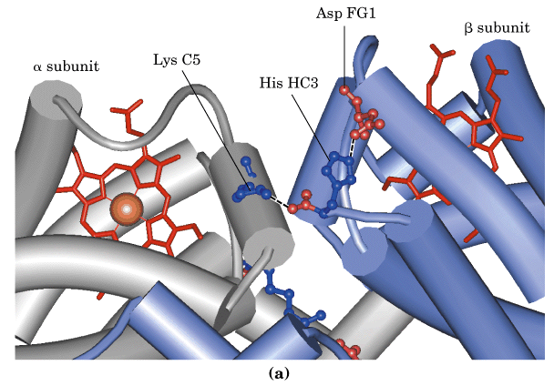
The effect of pH and CO₂ concentration on the binding and release of oxygen by hemoglobin is described as Bohr effect (Christian Bohr, 1904)
When protonated, His HC3 forms ion pairs with Asp FG1, which stabilizes deoxyhemoglobin structure.

Slide 17
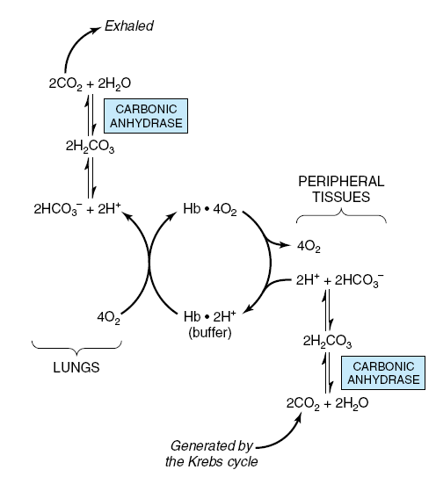
H⁺ produced in the reaction of carbamino-Hb formation contributes to Bohr effect!

Slide 18
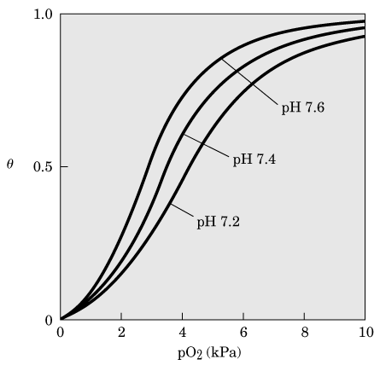
lungs
blood
tissues
Effects of pH on the binding of oxygen to hemoglobin.
Both lower pH and increased concentration of CO₂ decrease the Hb affinity for O₂ binding.

Slide 19

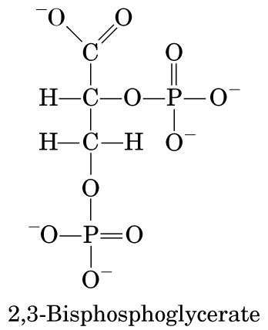
Oxygen binding is regulated by 2,3-bisphosphoglycerate (BPG),
which reduces the affinity of hemoglobin for oxygen.
Binding of BPG to hemoglobin and stabilization of T (deoxyhemoglobin) state
Negative charges of BPG interact with positively charged groups of amino acids in “binding pocket” which dissapears after oxygenation.
BPG is the allosteric regulator of oxygen binding to hemoglobin.

Slide 20
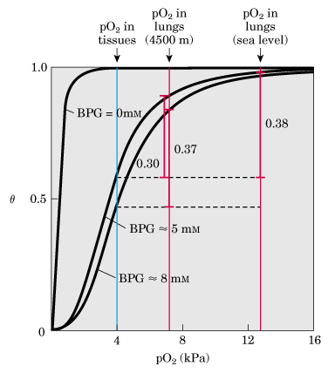
Effect of BPG on the binding of oxygen to hemoglobin. (physiological adaptation to lower pO₂ at higher altitudes, ↑BPG concentration; also present in hypoxia, and certain respiratory diseases)

Slide 21
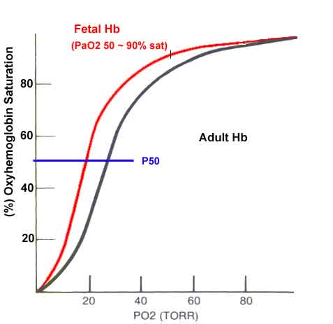
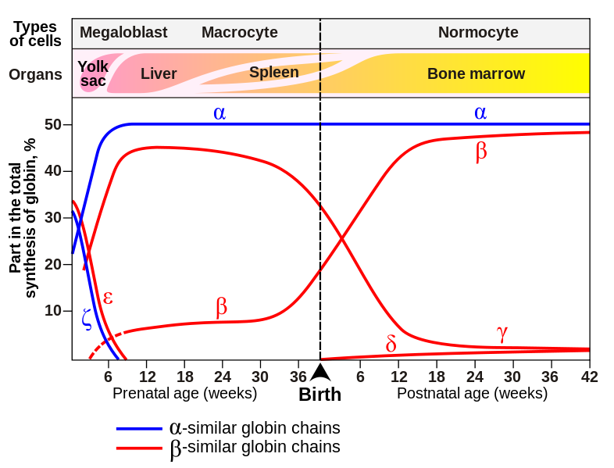
Fetal Hb (90% saturation)
Fetal hemoglobin (HbF) does not bind 2,3-BPG as well as adult hemoglobin.
Fetal hemoglobin structure is α₂γ₂ tetramer.
Fetal hemoglobin needs to have greater affinity for oxygen.

Slide 22
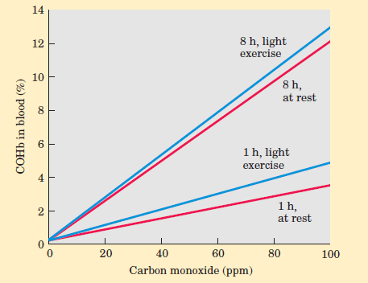
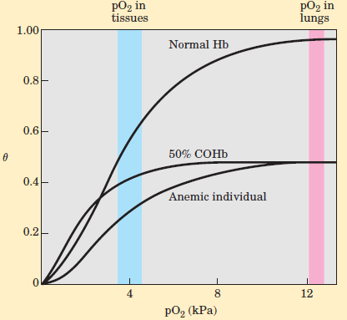
COHb in blood and CO in the air
Oxygen-binding curves compared
Intoxication with carbon monoxide -formation of carboxyhemoglobin: 10% of COHb no symptoms; 15% of COHb mild headaches; 20-30% of COHb severe headaches, nausea, confusion, disorientation, visual disturbances; 30-50% of COHb, neurological symptoms; 50% of COHb, loss of consciousness and coma, respiratory failure; death above 60% of COHb)

Slide 23
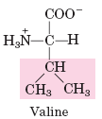
CLINICAL APPLICATIONS – ALTERATIONS IN STRUCTURE OF HEMOGLOBIN, LEADING TO DISORDERED FUNCTION OF HEMOGLOBIN
Sickle cell anemia – molecular disease of hemoglobin
First case described in 1904 – J. Herrick, Chicago physician
REPLACEMENT OF ONE AMINO ACID IN HEMOGLOBIN STRUCTURE LEADS TO DISEASE!
Linus Pauling described altered electrophoretical properties of HbS.
Vernon Ingram sequenced altered HbS – glutamate at 6th position of beta chain is replaced with valine.

Slide 24
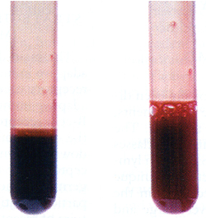
Methemoglobinemia - Hemoglobin M
Congenital - example of the mutation in the active site
Replacement of proximal or distal histidine with tyrosine causes stabilization of the heme in Fe³⁺ form in which binding of oxygen is not possible!
Change may occur in both types of polypeptide chains (alfa or beta).
Mutant hemoglobin is called methemoglobin (HbM).
Patients are cyanotic, only heterozygous carriers have been detected (homozygosity would lead to death).
2. Acquired - caused by exposure to certain medications
GLYCATED HEMOGLOBIN
Determined HbA_{1c} level is a relatively accurate measure of the amount of glucose in the blood and the length of time the concentration of blood glucose has been elevated. (Glucose reacts nonenzymatically with amino groups of amino acid residues in Hb β-chains.)

Slide 25
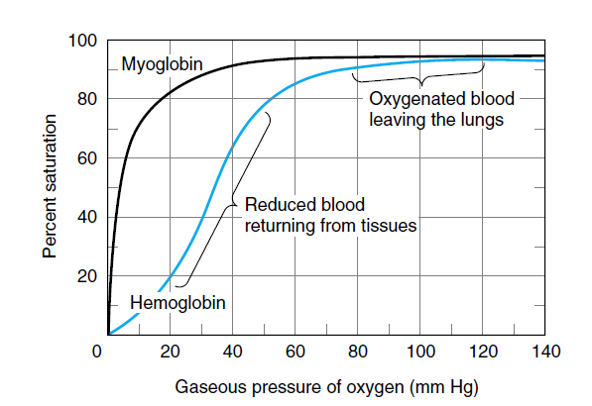
SUMMARY
Myoglobin and hemoglobin contain heme prosthetic group containing iron atom in its ferrous state (Fe²⁺)which binds oxygen reversibly.
Normal adult hemoglobin has four heme-containing subunits, similar in structure to myoglobin.
Oxygen binding to hemoglobin is allosteric and cooperative. As oxygen binds to one binding site, hemoglobin undergoes conformational changes which affect other binding sites. Conformational changes between T and R state result in cooperative binding.
Hemoglobin binds H⁺ and CO₂ (Bohr effect). Oxygen binding to hemoglobin is also modulated by 2,3-bisphosphoglycerate.
Literature:
1. D.L. Nelson i M.M. Cox: Lehninger Principles of Biochemistry, 5th edition, Worth Publishers, USA, 2008.
2. J.M. Berg, J.L. Tymoczko i L. Stryer: Biochemistry, 7th edition, W.H. Freeman and Company, USA, 2012
Link to website Medical Biochemistry Page - Myoglobin and hemoglobin

Slide 26
REVIEW QUESTIONS
The muscle protein myoglobin and the erythrocyte protein hemoglobin are both oxygen transport proteins. Describe the structural features that allow these molecules to perform their separate functions.
Fetal hemoglobin (HbF) binds to BPG to a lesser extent than does adult hemoglobin (HbA). Why do you think HbF has a greater affinity for oxygen than does maternal hemoglobin?

Slide 27
ANSWERS TO REVIEW QUESTIONS
The structural differences between two proteins underlie their different functions. Myoglobin contains one polypeptide chain and one heme as a prosthethic group, while hemoglobin consists of 4 polypeptide chains and 4 hemes. Myoglobin has high affinity for oxygen binding which makes it a perfect oxygene storage protein. Hemoglobin acts as an allosteric protein, as there is cooperative binding of its ligand, oxygen, to iron (Fe²⁺) in heme. Hemoglobin is more sensitive to small changes in partial pressure of oxygen, and is perfect transporter of oxygen in blood. (Remind that the binding of oxygen is called oxygenation. This should not be confused with oxidation, in which iron loses electron and acquires Fe³⁺oxidation state. If oxidation of heme iron occurs, which is related to certain disorders, there is no binding of oxygen at all!)
Fetal hemoglobin (HbF) has different structure than adult hemoglobin (HbA) – it contains 2 α and 2 γ chains, and due to this structural difference binding of 2,3 BPG is not possible for fetal hemoglobin. Thus, there is no effect of 2,3 BPG which decreases affinity of hemoglobin to oxygen binding. Physiologically, this structural feature of fetal hemoglobin and its higher affinity for oxygen than adult hemoglobin enables efficient fetal utilization of oxygen from maternal circulation.

