Slide 1
Mechanism of enzyme action
Coenzymes
Regulations of enzyme activity
Prof. dr. sc. Daria Pašalić

Slide 2
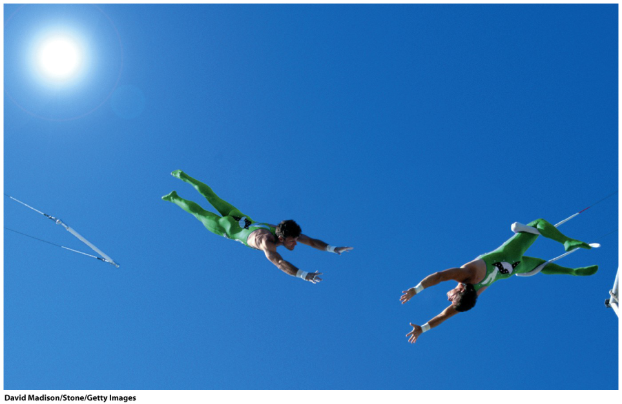
Mechanism of enzyme action
With this lecture students should solve:
Basic properties of enzymes
Classification of enzymes
Coenzyme
Activation energy and reaction coordinates
Mechanism of catalytic activity
Speed and precision

Slide 3
Enzyme Reactions- Enzyme-mediated reactions
Enzymology - The Science of Enzymes
  The name originates from 1878 (Greek: en - u; zyme - fungi)
1897bE. Buchner discovered that yeast extracts can ferment sugar to alcohol
  fermentation: a glucose -> ethanol - reaction that takes place in 12 degrees catalyzed by enzymes
James Batcheller Sumner - 1926
  isolation and crystallization of urea enzymes from bean grains showed to be a protein
  Other biocatalysts include ribosomes (RNAs) involved in the formation of peptide bonds

Slide 4
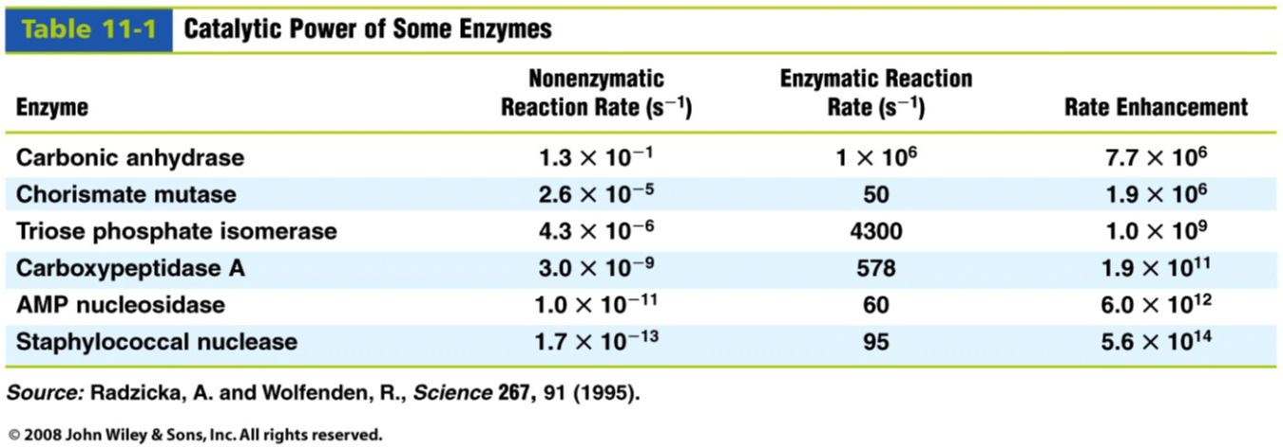
Basic enzyme properties
They differ from chemical catalysts:
reaction rate, 106-1012 times higher
mild reaction conditions ( body temp, close to neutral pH, ...)
great specificity (no nus products)
regulation capacity
The biocatalyst definition: catalyzes the reaction, but does not wear itself or does not change

Slide 5
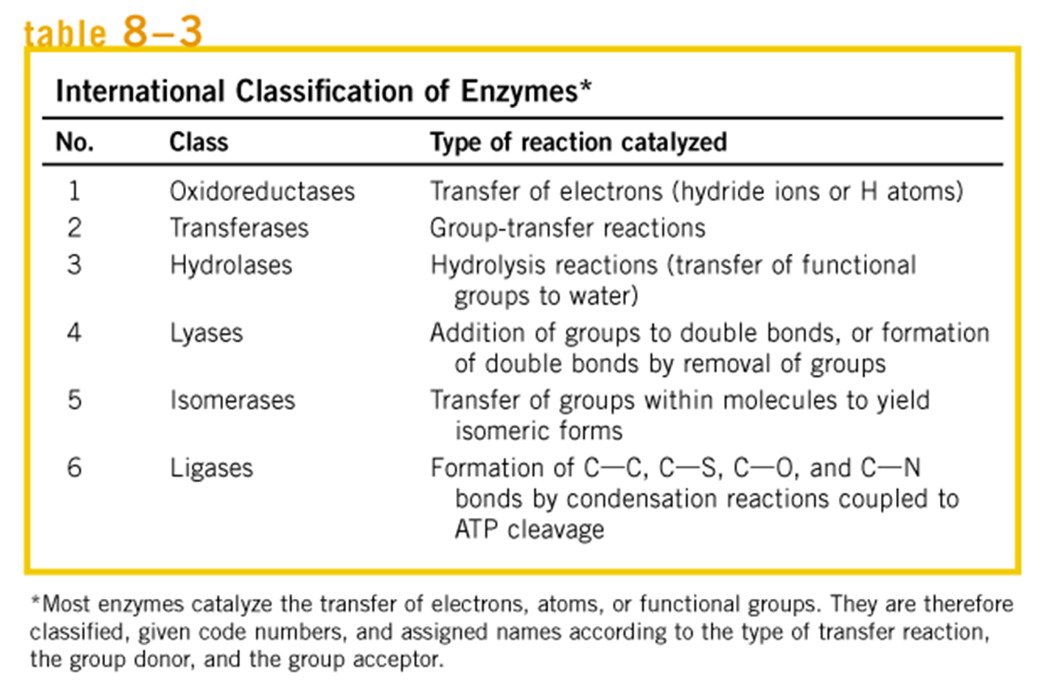

Classification of enzymes by type of reaction
naming: suffix "-aza"; urease, alcohol dehydrogenase
It's not a rule: pepsin, trypsin (digestive enzymes )
IUBMB-Nomenclature Committee of the International Union of Biochemistry and Molecular Biology
IUBMB classification: 6 classes according to the nature of the chemical reactions they catalyze
  http://enzyme.expasy.org/enzyme-byclass.html

Slide 6
Enzyme classes and subclasses
E-either the cleavage or formation of chemical bonds, with double bonds either arising or disappearing.
-energy-dependent and are therefore always coupled to the hydrolysis of nucleoside triphosphates.
Koolman, Roehm: Color Atlas of Biochemistry Second edition

Slide 7
Enzymes act on specific substrates
Bind a substrate by noncovalent bonds: van der Waals, electrostatic, hydrogen bonding and hydrophobic interactions
Enzyme and substrate relations:
  Geometric complementary
  Electrostatically complementary
  Induced fit model of binding
  Model of binding is INDUCED FIT

Slide 8
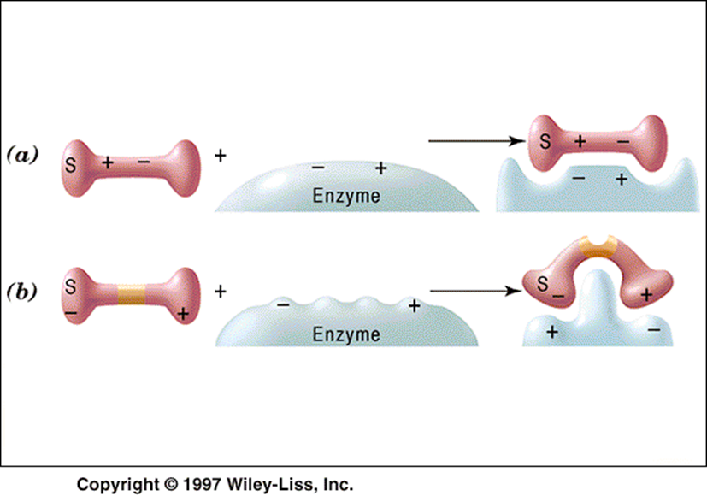
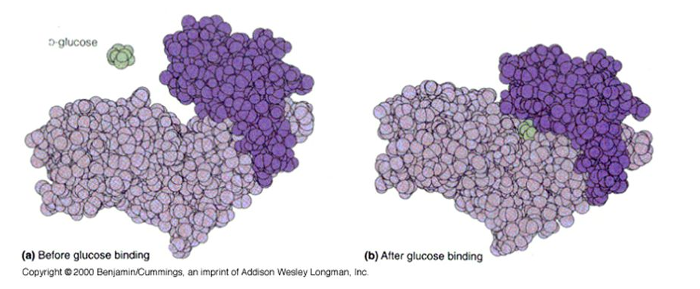
Induced fit model
Example Hexokinase as the enzyme (ATP:D-hexose-6-phosphotransferase E.C.2.7.1.1.)
And glucose as the substrate
http://web.chem.ucsb.edu/~molvisual/ABLE/induced_fit/
Enzyme and substrate fit to each other due to change in conformation- spatial rearrangement

Slide 9
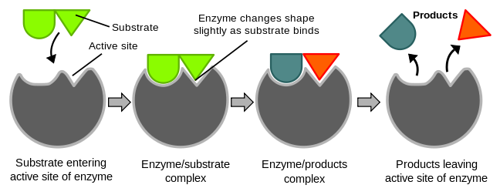
Adopting of enzyme and substrate shapes

Slide 10
Complex enzyme-substrate
Complementary
-Electrostatic
-Geometric

Slide 11
Enzymes are stereospecific
Enzymes are highly specific because they bind to a strictly specific chiral substrate or group of substrates of the same order and catalyze stereospecific reactions
(hexokinase 2. 7. 1. 1. Phosphotransferase with a -OH group as a D-series hexose sugar acceptor)
The enzymes are also chiral because the protein structure consists exclusively of L-amino acids, and thus the amino acids in the active center
The active center is asymmetrical

Slide 12
Some enzymes need cofactors for their activity
It is converted to the corresponding product
The non-protein part of the enzyme structure

Slide 13
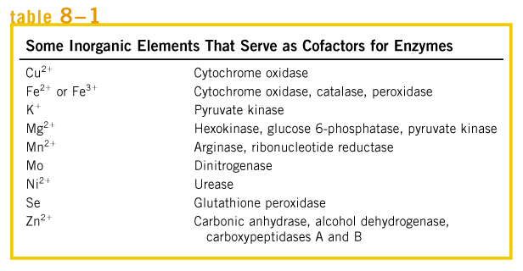
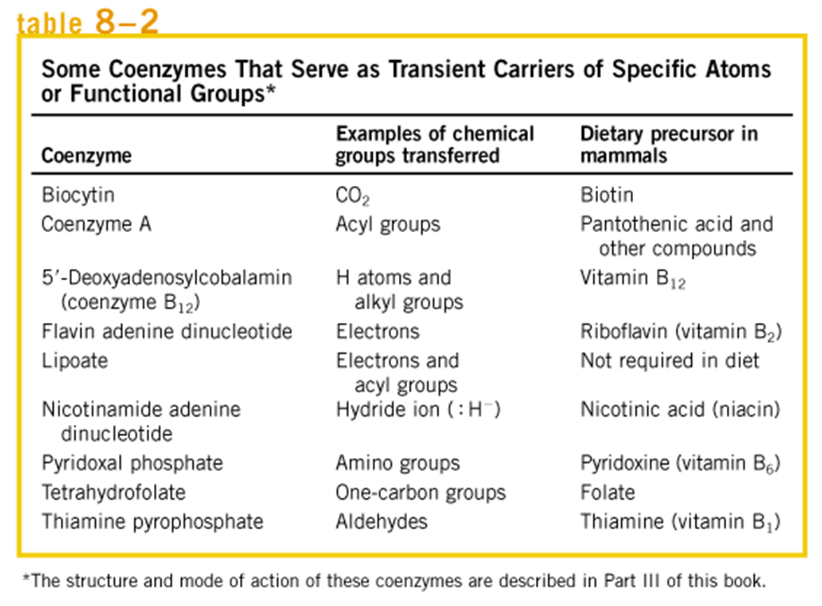

Slide 14
Prostetic group
Permanently attached to the enzyme, usually covalent bonds
    For example: - the heme group of enzymes called cytochromes
Holo-enzyme = enzyme + cofactor complex, active
Apoenzyme- without cofactor, inactive

Slide 15
Basic structure of coenzymes
Majority – nucleotide structure
    Nitrogenous base and sugar (monosaccharide, N-glycosidic bond)
    Phosphate and ribose (ester bond)
Tightly related to vitamins

Slide 16
Oxidoreductase coenzymes
NAD/NADH+H⁺
NADP/NADPH+H⁺
FAD/FADH₂
FMN/FMNH₂
  NAD, NADP, FAD and FMN are water- soluble coenzymes that undergo reversible oxidation and reduction in many of electron-transfer reactions of metabolism. The nucleotides NAD and NADP move readily from one enzyme to another; the Flavin nucleotides FAD and FMN are usually very tightly bound to enzymes, called flavoproteines, for which they serve as prosthetic groups.
Respiratory chain coenzymes (coenzyme Q, Fe-S proteins)
  Lipid-soluble Quinone such ubiquinone act as electron carrier and proton donor in the non-aqueous environment of membranes.
  Iron-sulfur proteins and cytochromes, which have tightly bound prosthetic-groups that undergo reversible oxidation and reduction, also serve as electron carriers in many oxidation-reduction reactions
Lipoic acic (oxidoreduction and transfer of C-2 unit)
  Lipoate (lipoic acid)- an intermediate carrier of hydrogen atoms and acyl groups in -keto acid dehydrogenases
Ascorbic acid

Slide 17
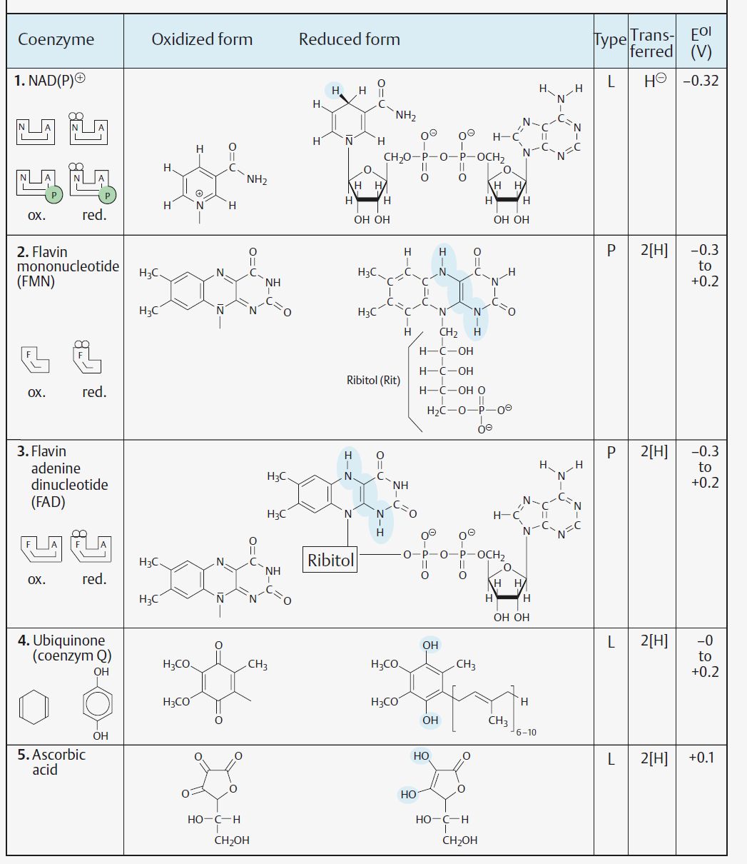
NAD⁺ i NADP⁺ dehydrogenase coenzymes
NAD⁺ in catabolic pathways and NADPH as reductant in biosynthetic pathways
FMN and FAD flavin coenzymes of dehydrogenases, oxidases and monooxygenases
Ubiquinone transfers reducing equivalents in the respiratory chain
Ascorbic acid a powerful antioxidant; cofactor of monooxygenases and dioxygenases; involved in hydroxylation of proline in collagen structure

Slide 18
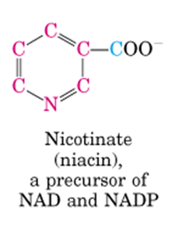
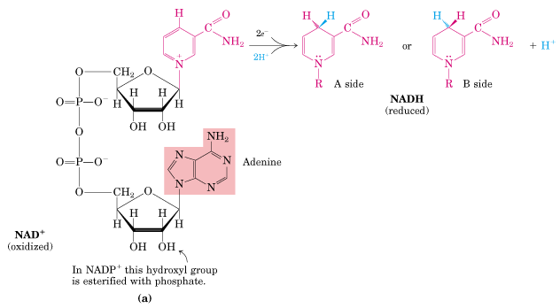
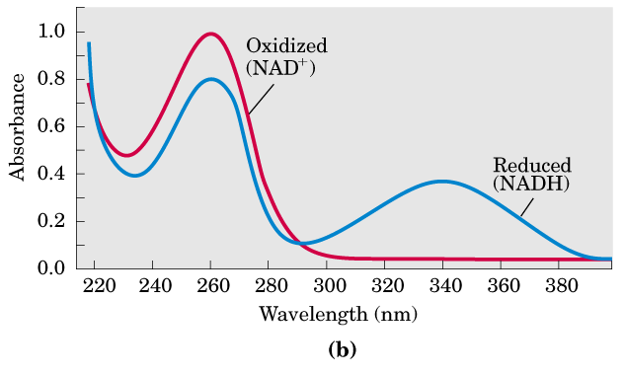
Oxidoreductase coenzymes
Nicotinamide-dinucleotide (co-substrate)
B₃
. Nelson D.L. and Cox M. M.: Lehninger Principles of Biochemistry. Worth Publishers, 3rd Ed., 2000.

Slide 19
NAD + is a mandatory cofactor in the reaction catalyzed by alcohol dehydrogenase
NADH dissociates with the enzyme to re-oxidize in an independent reaction.
Coenzymes should have to be regenerated, to be available for appropriate reactions.

Slide 20
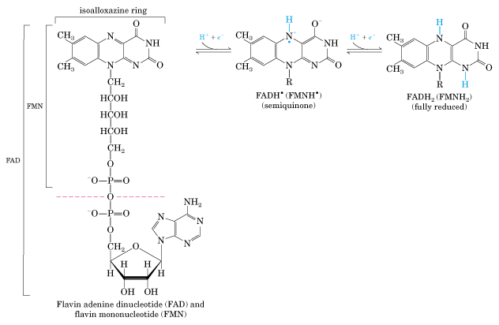
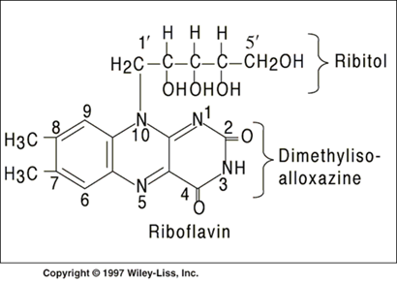
Flavin nucleotides
Oxidoreductase coenzymes
. Nelson D.L. and Cox M. M.: Lehninger Principles of Biochemistry. Worth Publishers, 3rd Ed., 2000.
B₂

Slide 21
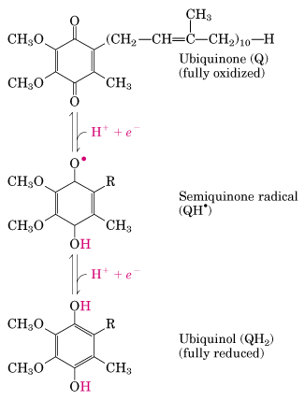
Coenzim Q
Oxidoreductase coenzymes
Quinone found in living cells and that function as coenzymes that transfer electrons from one molecule to another in cell respiration [syn: ubiquinone]
. Nelson D.L. and Cox M. M.: Lehninger Principles of Biochemistry. Worth Publishers, 3rd Ed., 2000.

Slide 22
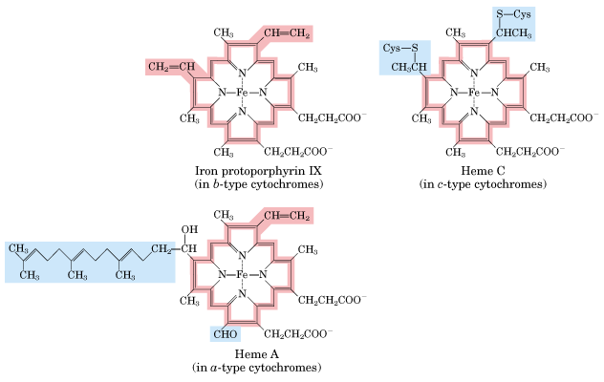
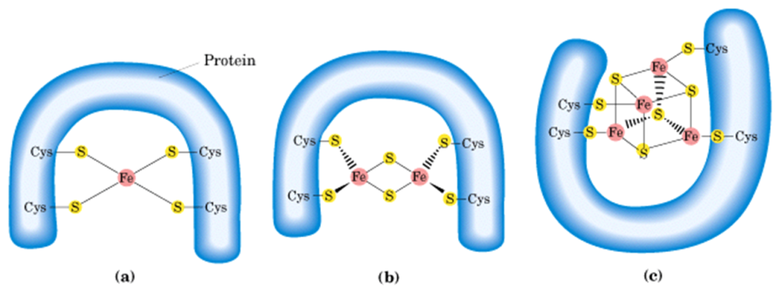
Hem – prosthetic group of cytochromes
Oxidoreductase coenzymes
Fe-S proteins
. Nelson D.L. and Cox M. M.: Lehninger Principles of Biochemistry. Worth Publishers, 3rd Ed., 2000.

Slide 23
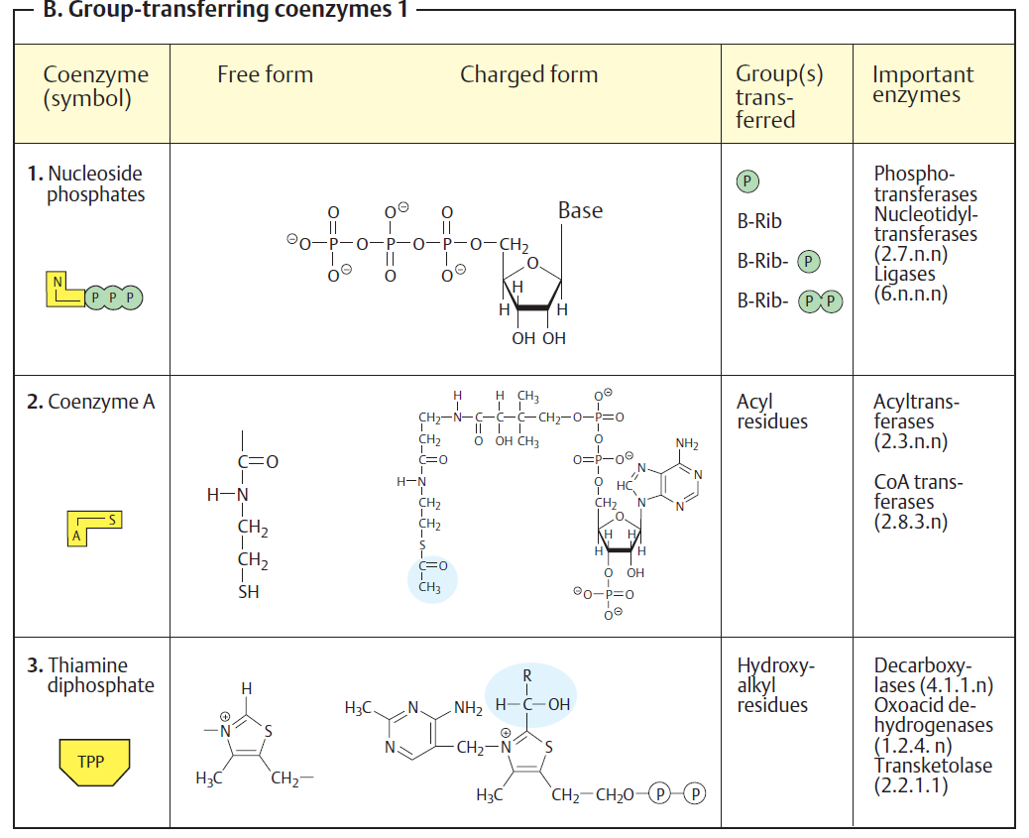
Group-transferring coenzymes
ATP, high-energy compound, high potential for group transfer!

Slide 24
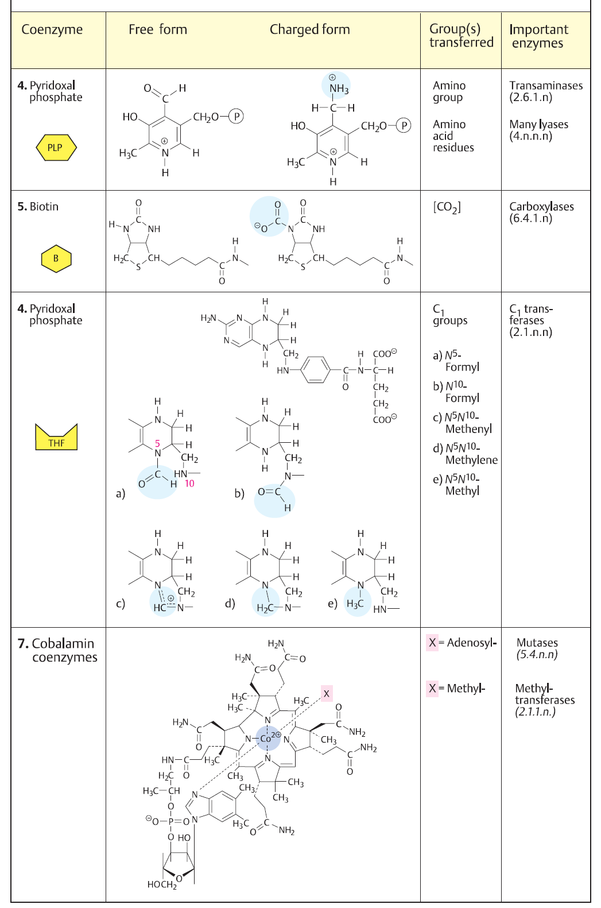
Group-transferring coenzymes
6. Tetra-
hydrofolate
6. Tetra-hydrofolate
Koolman, Roehm: Color Atlas of Biochemistry Second edition

Slide 25
THE ACTIVATION ENERGY AND REACTION COORDINATES
As the activation energy is higher, the reaction is slower
If the free energy of the reaction is ΔG <0, the reaction is spontaneous and releases energy, but this does not mean that it should be fast

Slide 26
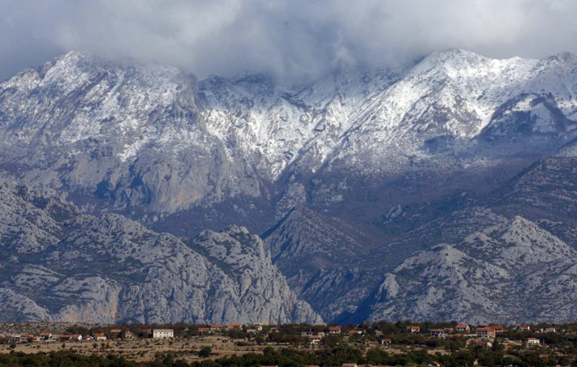
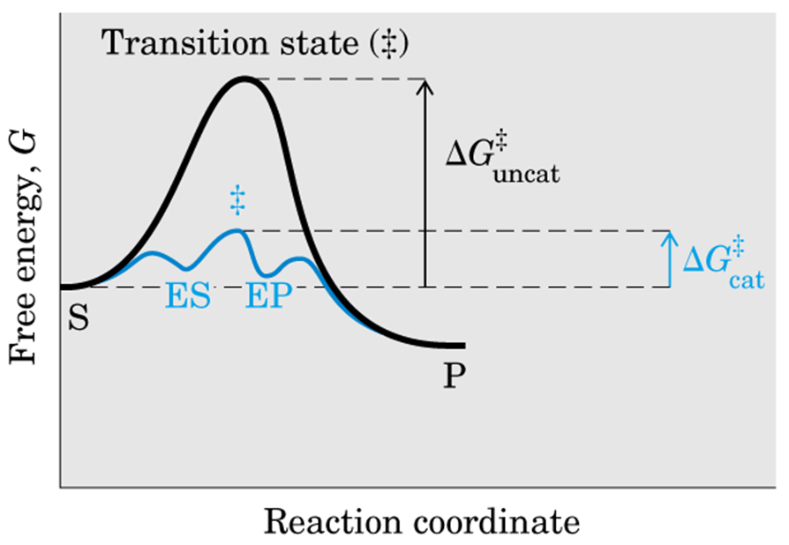
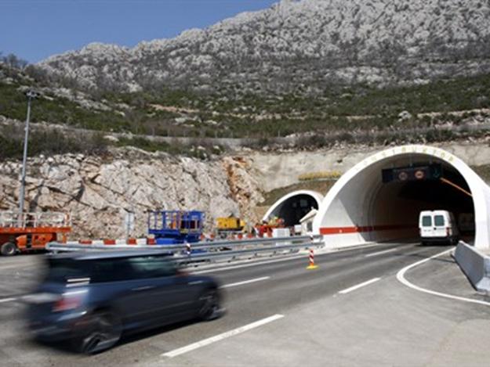
In the reaction S⇒P, ES i EP presents transition state and minimal energy in the progressive curve of enzymatic catalyzed reaction.
ΔG‡ uncat i ΔG‡cat – equal to activation energy of the catalyzed and non-catalyzed reaction, respectively

Slide 27
Mechanisms of enzyme catalyis
1. Acid-base
2. Covalent
3. Metal-ion
Proximity and strain effects
Electrostatic effects
Higher affinity to steady state

Slide 28
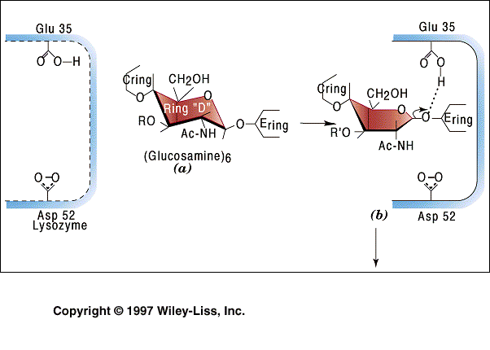
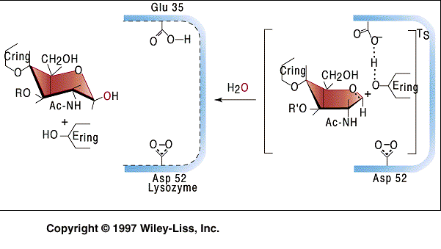
Lysozyme
Acid-base properties of the side change of amino acids localized in the active center could be included in the mechanism of the conversion of substrate to products.
At this figure those are COOH protonated group of Glu and COO⁻ , deprotonated group pf Asp52

Slide 29
Covalental catalysis
- a transient covalent bond is formed between the enzyme and the substrate.
(Ser, Cys, His-the most frequent) in active center
In the presence of covalent catalyst, the pathway of the reaction is changed (a hydrolytic cleavage of the bond between A and B).

Slide 30
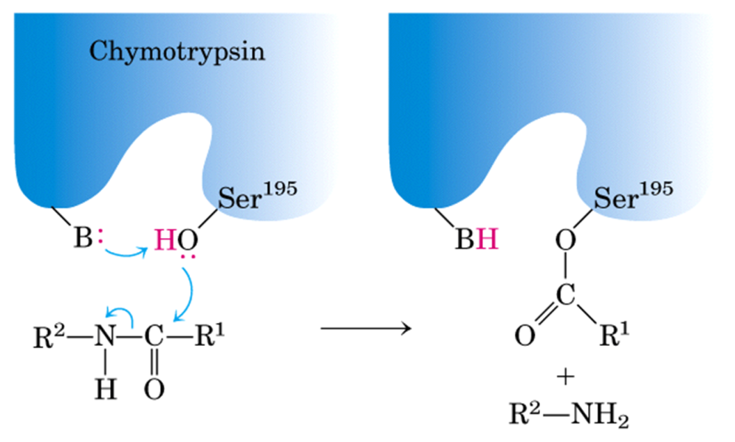
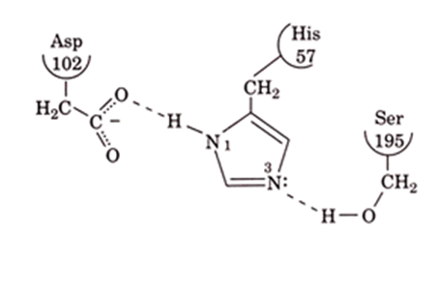
Combination of acid-base and covalent catalysis
Type of enzymes (as the example):Serin proteases
Ser, His and Asp – catalytic groups form hydrogen-bonding network, catalytic triad; catalytic mechanism involves acylation and deacylation of Ser residue

Slide 31
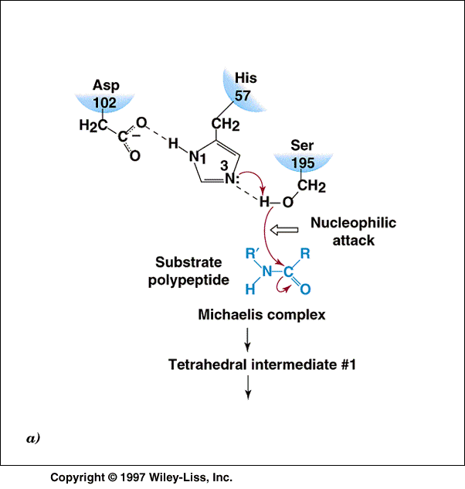
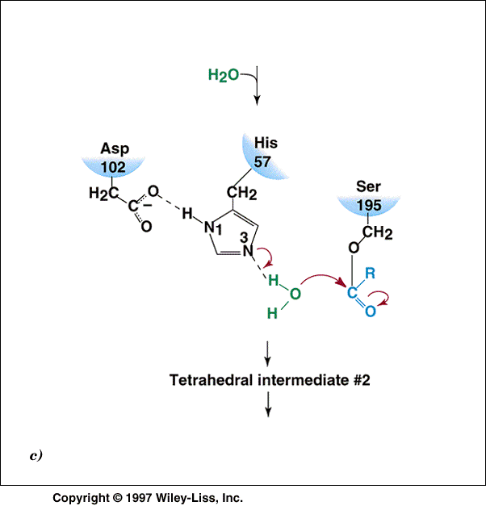
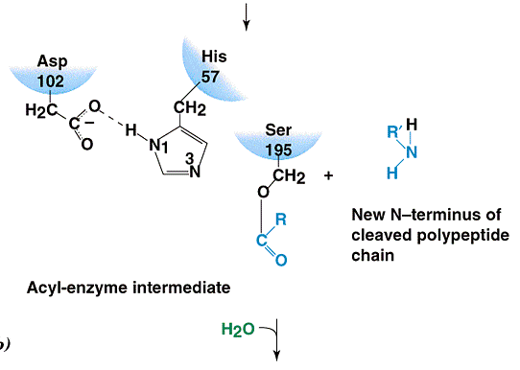
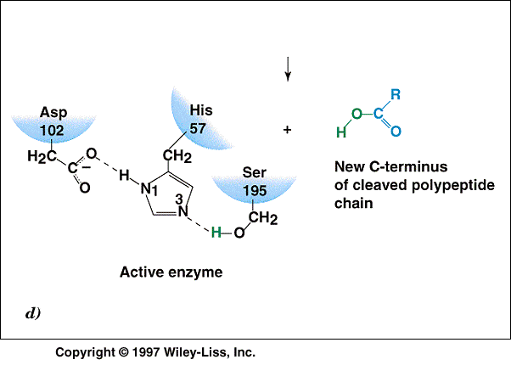
Chymotrypsin
Animacija http://www.andrew.cmu.edu/course/03-231/Protease/SerPro.htm

Slide 32
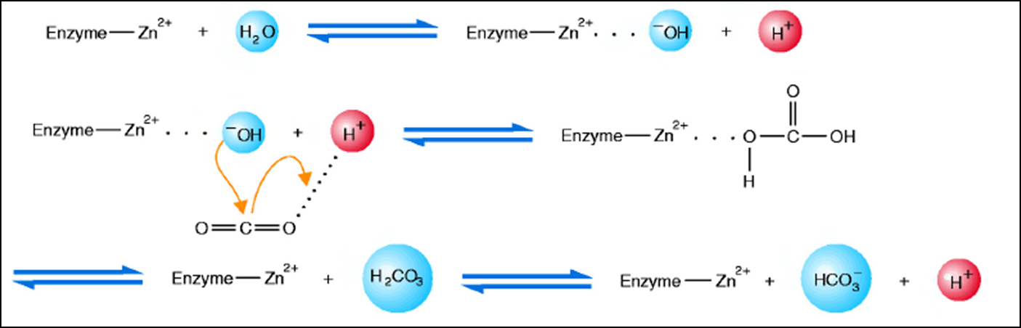
Metal ion catalysis
Ionic interactions between an enzyme bound metal and a substrate can help orient the substrate
Mediators in oxido-reduction reactions
Metaloenzymes-metal ion serves as prosthetics group involved in mechanism of catalysis (transitional state formation)
Carboanhydrase

Slide 33
Regulation ensures:
Regulation and coordination of overall metabolism –homeostasis
Constancy of intracellular environment
Enzyme catalyzed reaction proceed a rate responsive to changes in internal and external environment (specific metabolic reactions)

Slide 34
Basic principles of metabolic regulation
1. Organ specificity
2. Separate cellular compartments; selectivity of membranes
4. Regulation at enzyme level
a1-pace maker enzymes (rate limiting-enzyme)
a3-inhibition by product
a4-feedback inhibition
a5-inhibition by substrate
B-Mechanisms of regulation
co-operativity
b2-enzyme interconversion (covalent modification)
regulatory subunits
9. multienzyme complexes
a2-limiting metabolites (or substrate)
A- Position related to metabolic pathway
b1-allosteric regulation
3. Enzyme synthesis (induction) and degradation (ubiquitation)- REGULATION OF ENZYME AMOUNT
5. hormonal regulation
8. isoenzymes
7. Regulation on the level of Michaelis-Menten kinetics
B3 zymogene synthesis and activation

Slide 35
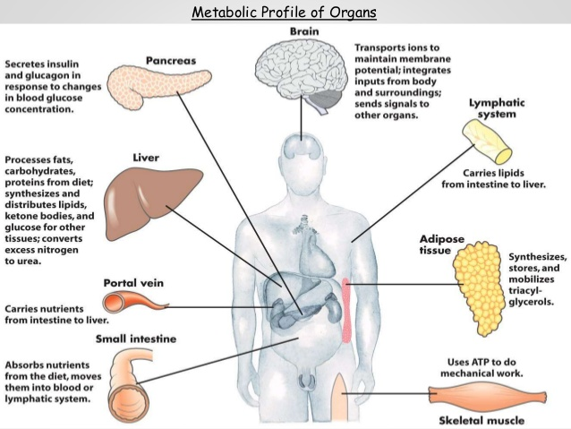
1-Organ specificity-each of metabolic pathway is more or less specific for specific organ
Examples-glycolysis (in all cells and tissues)
-gluconeogenesis- liver and kidney
http://www.slideshare.net/ashokktt/integration-of-metabolism-47652615

Slide 36
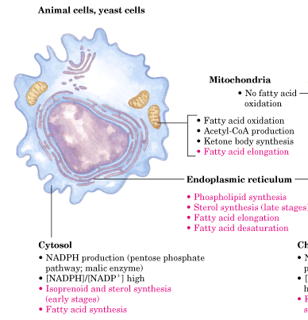
2- Intracellular location

Slide 37
Mitochondrion
CYTRIC ACID CYCLE,
β-OXIDATION, KETOGENESIS,
OXYDATIVE DECARBOXYLATION OF PYRUVATE,
SYNTHESIS OF CARBAMOIL PHOSPHATE AND PART OF UREA CYCLE,
*CARBOXILATION OF PYRUVATE AS PART OF GLUCONEOGENESYS (OXALOACETATE PRODUCTION)
Cytosol
GYCOLISIS, GLUCONEOGENESIS (except”*”part of)
GLYCOGEN METABOLISM
PART OF UREA CYCLE
Endoplasmatic reticulum
SMOOTH: FATTY ACIDS SYNTHESIS
ROUGH: PROTEIN SYNTHESIS

Slide 38
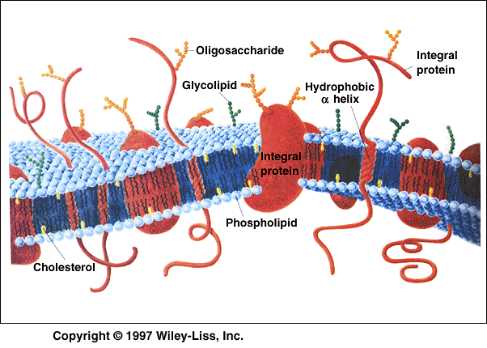
Membrane structure and permeability of different intermediates
The role of membrane structures in regulation
Specific and different membrane transporters regulate influx and efflux of different compounds

Slide 39
3-Regulation of enzyme amounts
Synthesis control
Inductors-metabolites which induce enzyme (protein) biosynthesis-molecular mechanisms of genetic expression
(lactose inducts lactase biosynthesis;
xenobiotic induct CYP P450 etc.)
Repressors -oppositely
Degradation control
ubiquitin-proteasome system- controlled mechanism of recognition and degradation of intracellular proteins

Slide 40
4- Regulation at the enzyme level
Catalytic contribution of specific, enzymatic catalytic groups

Slide 41
The flux of metabolites in metabolic pathways must be regulated in concerted manner
Only one or two key reactions: “regulatory enzymes”
Substrate concentration, products concentration, different intermediates
pH and temp are constant in human – little regulatory significance
!”nonequilibrium reactions” are potential control points
Enzyme concentrations are very low
Enzyme is subject to other control mechanisms
Flux-generating reaction
The first reaction in pathway that is saturated with substrate (i.e. hexokinase)
Allosteric and hormonal mechanisms

Slide 42
A-Position related to metabolic pathway
a1-pace maker enzymes (rate limiting-enzyme)
a2-limiting metabolites
a3-inhibition by product
a4-feedback inhibition
a5-inhibition by substrate

Slide 43
a1-Rate-limiting reactions
Rate-limiting enzyme catalyze the slowest reaction in metabolic pathway – therefore the enzymes that regulates the rate of metabolic pathway
Modulators of rate limiting reactions: ATP, ADP + Pi
  High levels of ATP inhibit ATP production
  Low level of ATP and high level of ADP + Pi stimulate ATP production
  Ca²⁺ can stimulate aerobic ATP production
  Other intermediates (Acetyl-CoA, citrate…….)

Slide 44
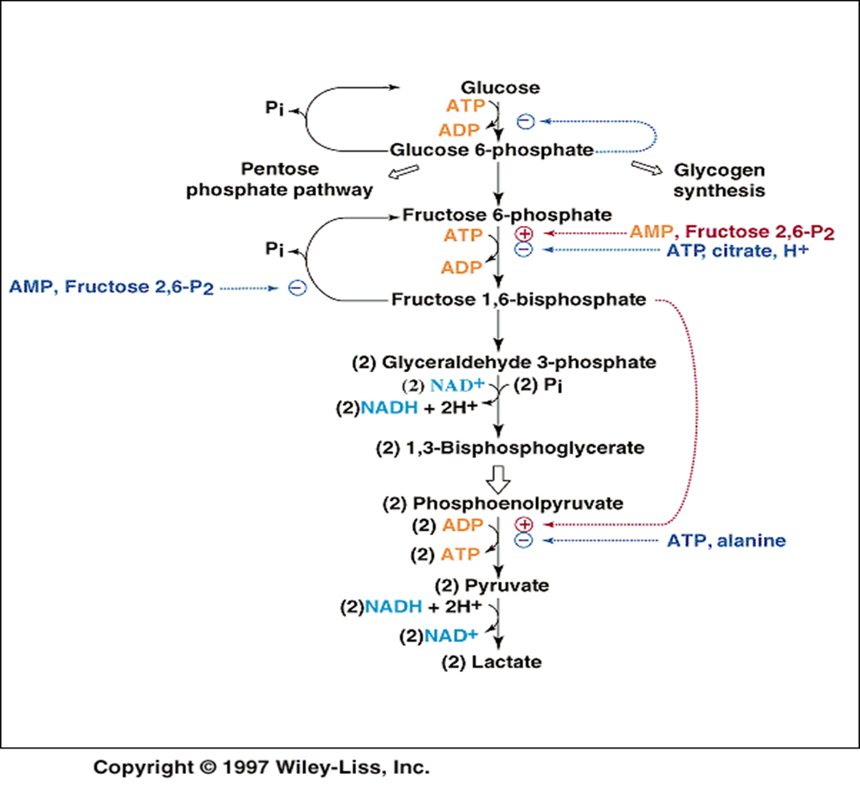
Example- phosphofructokinase I (glycolysis)
Flux-generating reaction
Rate-limiting reaction

Slide 45
a2-Regulation by limiting metabolites
RESPIRATORY CHAIN - low ADP
FATTY ACID SYNTHESIS - low NADPH
CITRIC ACID CYCLE – low oxaloacetate
The flux through pathway can be regulated by the availability of substrate

Slide 46
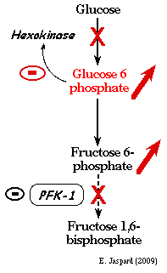
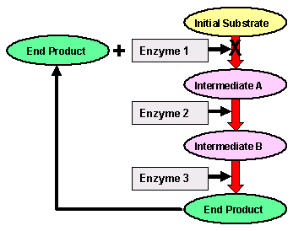
a3-inhibition by product
Directly- the product of the reaction inhibits its own enzyme
Feed back inhibition- the last product of metabolic pathway inhibits one of the first enzymes of the metabolic pathway
Feed-back

Slide 47
a5-inhibition by substrate
inhibition of an enzyme activity by a substrate of the reaction catalyzed by that enzyme;
often, this type of inhibition occurs at elevated substrate concentrations in which the substrate is binding to a second, non-active site on the enzyme.

Slide 48
B-Regulatory mechanisms
(changes in enzyme structure as a goal of regulation)
b1-Allosteric regulation
b2-Covalent modification
b3-Zymogen activation

Slide 49
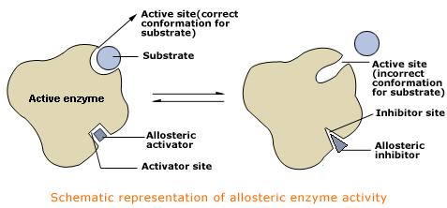
b1-Allosteric regulation
Effectors-metabolic intermediates which regulates enzyme activities
Positive allosteric effectors
Negative allosteric effectors
NOT „ISOSTERIC”, but „ALLOSTERIC”
Bind to allosteric site, not to substrate binding site
Change enzyme conformation
To shape that can bind substrate better or worse
a) changing of monomeric enzyme conformation
b) changing of polymeric enzyme conformation
cooperativity

Slide 50
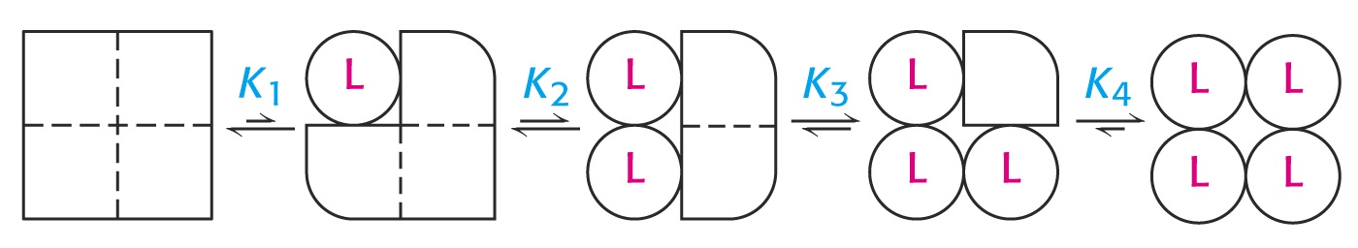
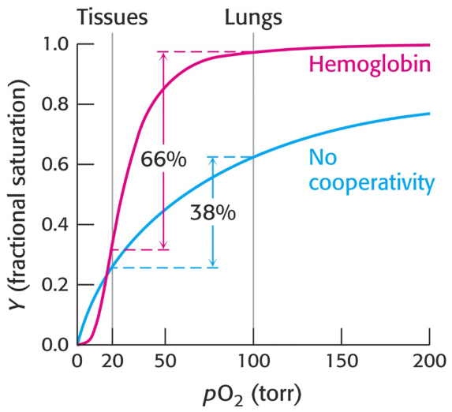
Cooperativity- allosteric effector changes the conformation of the first subunit- the consequence is changing the conformations of neighborhood subunits- enzyme affinity for substrate increases of decreases
Similar approach like for hemoglobin cooperative binding of oxygen

Slide 51
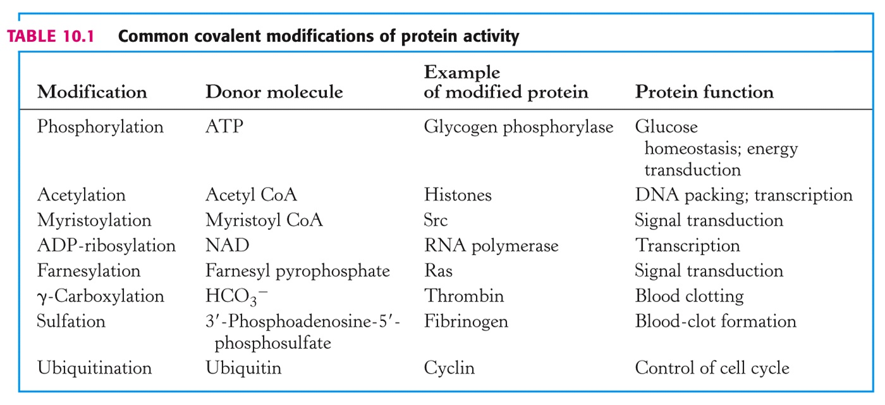
Covalent modification
b2-covalent modification
Formation of covalent linkage of different groups to amino acid the side chains of proteins (enzymes)- out of active site

Slide 52
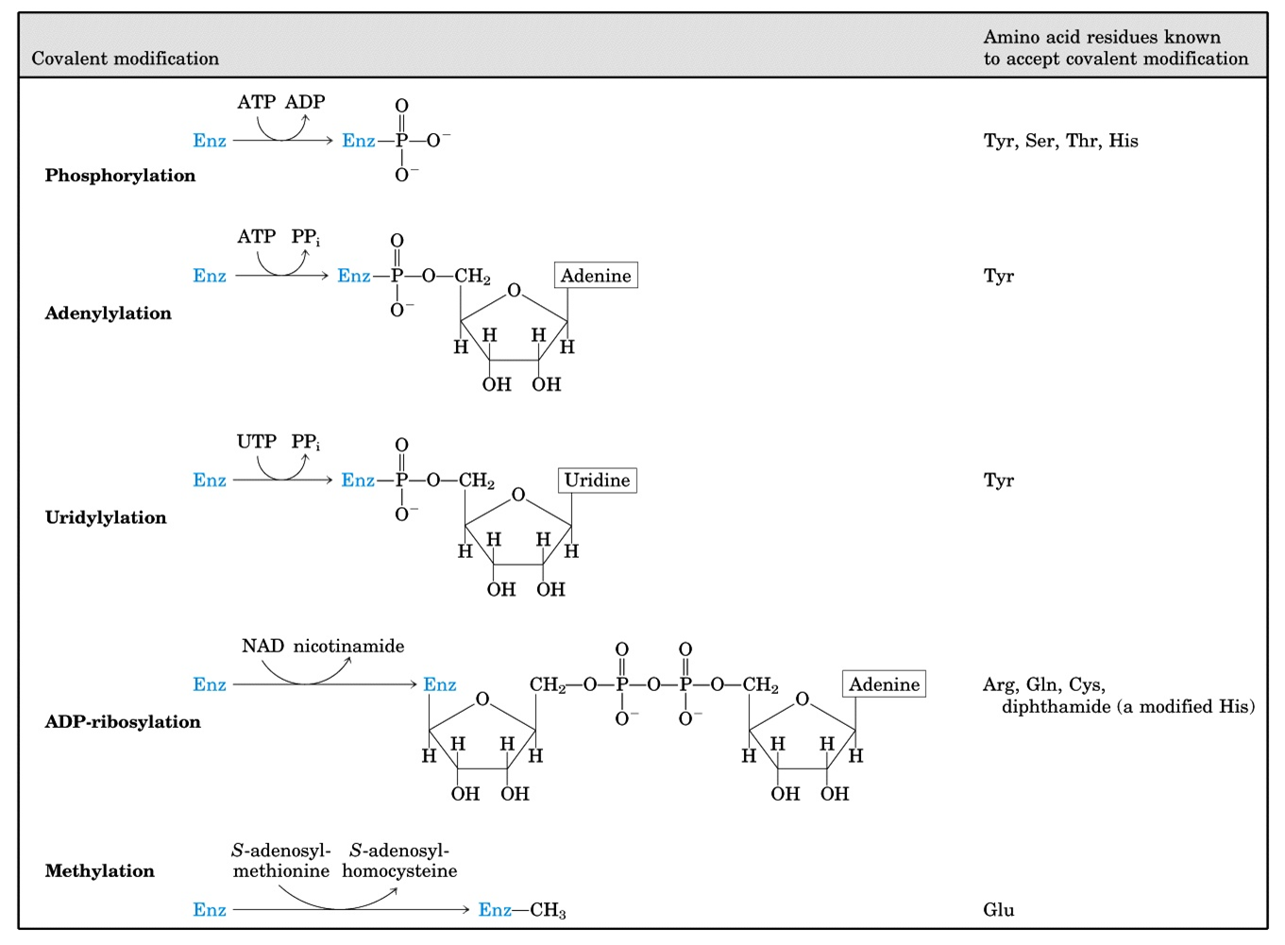

Slide 53
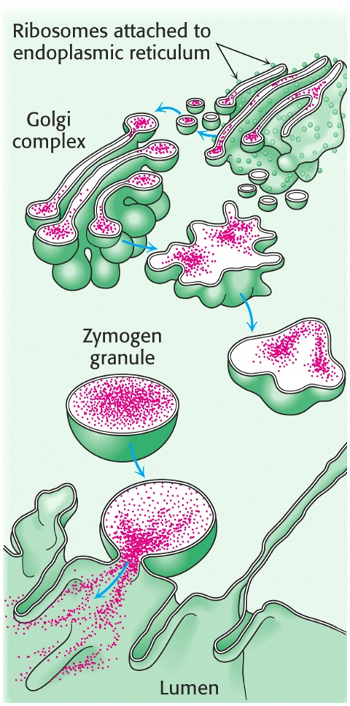
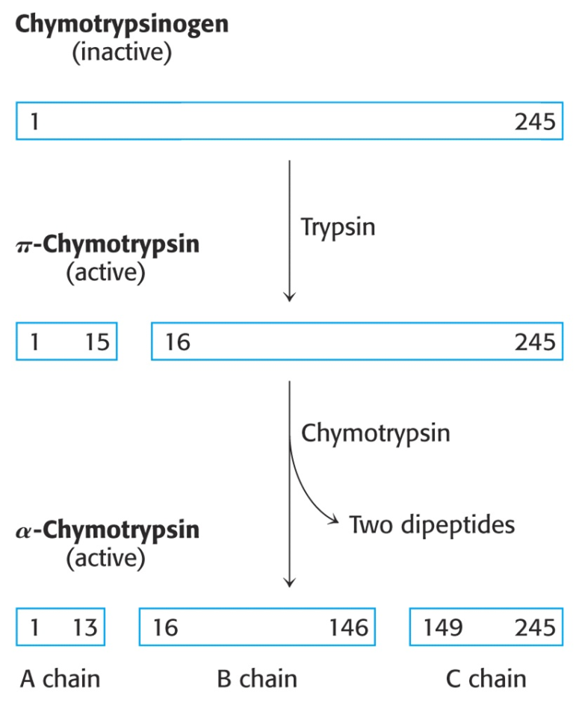
b3. Activation of so called „zymogens”
Proteolytic activation
Examples
-digestive enzymes
Inactive chymotripsynogen is released from pancreatic cells to duodenum, from, so called, zymogen granules in a form of inactive polypeptide. In duodenum, due to mild alkaline conditions and proteolytic activity of trypsin, chymotripsynogen is hydrolased to smaller peptides which are active enzymes.

Slide 54
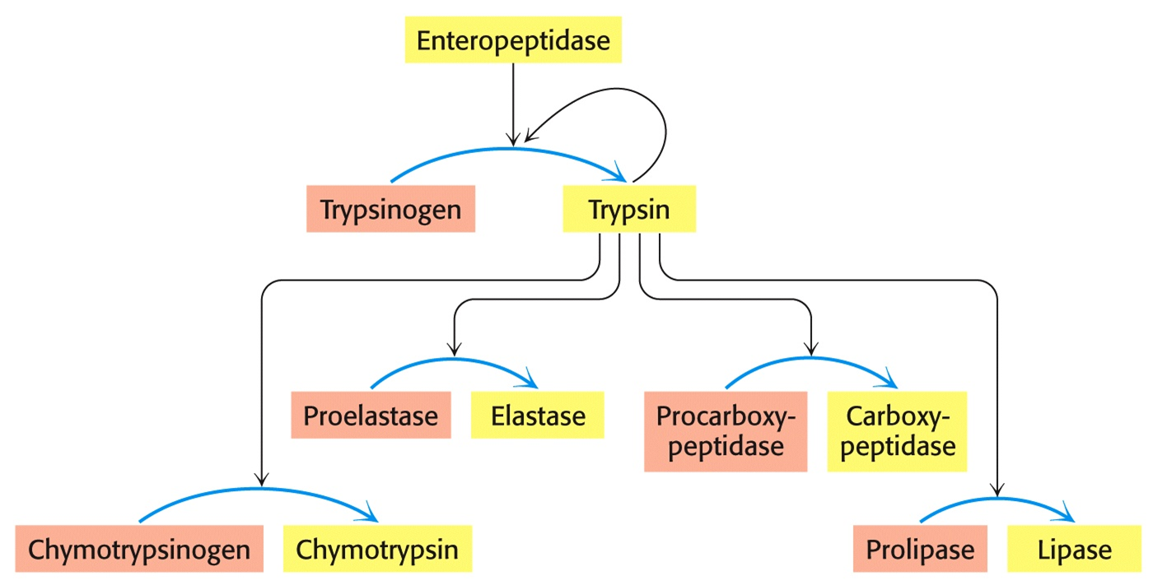
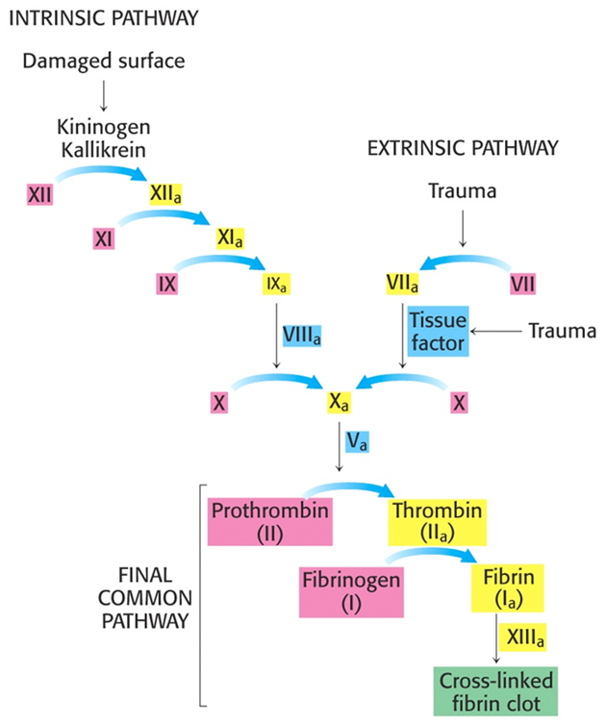
b3. Activation of so called „zymogens”
Proteolytic activation
Examples
-coagulation cascade

Slide 55
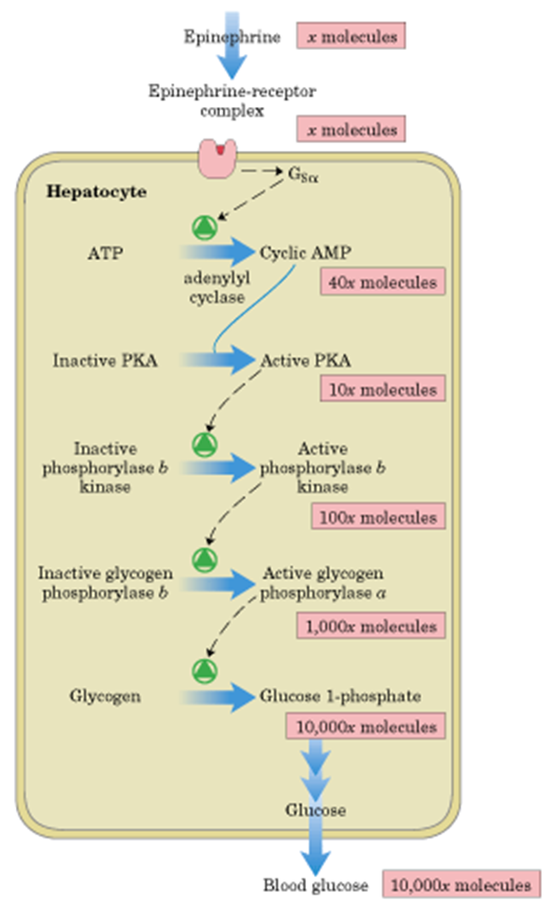
Hormone signal transduction
Covalent modifications-intracellular second messengers
Example- epinephrine activity – intracellular glycogen metabolism phosphorylation of glycogen phosphorylase and glycogen synthase
5. Hormonal regulation

Slide 56
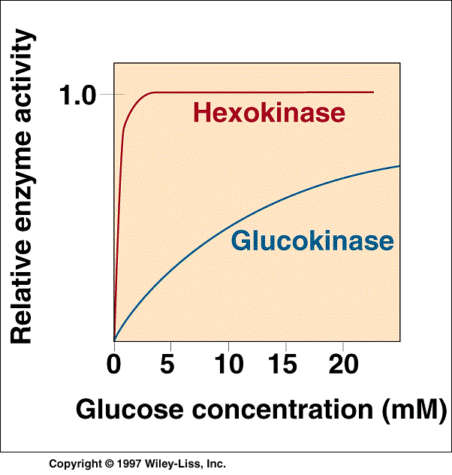
6. Regulation by Michaelis-
Menten kinetics
In other organs;
low Km=0.1 mmol/L
inhibited by substrate
Phosphorilation of the glucose
In liver; high Km= 10 mmol/L;
enzyme is active only at
elevated blood glucose
It is not inhibited by substrate

Slide 57
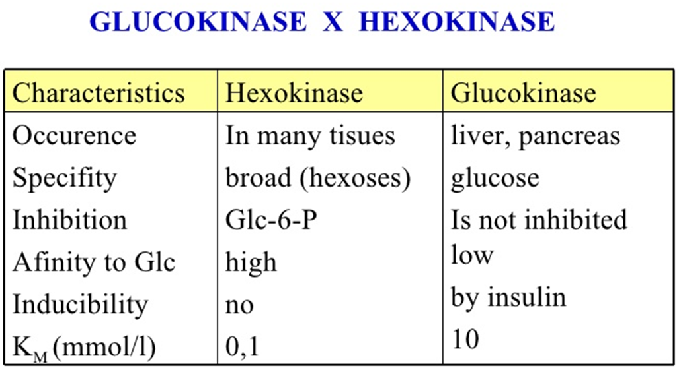

Slide 58
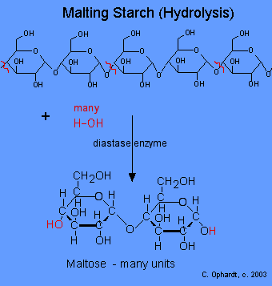
7. Isoenzymes α-amylase (diasatse)
pH∼7
oral cavity 6.6-6.8
duodenum (7.1)
mouth: salivary
duodenum: pancreatic

Slide 59
Literature and figures
D. L. Nelson, M. M. Cox: Lehninger Principles of Biochemistry,Worth Publishers; New York 2006.
Stryer, Biochemistry, W. H. Freeman, New York, 2006.
T. E. Devlin: Textbook of Biochemistry with Clinical Correlations, John Wiley and Sons Inc., 2002

Slide 60
How would you define the enzymes?
Which type of biomolecules (according structure) have biocatalytic properties?
List the major classes of enzymes!
How can we divide enzyme cofactors? Shortly explain the difference between the coenzyme and prosthetic group!
Shortly explain allosteric regulation of enzyme activity, interconversion and zymogen activation!
What are rate limiting reactions of the metabolic pathways?

