Slide 1

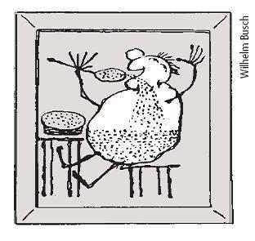
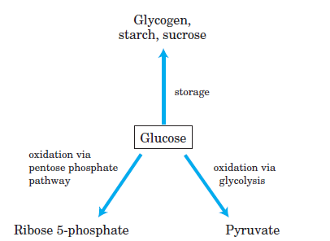
DIGESTION AND ABSORPTION OF CARBOHYDRATES
OVERVIEW OF CARBOHYDRATE METABOLISM
OXIDATIVE DECARBOXYLATION OF PYRUVATE
Svjetlana Kalanj Bognar; svjetlana.kalanj.bognar@mef.hr

Slide 2
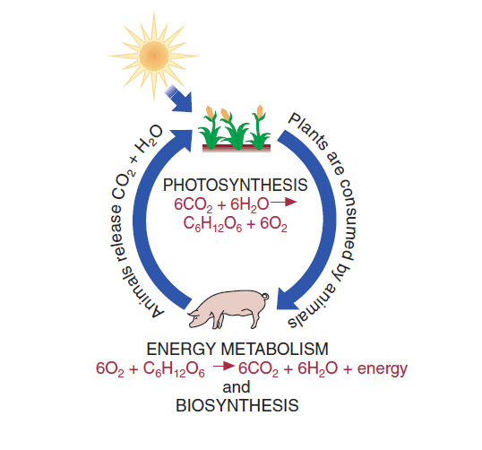
Carbohydrates - diversity of structures; the most abundant biomolecules in nature (50% of the Earth biomass)!
Carbohydrates contain C, H and O - hence the name „hydrate of carbon” and molecular formula - C_{n} (H₂O)_{n}
Carbohydrates are produced in plants by photosynthesis.
Natural carbohydrates are important source of energy for animal metabolism.
Other biological roles of of carbohydrates:
structural elements (cellulose, chitin);
precursors in synthesis of other biomolecules (amino acids, lipids, nucleotides).

Slide 3
CLASSIFICATION OF CARBOHYDRATES
I. SIMPLE CARBOHYDRATES
MONOSACCHARIDES
2. DERIVATIVES OF MONOSACCHARIDES
II. COMPLEX CARBOHYDRATES
DISACCHARIDES
OLIGOSACCHARIDES
POLYSACCHARIDES
GLYCOCONJUGATES (PROTEOGLYCANS, GLYCOLIPIDS, GLYCOPROTEINS)

Slide 4

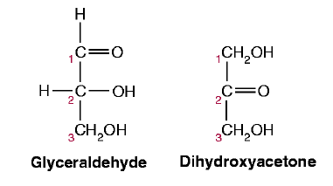
SIMPLE CARBOHYDRATES
1. MONOSACCHARIDES
polyhydroxyaldehydes and polyhydroxyketones
The smallest monosaccharides are trioses:
- glyceraldehyde (aldotriose) and dihydroxyacetone (ketotriose).
D-glyceraldehyde and dihidroxyacetone have the same molecular formula – constitutional (structural) isomers.

Slide 5
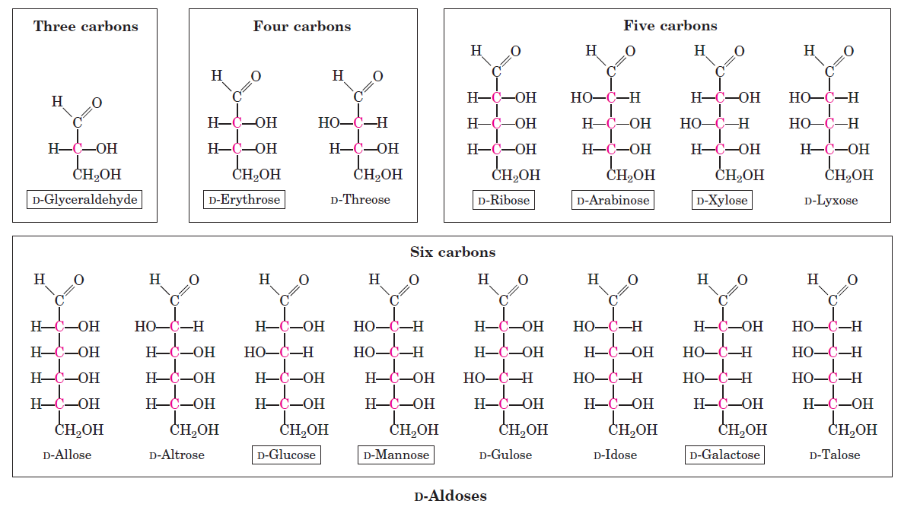
D-ALDOSES:
derived from D-glyceraldehyde by adding carbon atoms each bonded to -H and -OH (CHOH) between C1 and C2.
PENTOSES
TETROSES
TRIOSES
HEXOSES

Slide 6
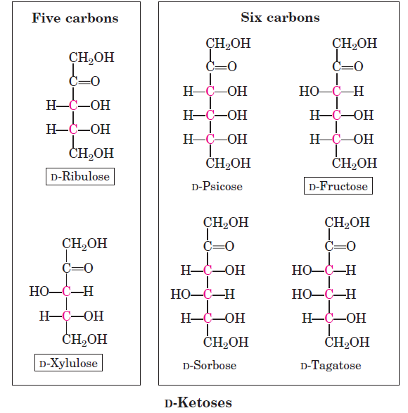
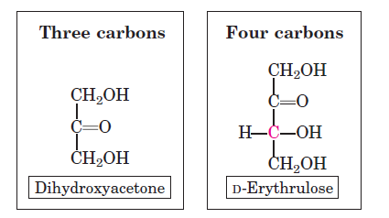
D-KETOSES:
formed from dihydroxyacetone by adding a new carbon between C2 and C3.

Slide 7
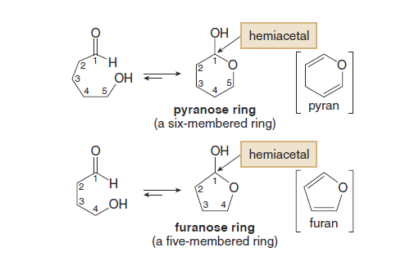
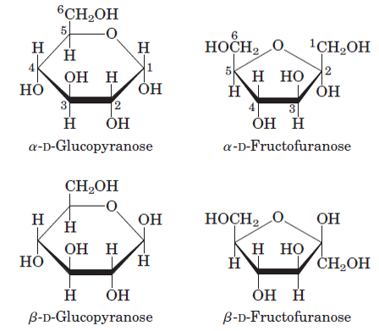
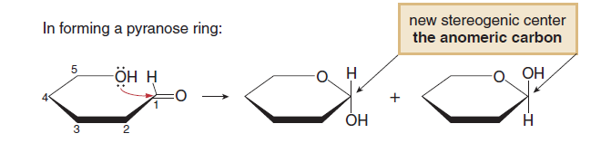
Monosaccharides are found in more stable cyclic structures formed in reaction of carbonyl and hydroxyl group (at C4 or C5) – intramolecular nucleophilic addition.
In this cyclization, a new stereogenic center is formed and new stereoisomers may be recognized as α- or β- anomers.
In nature, glucose is mostly present as glucopyranose and fructose as fructofuranose.

Slide 8
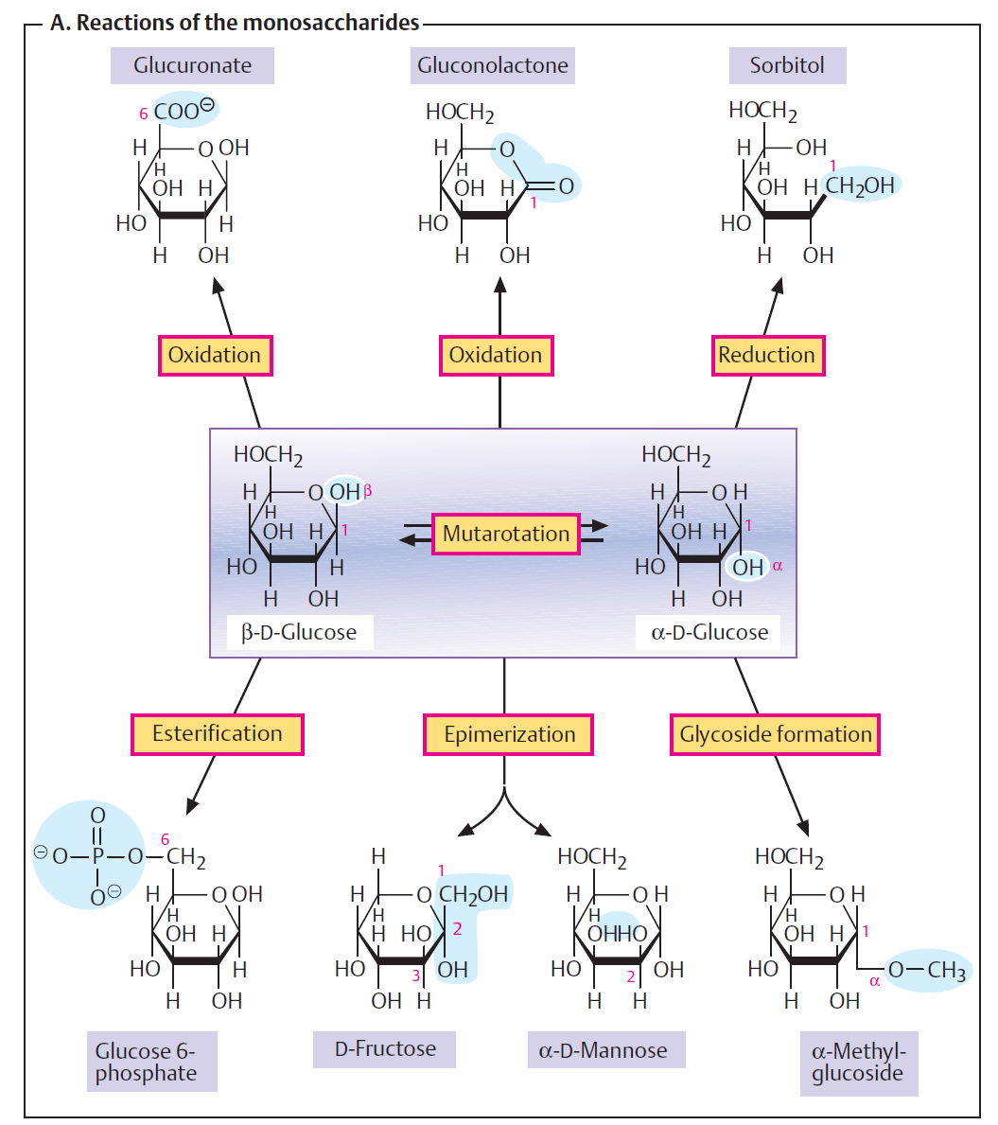
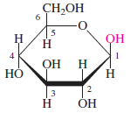
  GLUCOSE
  key molecule of carbohydrate metabolism
Isomerisation

Slide 9
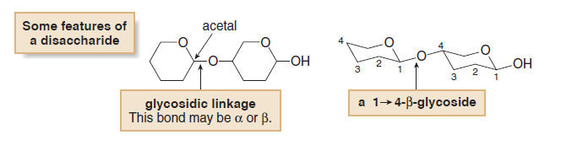
II. COMPLEX CARBOHYDRATES - DISACCHARIDES
  Two monosaccharides joined together by a glycosidic linkage.
Common disaccharides:

Slide 10
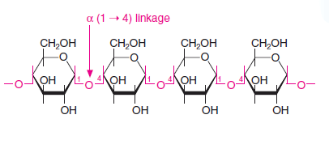
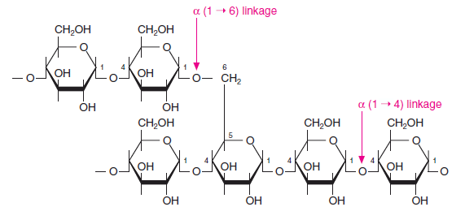
II. COMPLEX CARBOHYDRATES - POLYSACCHARIDES
Starch granules
Starch contains two glucose polymers: amylose (α1→4 glycosidic linkage) and amylopectin (α1→6 glycosidic linkage)
amylose
amylopectin

Slide 11
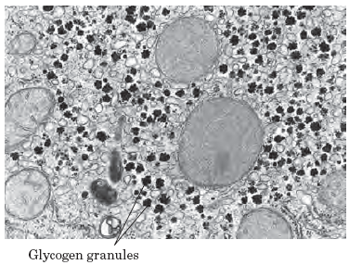
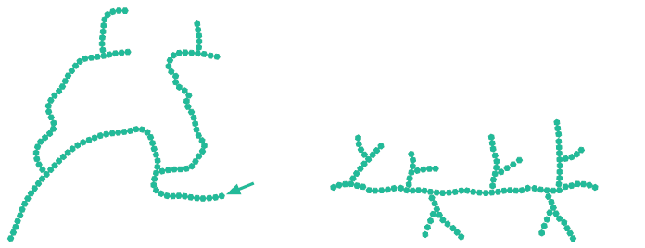
Glycogen is the main storage polysaccharide of animal cells.
(liver and muscle - organs rich in glycogen)
Glycogen granules
Glycogen is more extensively branched and more compact than starch!

Slide 12
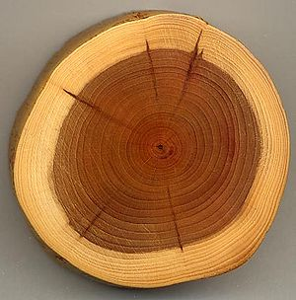
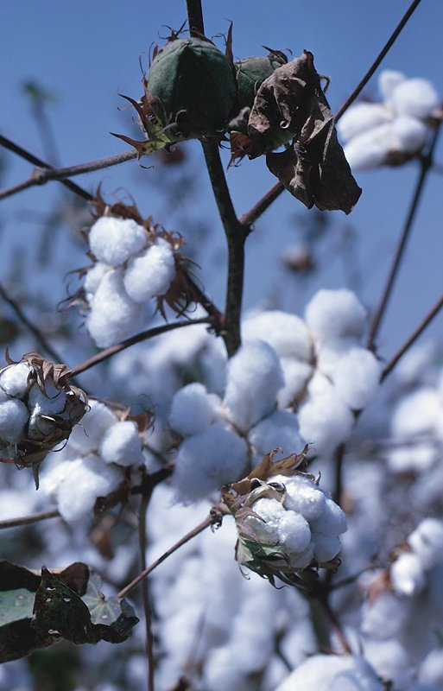
Cellulose is plant homopolysaccharide, serves structural roles.
fibrous, water-insoluble polymer of more than 10000 D-glucose units linked by β1→4 bonds
Animals lack the enzyme cellulase hydrolyzing (β1→4) glycosidic bond between glucose units. Termites and cattle digest cellulose through symbiotic microrganisms which secrete cellulase.

Slide 13
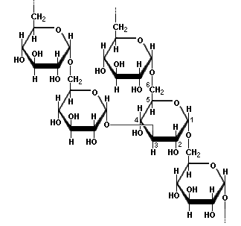
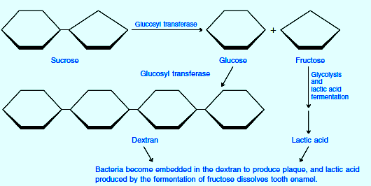

Dextran – bacterial and yeast polysaccharide made up of (α1→ 6) linked D-glucose units with (α1→3), and (α1→4) branches

Slide 14
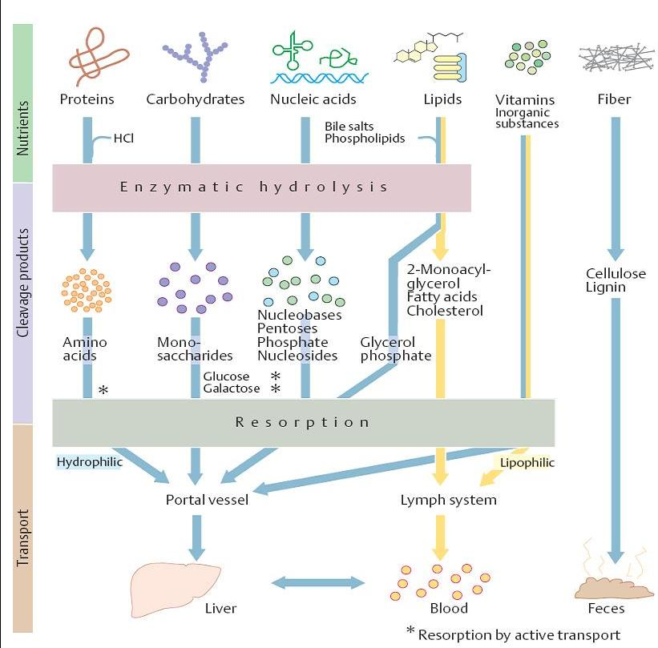
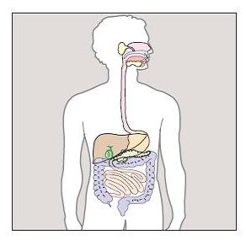
DIGESTION AND ABSORPTION OF CARBOHYDRATES

Slide 15
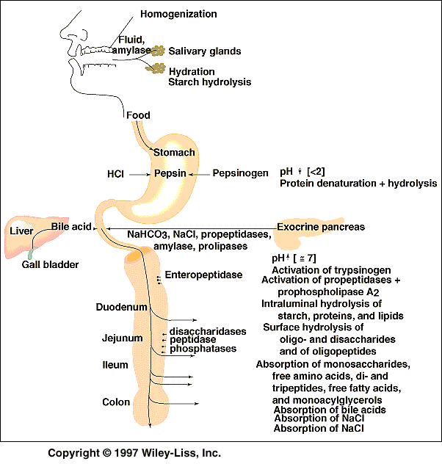
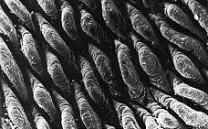
Blood glucose is derived from:
the diet
de novo synthesis of glucose (gluconeogenesis)
breakdown of glycogen stores (glycogenolysis).
DIGESTION
Electron micrography of intestinal lumen

Slide 16
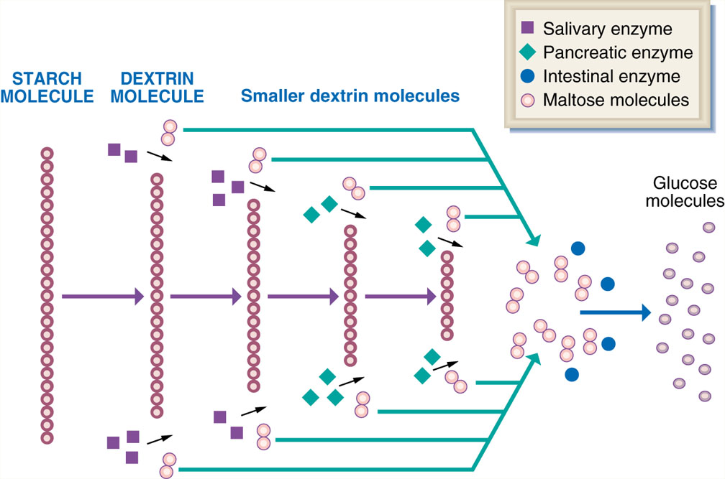
BREAKDOWN OF STARCH MOLECULES

Slide 17
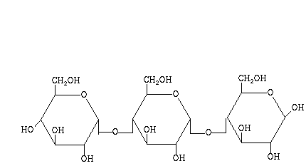
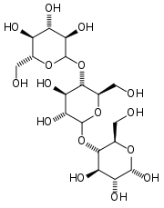
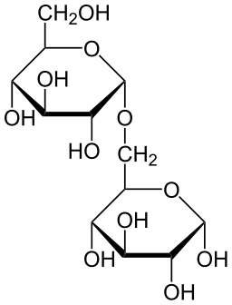
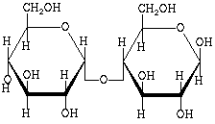
Polysaccharide degradation in digestive system –products of hydrolytic activity of salivary and pancreatic amylases
maltotriose
dextrin
Maltose and isomaltose are final disaccharide products of starch degradation in intestines, by action of pancreatic amylase. Intestinal disaccharidases (maltase and isomaltase) degrade further maltose and isomaltose to glucose.
maltose
isomaltose

Slide 18
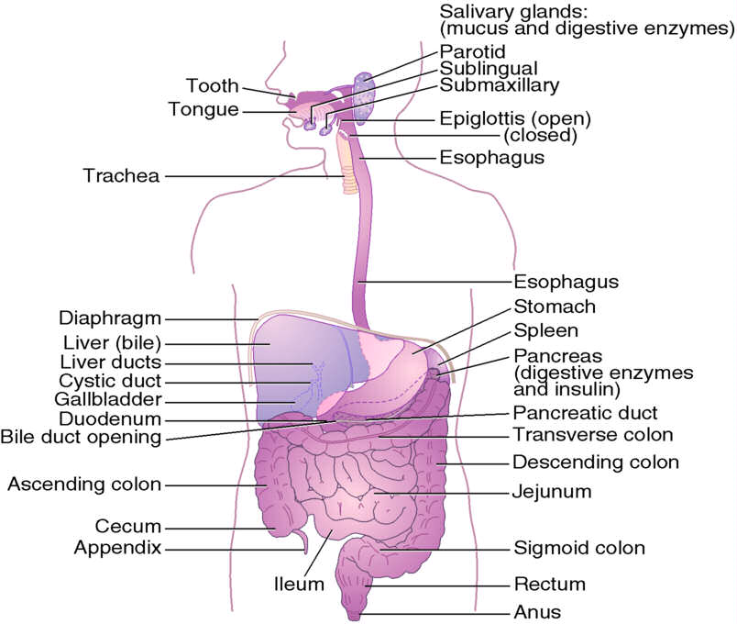
DIGESTION OF CARBOHYDRATES
Saliva: α-amylase (endoglycosidase activity, cleaves starch) and lysozyme (immune protection, attacks bacterial cell walls)
Pancreatic secretion: α-amylase (starch and glycogen)
Small intestine:
  α-glucosidase (oligosaccharides)
  oligo-1,6-glucosidase (oligosaccharides)
  β-galactosidase, lactase (lactose)
  sucrose α-glucosidase (sucrose)
  α, α – trehalase (trehalose)
THE DIGESTIVE SYSTEM

Slide 19
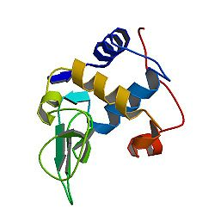
Lysozyme
enzyme present in tears and saliva
bactericidal activity due to catalyzing the hydrolysis of (β1→4) glycosidic bond between N-acetylglucosamine and N-acetylmuramic acid in bacterial wall

Slide 20
Lactase and other enzymes that hydrolyze dissacharides and oligosaccharides are present on microvilli of intestinal epithelial cell membranes (“brush” border enzymes).
LACTOSE INTOLERANCE
Lactose intolerance is an inability to digest lactose, that gives rise to gastrointestinal symptoms.
Lactose intolerance is caused by a deficiency of the intestinal enzyme lactase.
In most people, lactase activity is gradually lost through adolescence.
The primary symptoms of lactose intolerance are diarrhea, abdominal pain, discomfort.

Slide 21
Summary of enzymatic digestion and absorption of carbohydrates
Secretion | Enzyme | Substrate | Action | Final Product
Saliva | α-Amylase | Starch | Hydrolysis to form dextrins (α1→4) | Dextrins
Pancreatic exocrine secretion | α-Amylase | Starch, dextrins | Hydrolysis (α1→4) | Dextrin, Maltose
Brush border enzymes | 1,6-oligosaccharidase | (malto)-oligosaccharides | Hydrolysis (α1→6) | Glucose
 | Sucrase | Sucrose | Hydrolysis (α1→β2) | Glucose, Fructose
 | α, α-Trehalase | Trehalose | Hydrolysis (α1→1) | Glucose
 | Isomaltase | Dextrin, Isomaltose | Hydrolysis (α1→6) | Glucose
 | Maltase | Maltose | Hydrolysis (α1→4) | Glucose
 | Lactase | Lactose | Hydrolysis (β1→4) | Glucose, Galactose

Slide 22
Intestinal absorption of carbohydrates

Slide 23
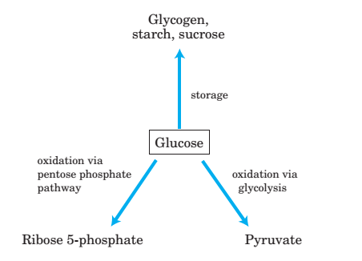
OVERVIEW OF CARBOHYDRATE METABOLISM

Slide 24
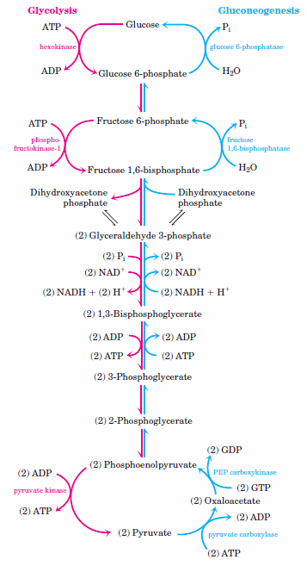
Degradation and synthesis of glucose:
Glycolysis and gluconeogenesis
Glycolysis is occuring in all animal tissues.
Gluconeogenesis is expressed in liver, and to a lesser extent in kindeys and intestines.

Slide 25
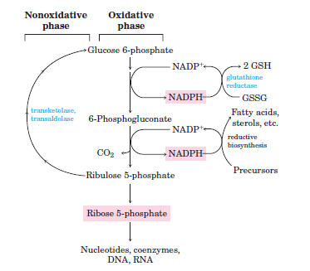
Pentose phosphate pathway
Alternative pathway of glucose oxidation without ATP production
Formation of NADPH and pentoses in the irreversible oxidative phase
Transformation of monosaccharides by reversible reactions of the nonoxidative phase (pentoses are used for production of hexoses and trioses, and vice versa)

Slide 26
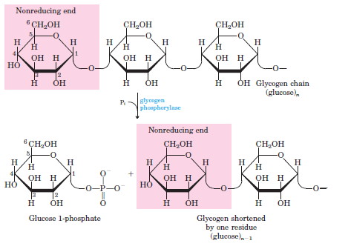
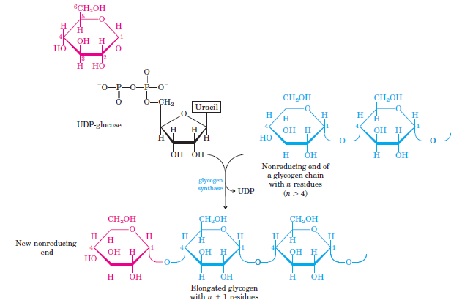
Glycogenolysis and glycogenesis
Degradation and synthesis of glycogen in muscles and liver

Slide 27
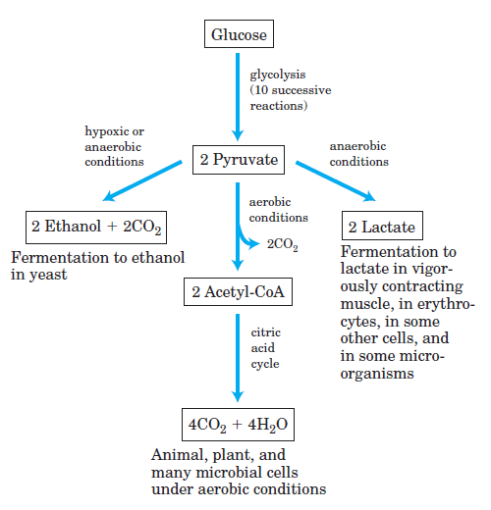
Glycolysis – utilization of glucose in energy metabolism; a series of reactions in which one molecule of glucose is degraded to two molecules of pyruvate and energy released is conserved in form of ATP and NADH.

Slide 28
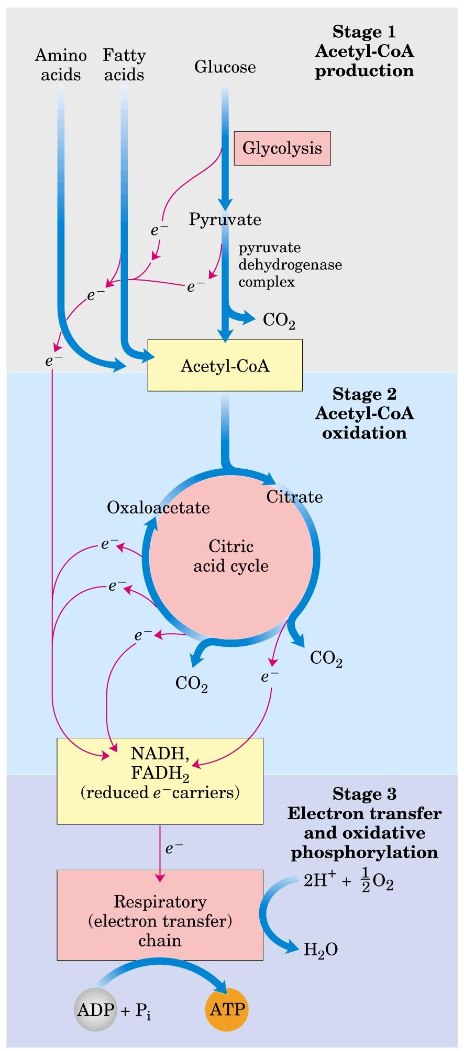
Aerobic metabolism
Fuel metabolism - Production of chemical energy/ATP synthesis by complete oxidation of biomolecules!
THREE STAGES OF CELLULAR RESPIRATION
Large molecules are broken to smaller ones - glucose, fatty acids, amino acids. Their oxidation results in production of acetyl-CoA.
Oxidation of acetyl-CoA in citric acid cycle reactions; formation of CO₂ and reduced coenzymes NADH and FADH₂.
Respiratory chain, oxidation of coenzymes, transfer of electrons to O₂, ATP synthesis, complete oxidation to CO₂ and H₂O.

Slide 29
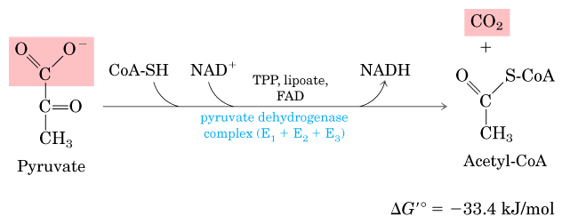
OXIDATIVE DECARBOXYLATION OF PYRUVATE
Acetyl-CoA is produced from pyruvate in reaction catalyzed by pyruvate dehydrogenase (PDH) – link of glycolysis to citric acid cycle.
Pyruvate is transported from cytosol to mitochondria by a carrier, in symport with H⁺.
!!!
Mitochondrial localization of the reaction!

Slide 30
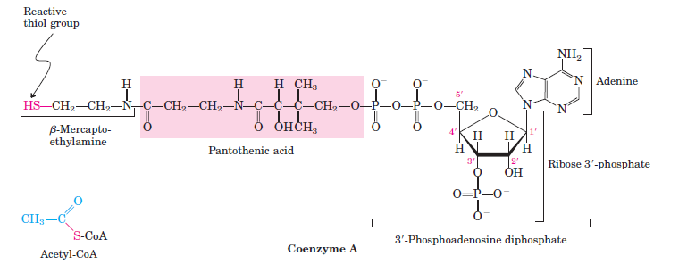
Acetyl-CoA
„high-energy” thioester compound (activated acetate); ΔG°’ for its hydrolysis is -31.5 kJmol⁻¹
used as carrier of acetyl and acyl residues in metabolic pathways

Slide 31
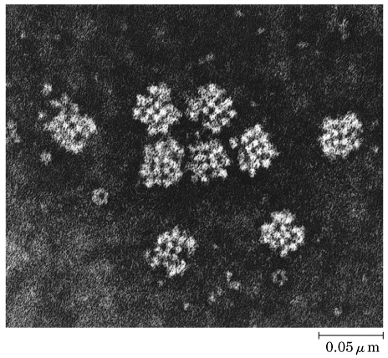
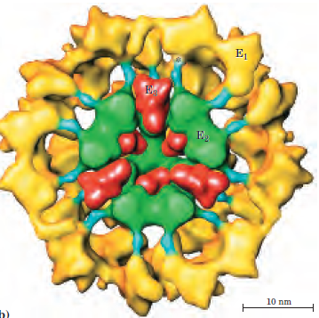
Pyruvate dehydrogenase (PDH)
Multienzyme complex:
E1, pyruvate dehydrogenase (pyruvate decarboxylase)
E2, dihydrolipoyl transacetylase
E3, dihydrolipoyl dehydrogenase
Additional 2 regulatory proteins with catalytic activity are found in PDH complex: protein kinase and phosphoprotein phosphatase.
5 coenzymes are required for the PDH activity:
Thiamine pyrophosphate (TPP)
Lipoic acid
CoA
NAD⁺
FAD

Slide 32
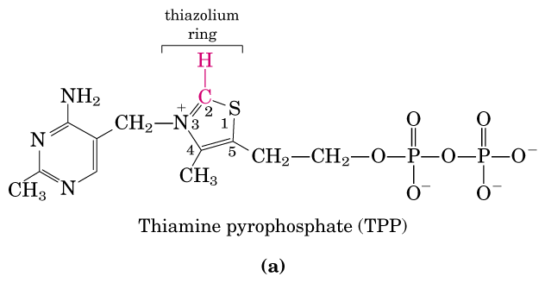
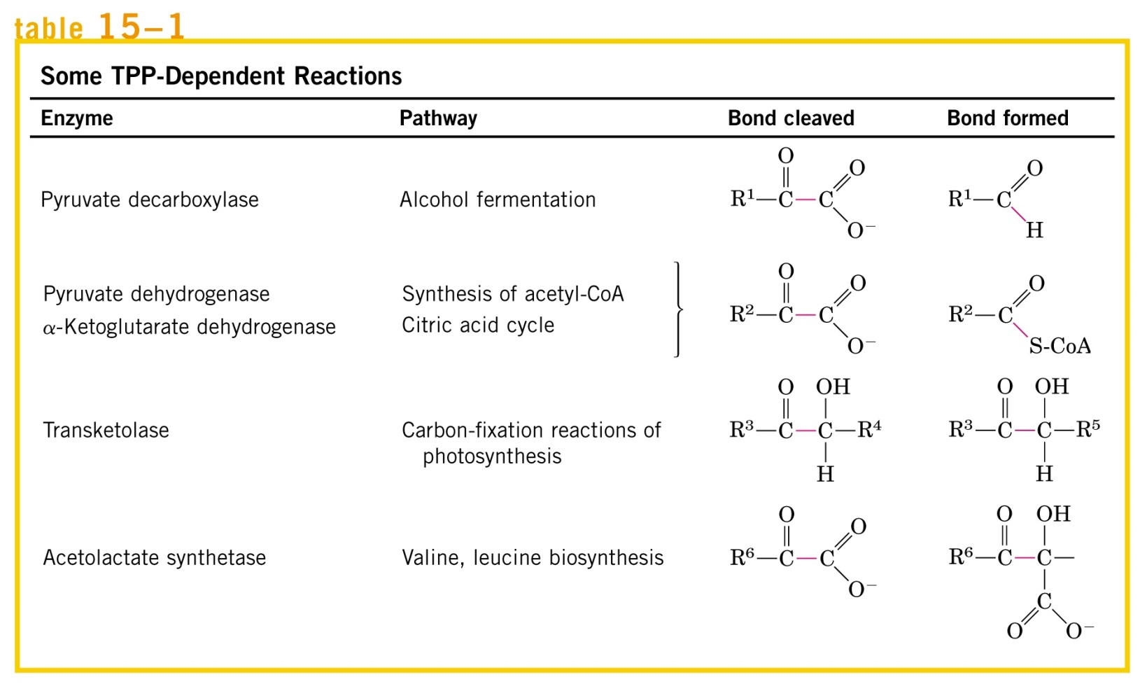
Thiamine pyrophosphate (TPP) is active form of vitamin B₁ utilized as cofactor by several important enzymes of animal metabolism.
Non-oxidative reactions of pentose phosphate pathway
Enzymes using TPP as cofactor, and relevant for animal cells are framed in red.

Slide 33
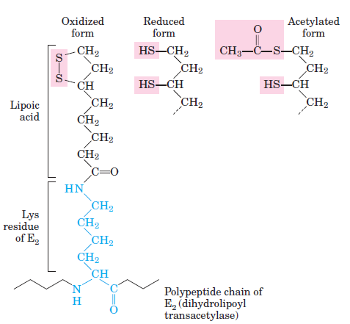
Lipoic acid in amide linkage with a Lys residue of E2 subunit.

Slide 34
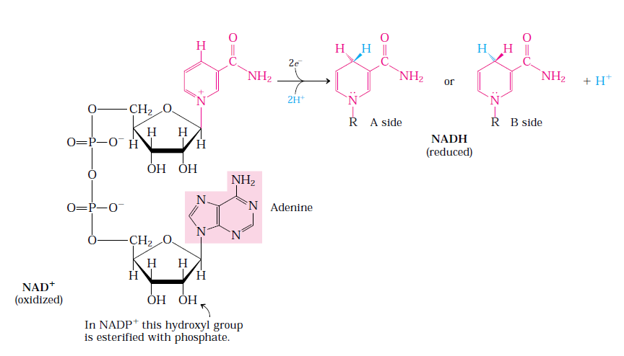

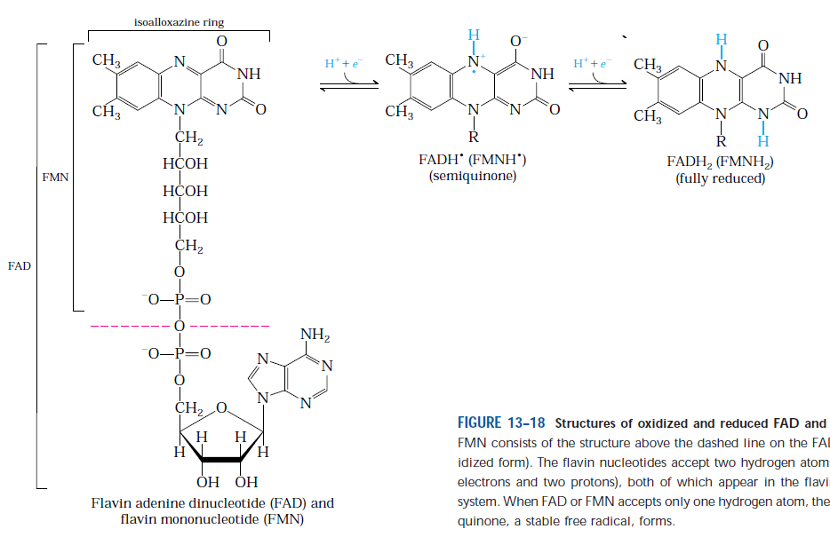
NAD⁺/NADH
(nicotinamide adenine dinucleotide)
NAD and FAD – coenzymes enabling transfer of electrons in important metabolic reactions and pathways.
FMN and FAD/FADH₂

Slide 35
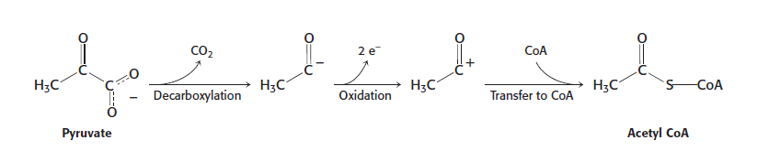
Three steps of pyruvate conversion to acetyl CoA:
Decarboxylation
Oxidation
Transfer of acetyl group to coenzyme A

Slide 36
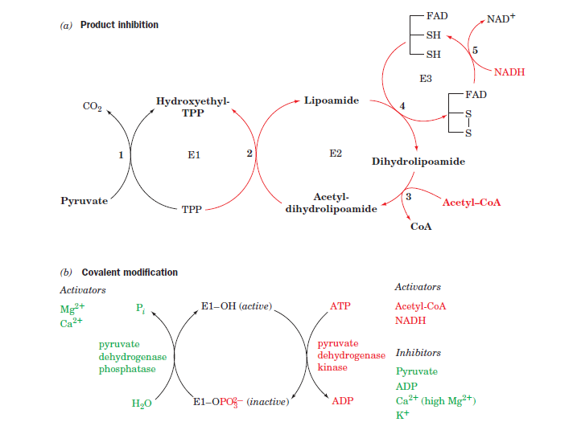
Regulation of pyruvate dehydrogenase activity (PDH)
Product inhibition - by allosteric mechanism
Covalent modification-PDH phosphorylation and de-phosphorylation
Activators and inhibitors of PDH kinase are acting as allosteric regulators.

Slide 37
Literature:
1. J.G. Smith: Organic Chemistry, 3rd edition, McGraw-Hill, USA, 2011.
2. K. Denniston: General, Organic and Biochemistry, 4th edition, McGraw-Hill, USA, 2003.
3. D.L. Nelson i M.M. Cox: Lehninger Principles of Biochemistry, 3rd edition, Worth Publishers, USA, 2000.
4. McKee and McKee: Biochemistry-The Molecular Basis of Life, 3rd edition, Oxford University Press, 2004.
5. J. Koolman i K.H. Roehm: Color Atlas of Biochemistry, 2nd edition, Flexibook, Stuttgart-New York, 2005.
REVIEW QUESTIONS
How does the structure of cellulose differ from starch and glycogen?
Individuals with a thiamine deficient diet have relatively high levels of pyruvate in their blood. Explain this in biochemical terms. (Hint: remember which cofactors are required for PDH activity, and what is their relationship with vitamins.)
Represent by structural formulas two possible disaccharide products of starch degradation by pancreatic amylase.
Transport of glucose, galactose and fructose across intestinal membranes to blood is enabled by:
  Active transport
  Secondary active transport
  Facilitated diffusion

