Slide 1
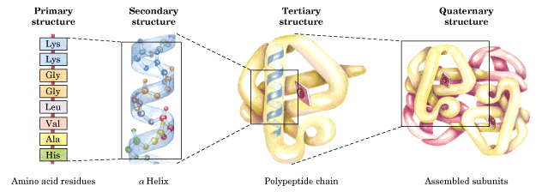
PROTEINS
- STRUCTURE AND FUNCTIONS
Svjetlana Kalanj Bognar
svjetlana.kalanj.bognar@mef.hr

Slide 2

OUTLINES
What are proteins?
What is a protein structure?
In which way the structural organisation of proteins determines protein functions?
How disorders in protein structure cause disease?
Slides 3-7 give a few historical remarks on protein research, and diversity of protein functions.
Slides 8-12 remind on structural features of amino acids as protein building blocks.
Slides 13-19 present classifications of amino acids and proteins.
Other slides are dealing with explaining protein structural organization.
The presentation ends with several review questions.

Slide 3
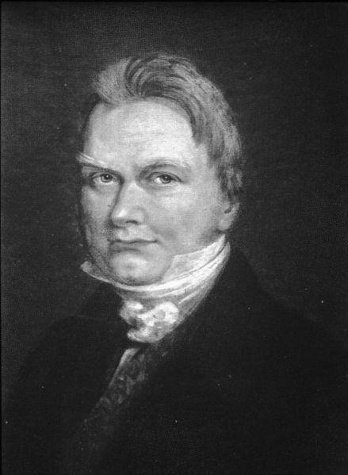
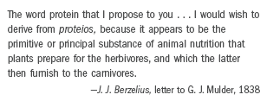
PROTEINS
πρϖτος - the first
1838. Jöns J. Berzelius (1779-1848) suggested the term protein.

Slide 4
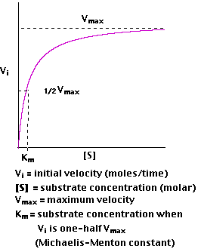
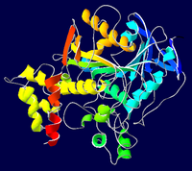
DIVERSITY AND SIGNIFICANCE OF PROTEIN BIOLOGICAL FUNCTIONS
Enzyme catalysis: all enzymes are structurally the proteins with extraordinary catalytic power enabling acceleration of chemical reactions up to million and more times.
(Michaelis-Menten constant)
Structure of acetylcholinesterase

Slide 5
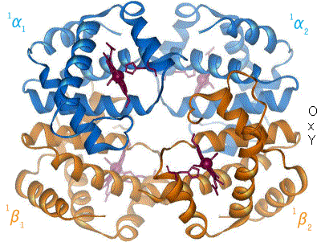
Transport and storage of various other molecules and ions
hemoglobin

Slide 6
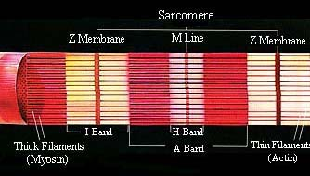
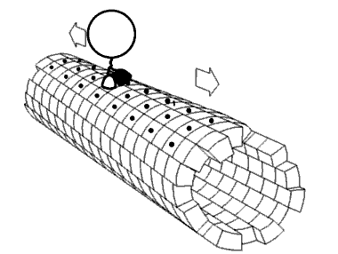
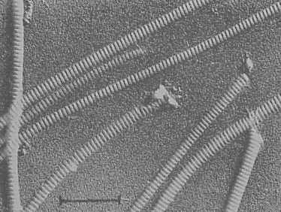
Movement coordination - actin, myosin and other muscle tissue proteins; cellular movement by protein motor molecules (for example, kinesin enables transport of intracellular components)
Mechanical rigidity - collagen in the skin and bone structure

Slide 7
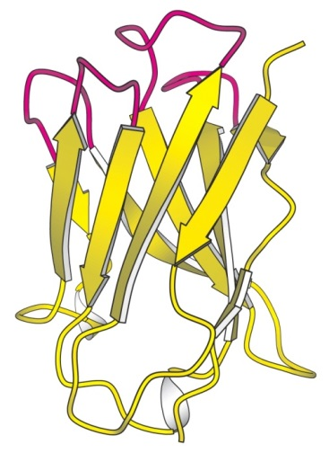
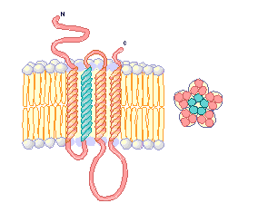
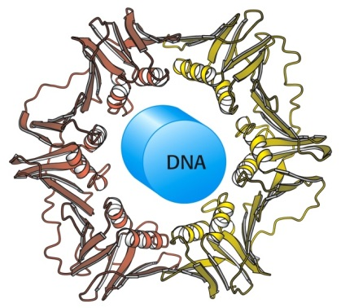
Immunity of the organism - antibodies are highly-specific proteins
Generation and propagation of nerve impulses - receptor proteins
Control of growth and differentiation - proteins associated with DNA replication machinery; growth factors, hormones, etc.
Acetylcholine nicotinic receptor
DNA polymerase

Slide 8
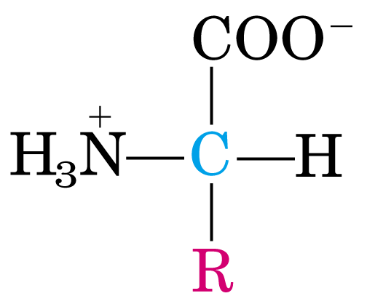
PROTEINS ARE POLYMERS OF AMINO ACIDS
General structure of an amino acid:
Amino group (-NH₂)
Carboxyl group (-COOH) bonded to the same carbon atom (α carbon)
R-group (side chain) varying in structure, size and electric charge
α

Slide 9
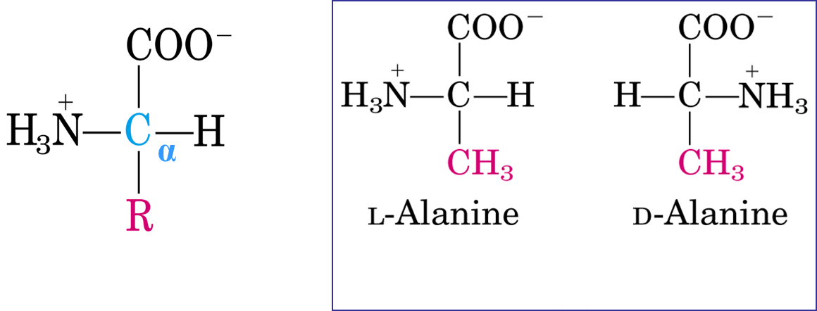
STRUCTURAL FEATURES OF AMINO ACIDS
In protein molecules, amino acid residues are exclusively L-stereoisomers.
Explain why amino acids have two possible stereoisomers?
What type of stereoisomers are L and D isomers of amino acids?
Do all known 20 amino acids, found in natural proteins, contain one chiral (stereogenic) center and occur as two possible stereoisomers?

Slide 10
Several exceptions – amino acid structural and steroisomeric properties
Glycine is the simplest amino acid with no stereogenic center!
Proline is a secondary amine (its N atom is part of a five-membered ring); all other amino acids are primary amines!
Isoleucine and threonine contain an additional stereogenic center, however only one stereoisomer is found in nature, i.e. L-isoleucine and L-threonine!

Slide 11
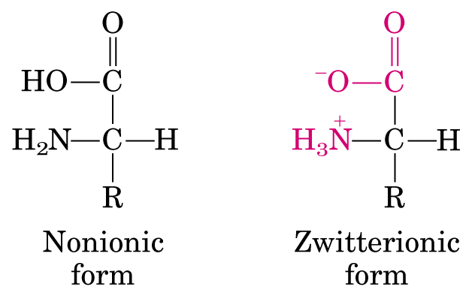
Amino acid dissolved in a water solution are present as dipolar ion (zwitterion). Amino acids are amphoteric molecules (ampholytes).
Amino acid can act as an acid (proton donor) or a base (proton acceptor) :

Slide 13
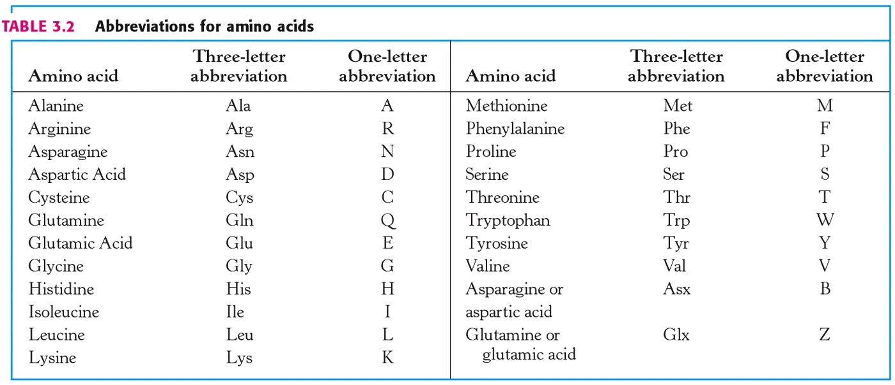
Proteinogenic amino acids
Essential proteinogenic amino acids
Modified (uncommon) amino acids
Non-proteinogenic amino acids – ornithine and citrulline
Proteins of all species (from bacteria to human) consist of the same 20 amino acids – proteinogenic amino acids!

Slide 14



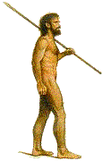



10 PROTEINOGENIC AMINO ACIDS ARE ESSENTIAL AMINO ACIDS – THESE AMINO ACIDS CANNOT BE SYNTHESIZED BY HUMAN ORGANISM
Threonine, Tryptophan, Valine, Arginine*, Histidine, Lysine, Phenylalanine, Leucine, Isoleucine, Methionine
These Ten Valuable Amino Acids Have Long Preserved Life In Man
*conditionally essential amino acid

Slide 15
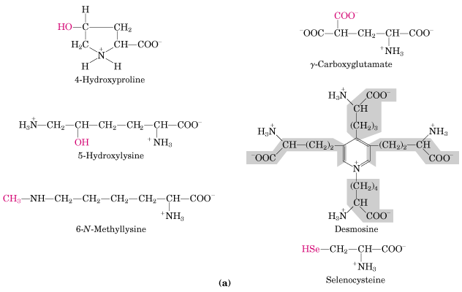
Several uncommon amino acids with important biological functions - modifications of these amino acids occur after their incorporation into the polypeptide chain (posttranslational modifications).
In prothrombin
In collagen
In ellastin
In myosin
In several enzymes

Slide 16
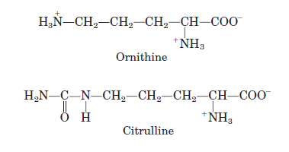
Non-proteinogenic amino acids
Ornithine and citrulline participate in urea cycle.
ornitine
citrulline

Slide 17
CLASSIFICATION OF PROTEINS
according to “shape” and chemical properties
FIBRILLARY/FIBROUS proteins are insoluble in water; mostly structural proteins
GLOBULAR proteins are soluble in water
COMPLEX PROTEINS, contain other non-protein groups, prosthetic groups etc.

Slide 18
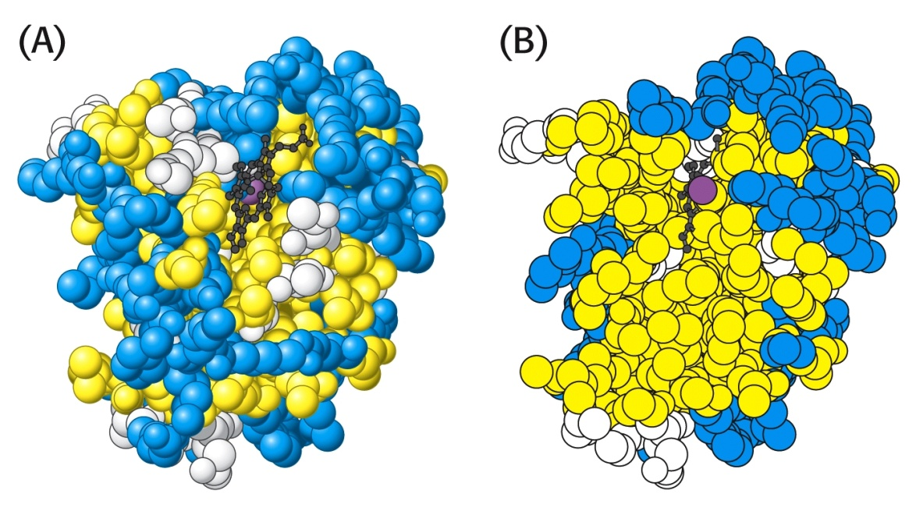
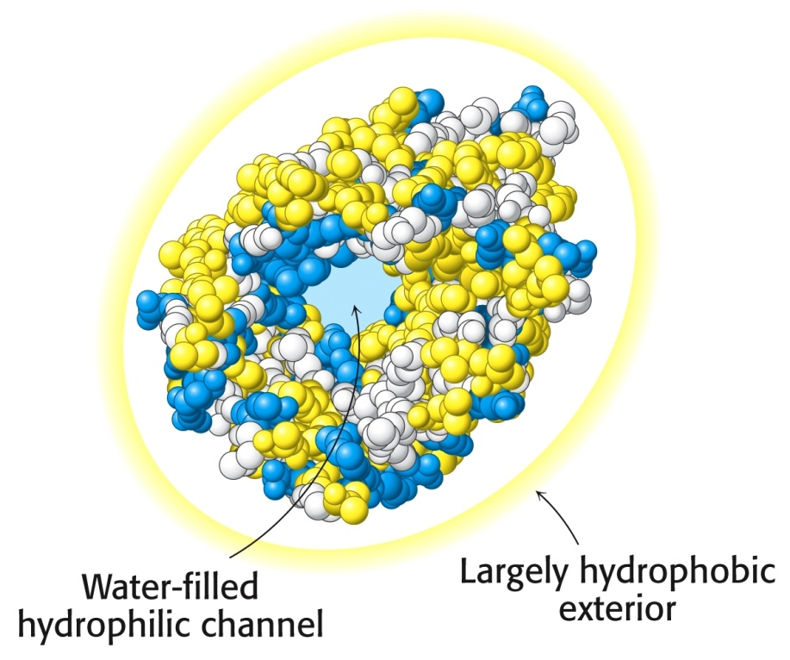
Water-soluble globular proteins fold into compact structures with nonpolar cores.
Hydrophobic amino acids in the interior of the myoglobin structure (in yellow).
Membrane proteins are situated within hydrophobic environment.
Inverse position of the amino acids in membrane protein porin.

Slide 19
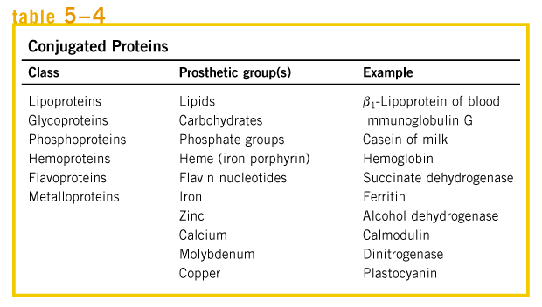
CLASSIFICATION OF COMPLEX (CONJUGATED) PROTEINS

Slide 20

LEVELS OF PROTEIN STRUCTURAL ORGANISATION
PROTEINS ARE POLYMERS OF AMINO ACIDS

Slide 21
PRIMARY STRUCTURE
-amino acid sequence in a polypeptide chain
AMINO ACID MOLECULES ARE JOINED THROUGH AMIDE LINKAGE -PEPTIDE BONDS
Peptide bond is formed between α-carboxyl group of one amino acid and α-amino group of another amino acid.

Slide 22
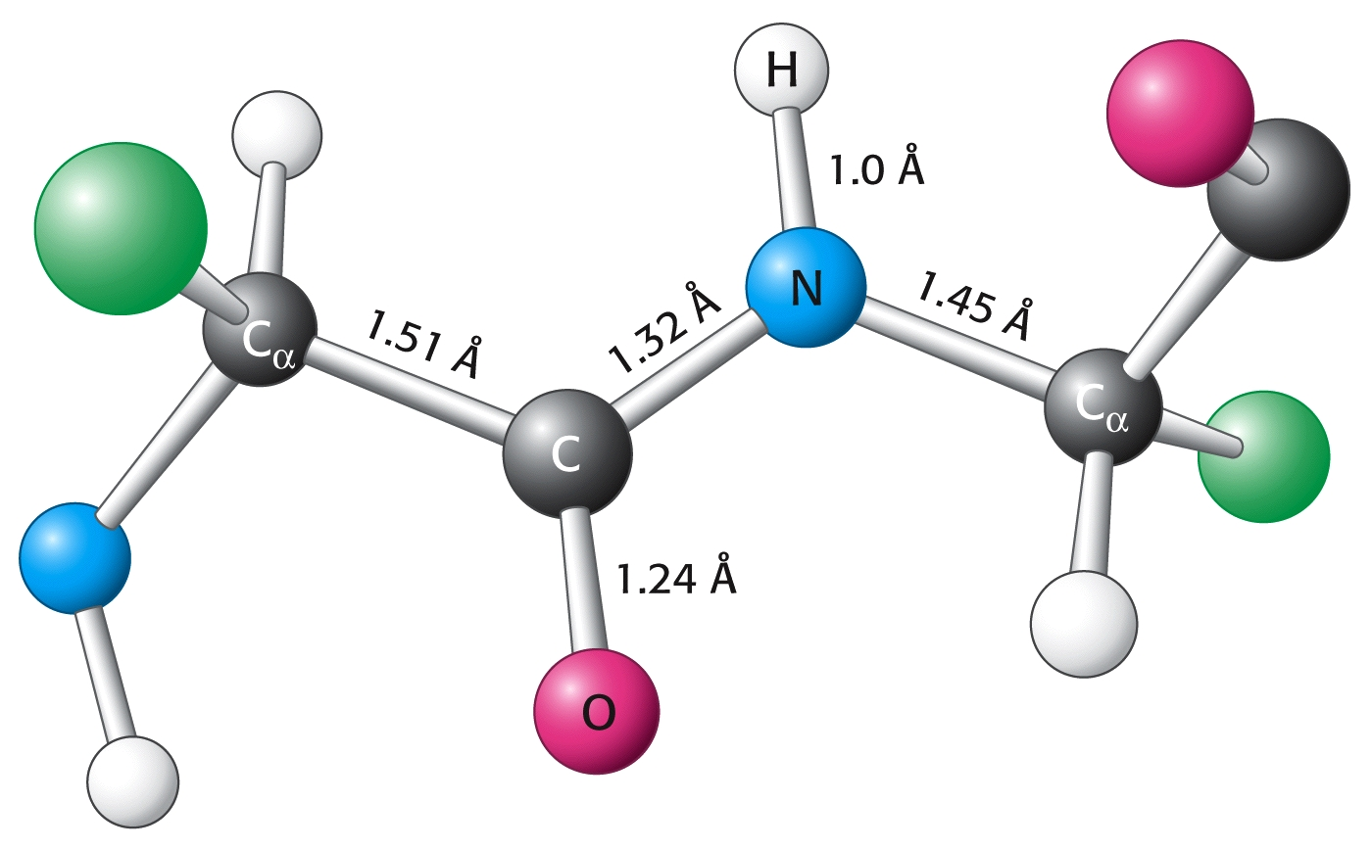
Peptide C-N bond is shorter (0.132 nm) than single C-N bond (0.149 nm) but longer than double C=N bond (0.127 nm) → Linus Pauling and Robert Corey suggested a partial double-bond character of the peptide bond.

Slide 23
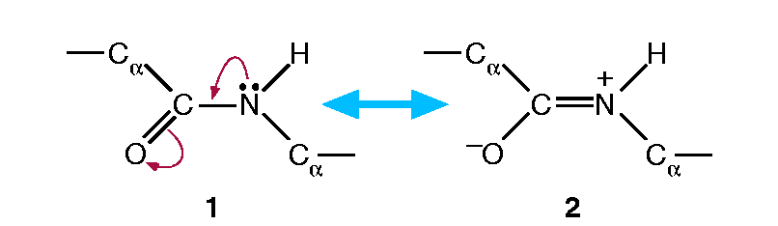
Peptide bond is planar and has the properties of double bond; the rotation around the bond is limited - peptide bond is rigid - which determines the conformation of the peptide backbone.

Slide 24
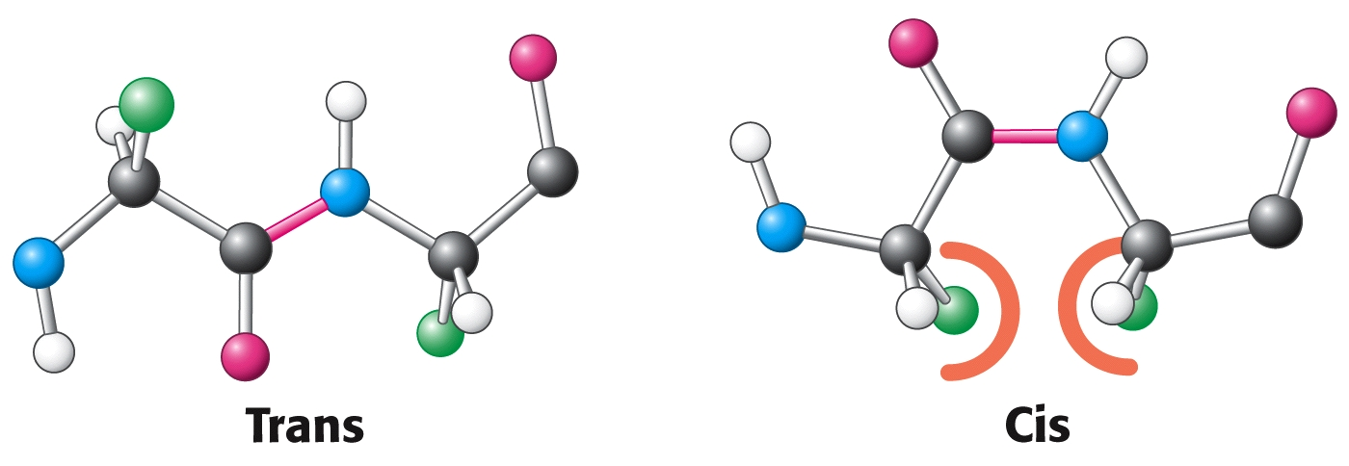
Two possible configurations of peptide bond – trans configuration predominates.

Slide 25
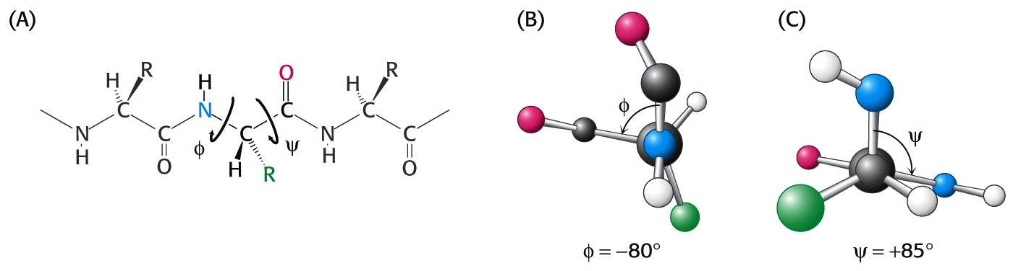
Rotation is permitted about the N -C_{α} (Φ rotation angle) and C_{α} - C (ψ rotation angle).
Many combinations of rotations are not possible due to steric hindrance between atoms.

Slide 26
Amino acids associate in dipeptides, tripeptides, tetrapeptides…oligopeptides….polypeptides…proteins.
Distinction between polypeptides and proteins is not strict (approximately, proteins contain more than 100 amino acids).
STRUCTURE OF A TRIPEPTIDE

Slide 27
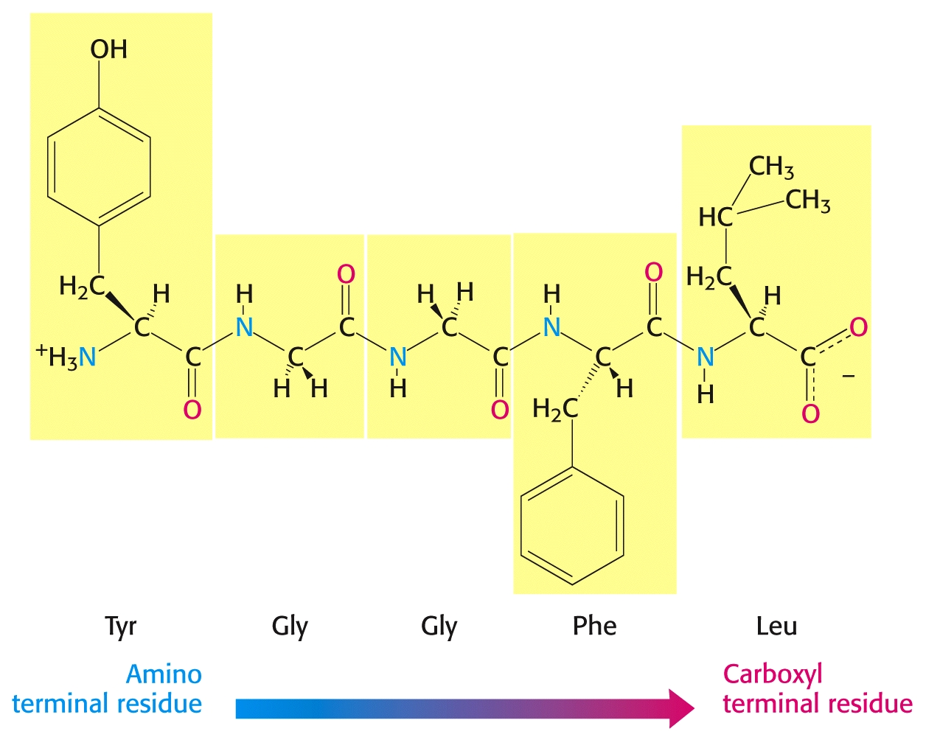
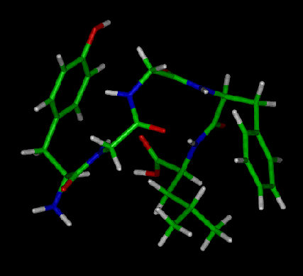
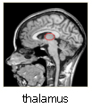
It is accepted to designate the amino acid sequence in the polypeptide chain starting from amino terminal (N-terminal) residue to carboxyl terminal (C-terminal) residue. (example shown in picture: leu-enkephalin, opioid peptide)

Slide 28
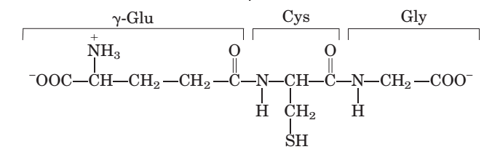
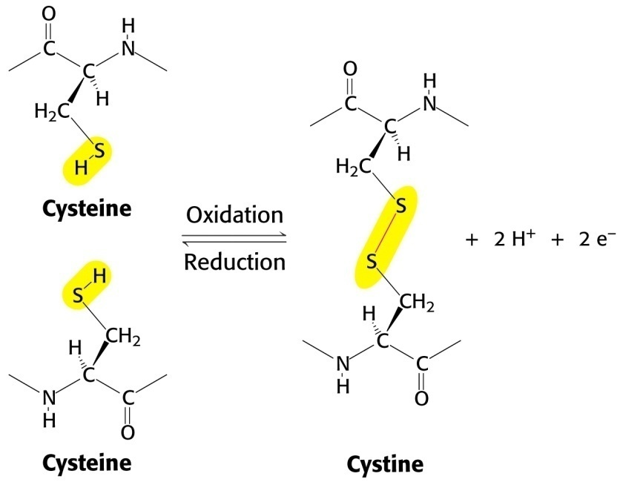
Glutathione – tripeptide γ-Glu-Cys-Gly
α
β
γ
Disulfide bridge (-S-S-) is formed from –SH groups of two cysteinyl residues leading to formation of cystine dimer.

Slide 29
SECONDARY STRUCTURE
-local conformation of amino acid residues in a polypeptide chain
α-helix
β-pleated sheet
collagene helix

Slide 30
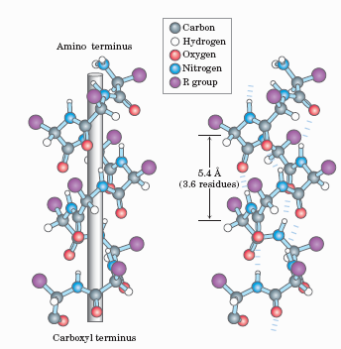
α-helical structure
polypeptide backbone is wound around an imaginary axis
each helical turn includes 3.6 amino acid residues

Slide 31
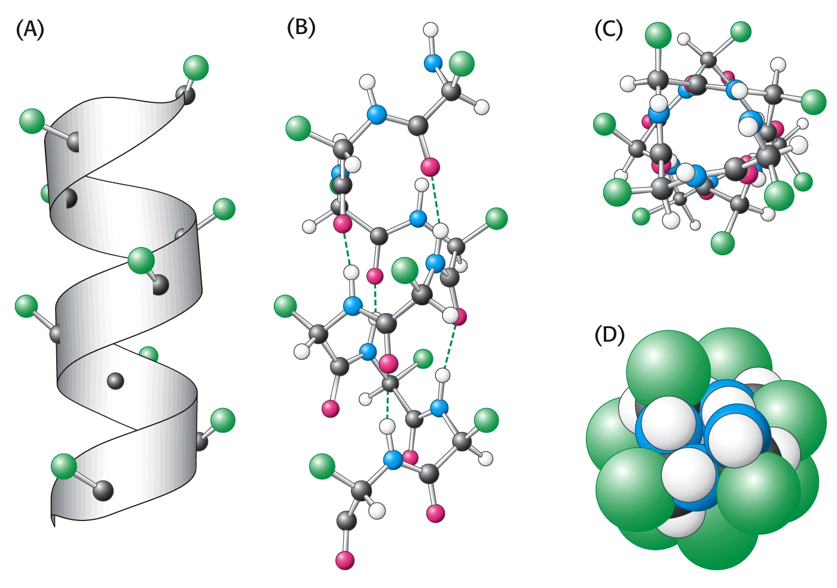
Structure of the α-helix is stabilized by hydrogen bonds between NH and CO groups of the polypeptide chain.

Slide 32
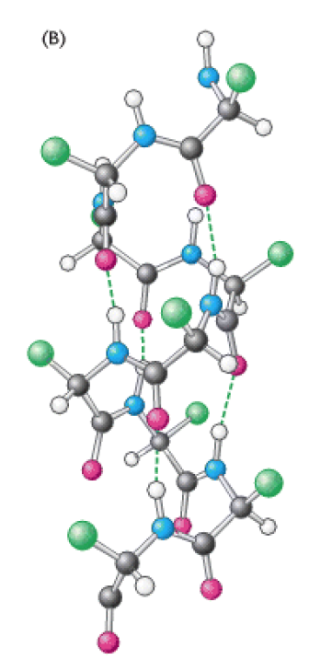
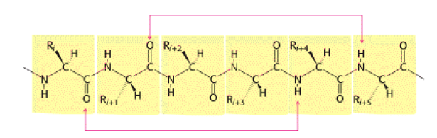
In α-helix, CO-group of one amino acid residue is linked to NH-group of n-residue by hydrogen bond (n+4).

Slide 33
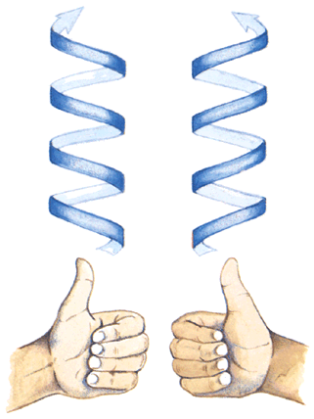
Alfa helices are mostly right handed helices.

Slide 34
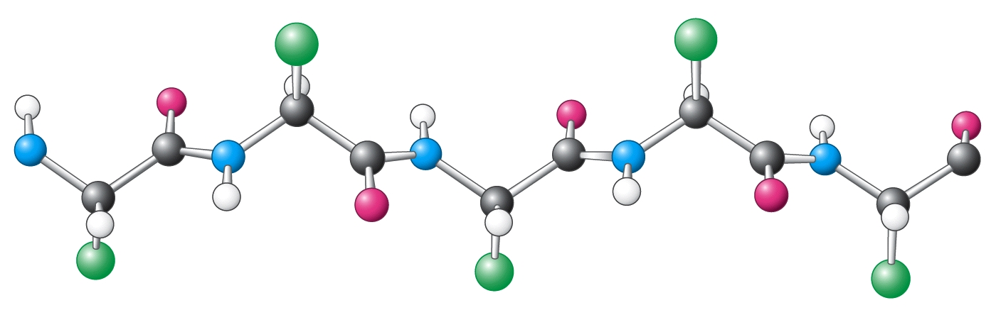
β-pleated sheets
Antiparallel and parallel β-sheets
Backbone of the polypeptide chain is extended

Slide 35
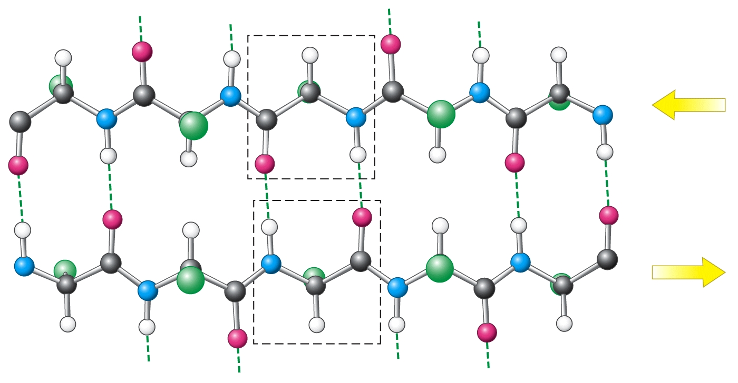
C
N
O
H
H
O
N
C
ANTIPARALLEL PLEATED SHEET
Adjacent polypeptide chains are oriented in the opposite direction. Hydrogen bonding is present between NH i CO groups.

Slide 36
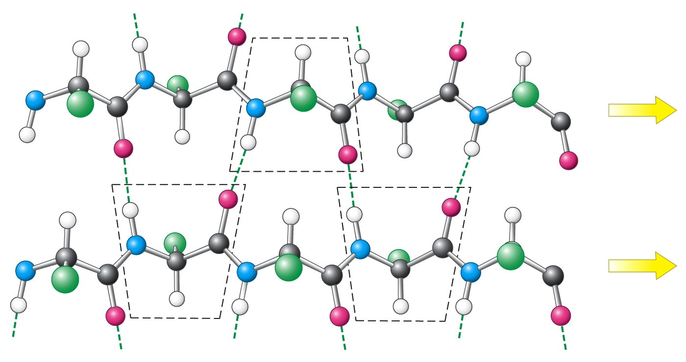
PARALLEL PLEATED SHEET
Polypeptide chains are strechted in one direction; hydrogen bonds between NH and CO groups link one amino acid of one chain with two amino acids of the neighboring chain.

Slide 37
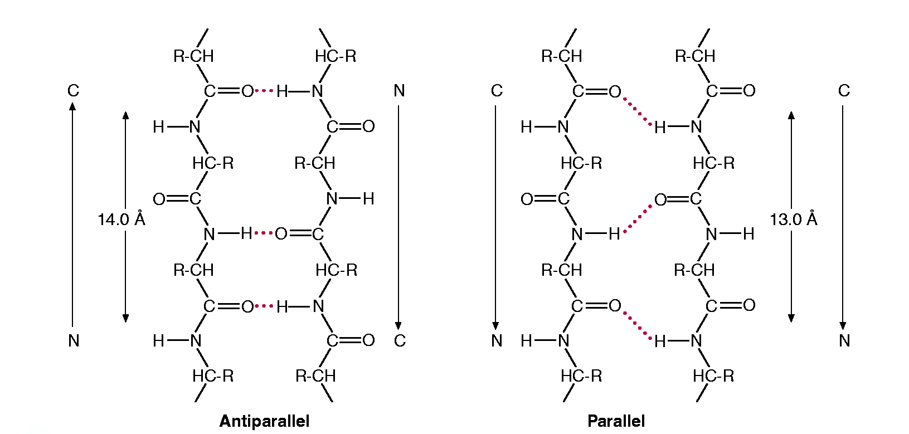

Slide 38
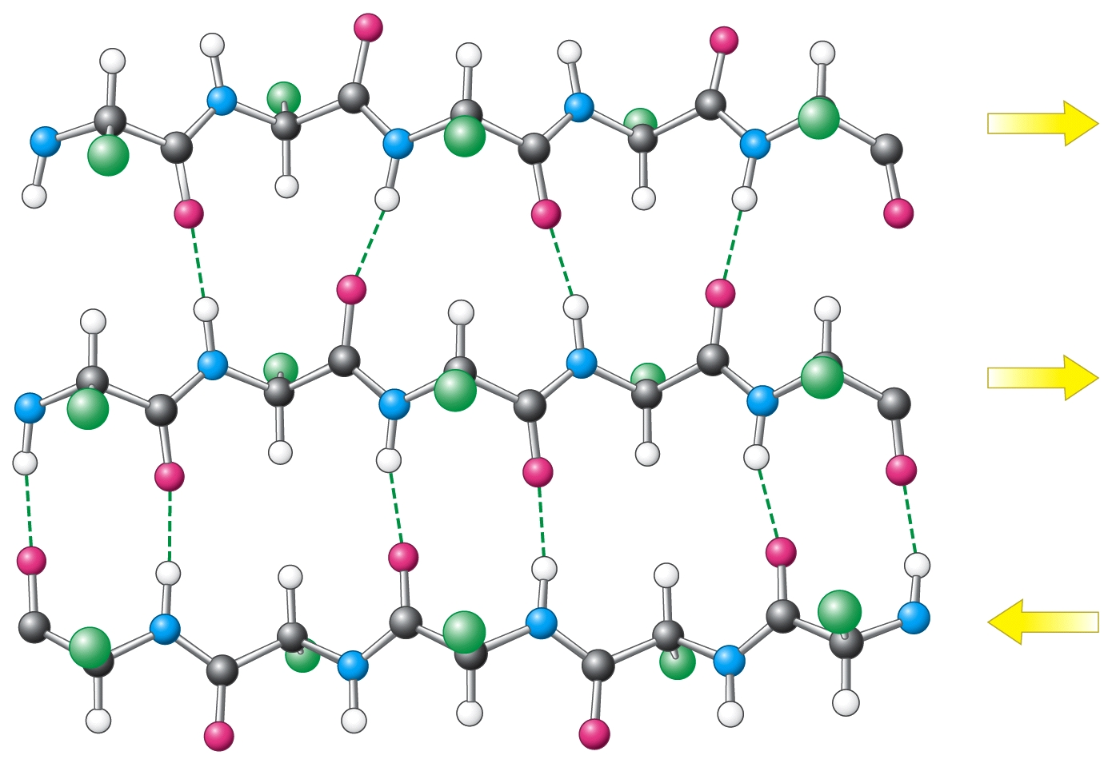
Combination of parallel and antiparallel sheets

Slide 39

-Polypeptide chains may change the direction.
-Many proteins have globular shape due to change in chain direction.
-Structural elements enabling the change in direction are: β-turn (hairpin) and ω-loop.
-Turns and loops are usually situated at the protein surface and participate in interactions with other proteins and molecules.
Antibody

Slide 40
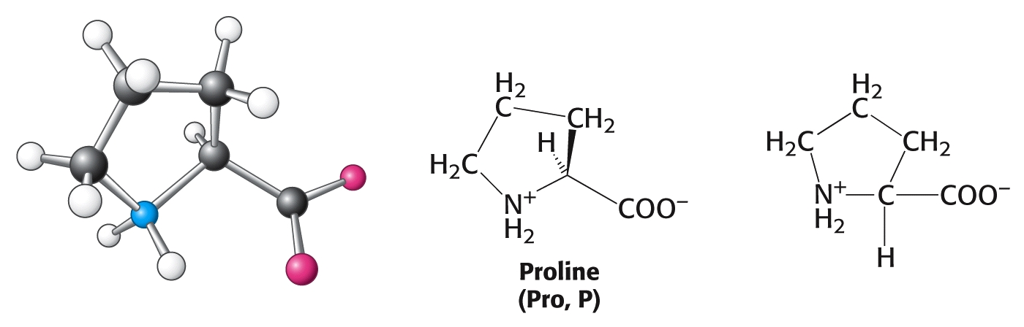
Proline has cyclic form – its side chain is linked to both amino-group and Cα atom; proline can not fit in the helix thus proline may cause the helical turn.

Slide 41
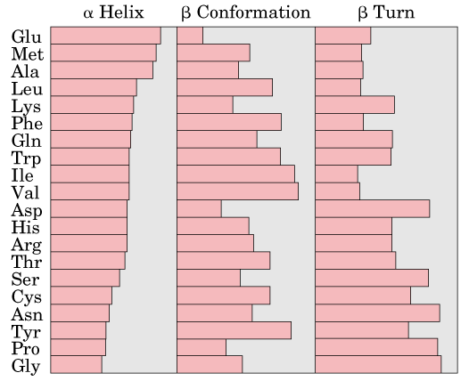
Relative probabilities for a given amino acid to occur in one of the three common types of secondary structure.

Slide 42
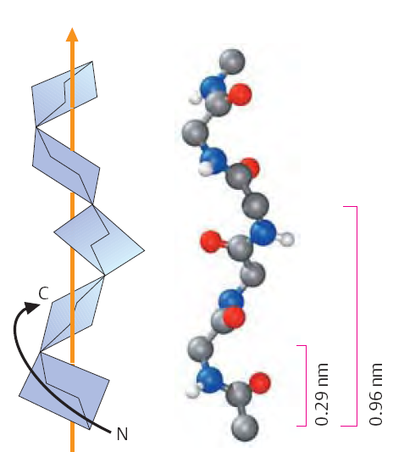
Collagen helix is a specific secondary structure found in a fibrillary protein collagen.
Collagen helix – left helix containing 3.3 amino acid residues per turn; hydrogen bonds are not possible in this secondary structure.

Slide 43
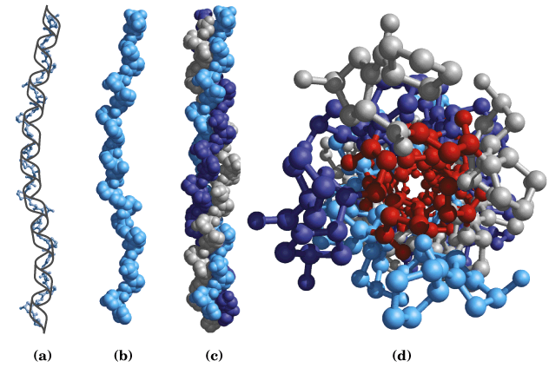
Collagen protein is formed by 3 peptide chains of the same size, supertwisted about each other; several collagen helices form collagen fibres.

Slide 44
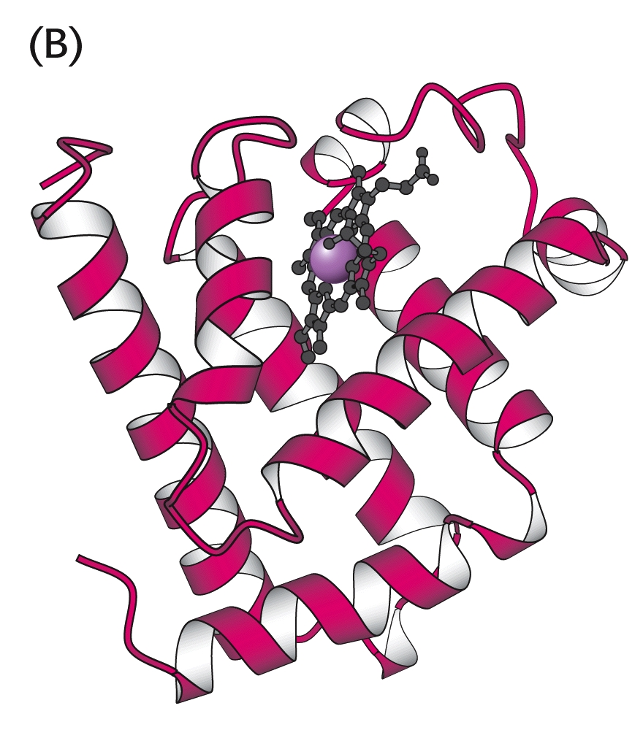
TERTIARY STRUCTURE
Three-dimensional conformation of a protein determined by amino acid sequence
myoglobin

Slide 45
PROTEIN CONFORMATION IS STABILIZED MAINLY BY WEAK INTERACTIONS – hydrogen bonds, hydrophobic and ionic interactions
Stabilization of structural organisation of proteins:
Hydrogen bonds are the most abundant interactions stabilizing secondary structures; hydrogen bonds are involved as well in stabilization of tertiary and quaternary structures.
Electrostatic forces (between amino acid side chains; mostly tertiary structure)
Hydrophobic interactions of non-polar groups and residues (mostly tertiary structure)
Disulfide bonds are the only covalent bonds which stabilize protein structure (mostly tertiary structure).
Proteins showing quaternary organization are stabilized mainly by different weak interactions.

Slide 46
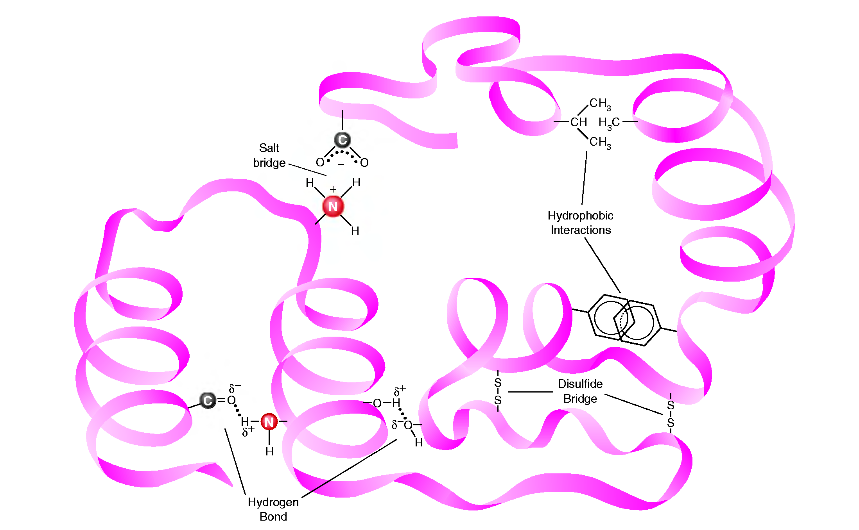
Interactions stabilizing protein structure

Slide 47
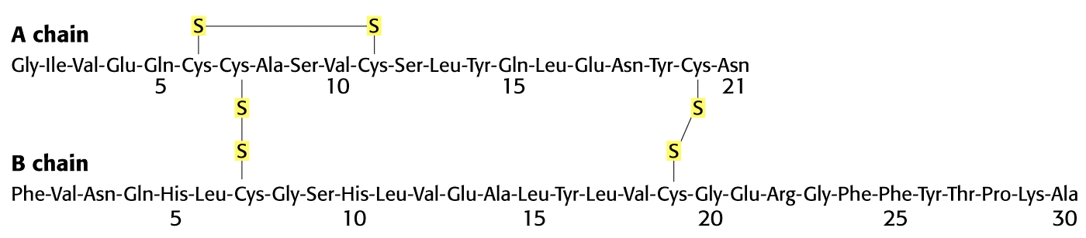
Insulin structure – mature peptide, stabilized by disulfide bridges
Disulfide bridge (-S-S-) is formed from –SH groups of two cysteinyl residues leading to formation of cystine dimer.

Slide 48
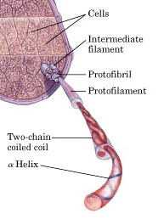
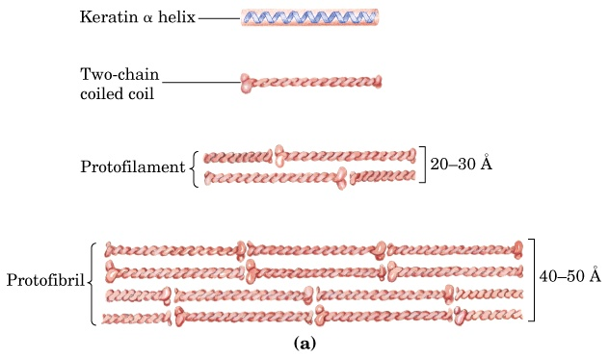
Structure of hair – helical structural elements of keratin.

Slide 49

Keratin in nature
Keratin structure strength depends on disulfide bonds.
Keratin of the rhinoceros’ horn contains approx. 18% of cystine residues within disulfide bonds.
hair
nails
wool
claws
hooves
horns
feather

Slide 50

Disulfide bridges in hair keratin structure
See Box 4-2, in Lehninger Biochemistry – “Permanent Waving is Biochemical Engineering”

Slide 51

SECONDARY AND TERTIARY STRUCTURE DETERMINE AND ENABLE PROTEIN FUNCTIONALITY.
Amino acid sequence determines tertiary structure
Christian Anfinsen’s experiment with ribonuclease showing denaturation and renaturation of the protein molecule.
Destroying the native protein state leads to loss of specific protein function – denaturation impairs all protein structural levels except a primary structure.

Slide 52

QUATERNARY STRUCTURE
ASSOCIATION OF TWO OR MORE CHAINS IN SUBUNITS (for example: dimers, trimers, tetramers etc.)
α₂β₂ tetramer of human hemoglobin

Slide 53

COLLAGEN – the extracellular matrix protein
Most mammalian cells are located in tissues, surrounded by a complex extracellular matrix (ECM), a connective tissue.
Extracellular matrix is complex network of proteins and polysaccharides which strenghten the structure and function of connective tissue.
Protein collagen is the major component of most connective tissues, which constitutes approx. 25% of mammalian proteins:
liver: 4%
lung: 10%
aorta: 12-24%
bone: 23%
skin: 74%

Slide 54

TROPOCOLLAGEN
is a structural unit of collagen.
3 polypeptide chains (collagen helices)
approx. 1000 amino acid residues
triple helix stabilized by hydrogen bonds
being composed of more than one polypeptide chain, collagen is showing a quaternary structural organization
Tropocollagen structure ensures the strength of a collagen fibre: – collagen fibre of 1 mm diameter will break under 10 kg weight!

Slide 55

Amino acid composition of collagen
33% Gly
10% Pro
10% Hyp
1% Hyl
Amino acid sequence: each 3. aa in collagen helix is Gly

Slide 56

The interior of the helical structure of collagen is extremely compact:
– glycine is the only amino acid which suits to internal part of the collagen helical structure.

Slide 57


Hydroxylation of prolin (and lysine) ensures the stability of the triple collagen helix.
Proline residues are modified in collagen to hydroxyproline by the catalytic activity of a prolyl-hydroxylase, while part of lysine residues is hydroxylated (hydroxylysine) by activity of a lysil-hydroxylase
Prolyl-hydroxylase contains Fe(II)ion in the active site, and for normal activity, the enzyme needs the presence of a reducing agent (ascorbic acid).
SCURVY
- this disease is the consequence of lack of dietary vitamin C

Slide 58



DISORDERS IN AMINO ACID SEQUENCE OF A POLYPEPTIDE CHAIN (PROTEIN) AND MISFOLDING OF PROTEINS MAY CAUSE A DISEASE
Examples:
Sickle cell anemia (replacement of glutamate with valine at the 6th position of hemoglobin beta chain)
Some neurological diseases are characterized by disturbed protein processing and consequently altered protein conformation: prion diseases, Alzheimer’s disease

Slide 59
Methods used for analysis, separation and purification of proteins
According to size of molecule
According to solubility
According to charge
According to specific binding affinity

Slide 60


Chromatographic methods used in protein purification: 1. ion-exchange chromatography; 2. size-exclusion chromatography (gel-filtration); 3. affinity chromatography.

Slide 61


Electrophoresis

Slide 62

SUMMARY – Proteins
Proteins are made of amino acids. All naturally occurring proteins consist of the same 20 amino acids. Side chains of amino acids are of variable sizes, shapes and contain different functional groups, thus many diverse structures are possible.
Levels of protein structure are: primary, secondary, tertiary and quaternary.
Amino acid sequence of protein (primary structure) determines its three-dimensional structure (secondary and tertiary structure) and the function of a protein.

Slide 63
LEARNING OUTCOMES
To describe main structural features of proteins as polymers of amino acids;
To understand acid-base properties of proteins being polymers of amino acids;
To be acquainted with a general classification of proteins according to their three-dimensional conformation (globular and fibrillary proteins) and water solubility;
To recognize classes of complex proteins (such as hemoproteins, lipoproteins, glycoproteins, phosphoproteins);
To understand and distinguish levels of structural organization of proteins (primary, secondary, tertiary and quaternary structure);
To describe features of common types of secondary protein structures (α-helix, β-pleated sheet, collagen helix);
To recognize bonds and interactions involved in stabilization of secondary, tertiary and quaternary protein structure;
To describe the structure of collagen as the most abundant extracellular matrix protein – levels of structural organization, specific amino acid composition;
To explain influence of vitamin C deficiency on collagen synthesis and structure - biochemical basis of scurvy symptoms.

Slide 64
FROM PROTEIN STRUCTURE TO PROTEIN FUNCTION!
Literature:
1. D.L. Nelson i M.M. Cox: Lehninger Principles of Biochemistry, 5th edition, Worth Publishers, USA, 2008.
2. J.M. Berg, J.L. Tymoczko i L. Stryer: Biochemistry, 7th edition, W.H. Freeman and Company, USA, 2012
3. Smith JG: Organic chemistry, 3rd edition, McGraw Hill, USA, 2011

Slide 65

REVIEW QUESTIONS
1. Represent by structural formula the dipeptide alanyl-glycine.
2. Consider the following molecule:
a) Name it.
b) Using the three-letter symbols
for the amino acids, how would
this molecule be represented?
3. Define the following terms:
a) α-carbon
b) isoelectric point
c) peptide bond
4. Indicate the level(s) of protein structure to which each of the following contributes:
a) amino acid sequence
b) β–pleated sheet
c) hydrogen bond
d) disulfide bond
5. List six functions of proteins in the body.

Slide 66

ANSWERS TO REVIEW QUESTIONS
1. Represent by structural formula the dipeptide alanyl-glycine.
2. Consider the following molecule:
a) Name it.
b) Using the three-letter symbols
for the amino acids, how would
this molecule be represented?
3. Define the following terms:
a) α-carbon
b) isoelectric point
c) peptide bond
4. Indicate the level(s) of protein structure to which each of the following contributes:
a) amino acid sequence
b) β–pleated sheet
c) hydrogen bond
d) disulfide bond
5. List six functions of proteins in the body.
1.
Alanyl-glycine
2.
a) cysteyl-glycyl-tyrosine
b) Cys-Gly-Tyr
4.
a) primary structure
b) secondary structure
c) secondary, tertiary (and quaternary structure)
d) tertiary (and quaternary structure)

