Slide 1
An overview of lipid metabolism
Professor Daria Pašalić, MSc, PhD

Slide 2
Exogenous (dietary) lipid metabolism
Over 95% of dietary lipids are
Triglycerides
The remaining about 5% of dietary lipids are
Phospholipids
Free fatty acids (FFAs)
Cholesterol (present in foods as esterified cholesterol)
Fat-soluble vitamins

Slide 3
Endogenous lipid metabolism
Lipoproteins synthesized by the liver transport endogenous triglycerides and cholesterol.
Lipoproteins circulate through the blood continuously until the TGs they contain are taken up by peripheral tissues or the lipoproteins themselves are cleared by the liver.
Factors that stimulate hepatic lipoprotein synthesis generally lead to elevated plasma cholesterol and TG levels.

Slide 4
Fatty acids are taken up by cells
They may serve as:
  precursors in synthesis of other compounds
  fuels for energy production
  substrates for ketone body synthesis.
Ketone bodies may be exported to other tissues: used for energy production.
Some cells synthesize fatty acids for storage or export.
Fatty acids
  Exogenous
    Chylomicrons transport of TGs
    Lipolysis of TGs in the blood stream
    Released fatty acids
    Transport to tissues
  Endogenous
    TGs from adipose tissue and liver
    Lipolysis
    Transport of fatty acids from adipose tissue (albumin carrier)
    Transport from the liver

Slide 5
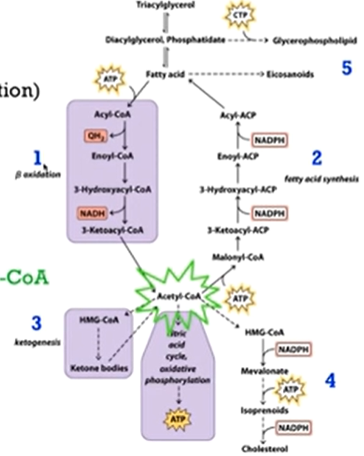
Intracelular lipid metabolism
Major pathways
  1) Fatty acid catabolism
  2) fatty acid synthesis
  3) ketogenesis
  4) Cholesterol synthesis
  5) Synthesis of other lipids

Slide 6
Lipoproteins: Metabolism and Role(s); Related Diseases
Professor Daria Pašalić, MSc, PhD

Slide 7
With this lecture student should solve
What the properties of the group of biomolecules that belongs to a group of lipids?
Digestion of lipids
Absorption of lipids
Structural composition of different lipoprotein classes
Specifies of the metabolism of different types of lipoproteins

Slide 8
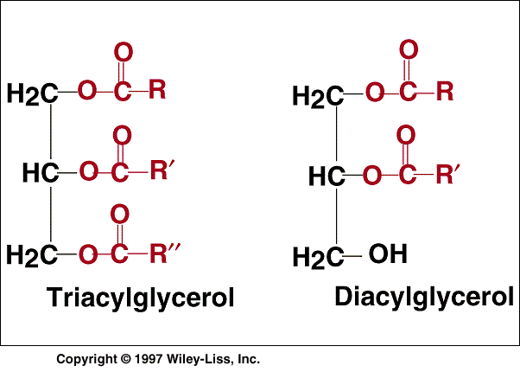
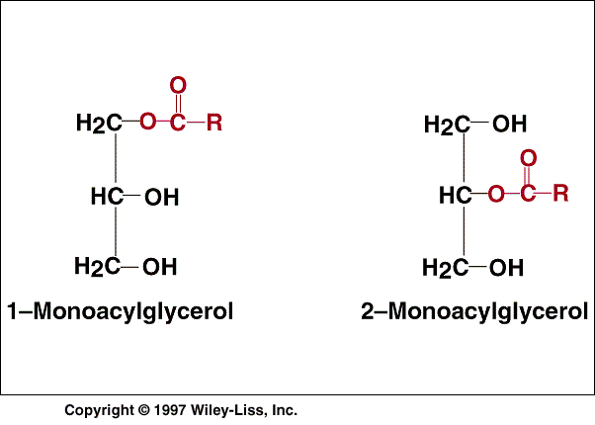
Physical-chemical properties of lipids present in circulation
Amphiphilic
Lipophilic

Slide 9
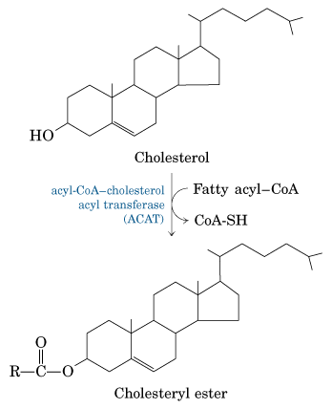
Amphiphilic
Lipophilic

Slide 10
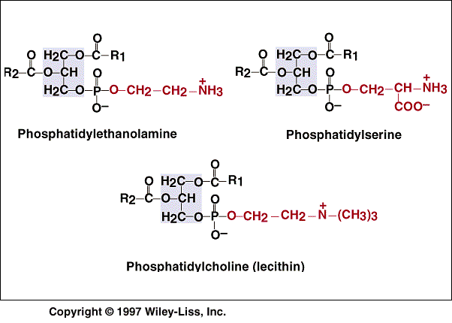
Phospholipids
Amphiphilic

Slide 11

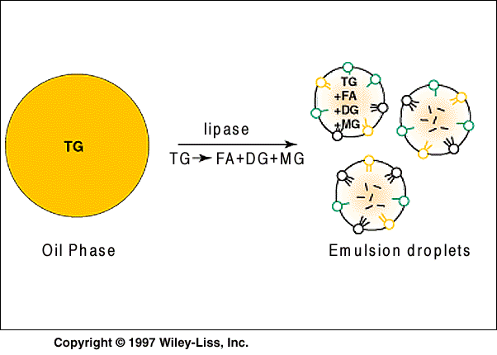
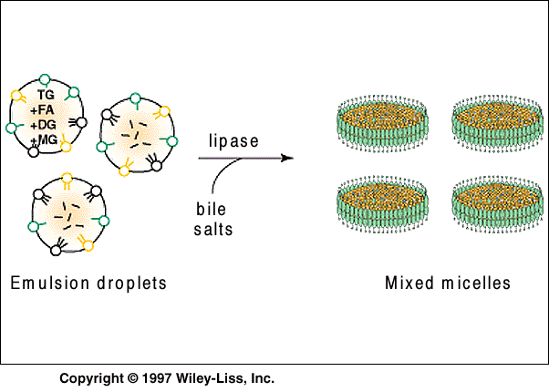
LIPID DIGESTION

Slide 12
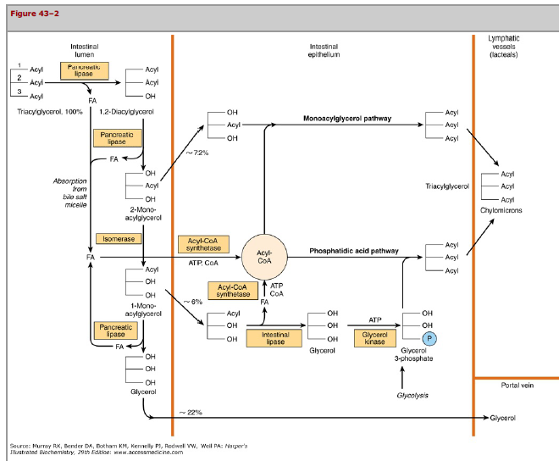

Slide 13
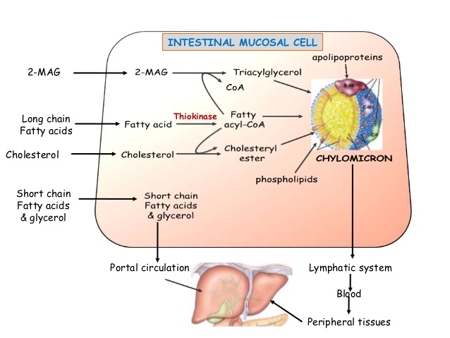
Absorbtion of hydrolised lipid products through the intestinal cell mucosa
http://www.slideshare.net/ashokktt/digestion-and-absorption-of-lipids-43186487

Slide 14
Lipoproteins
(plasma)
Transport of
dietary
lipids from
intestine
oxidation
storage
Transport of
lipids
from liver to
other
tissues
oxidation
storage
Transpot of lipids in circulation

Slide 15
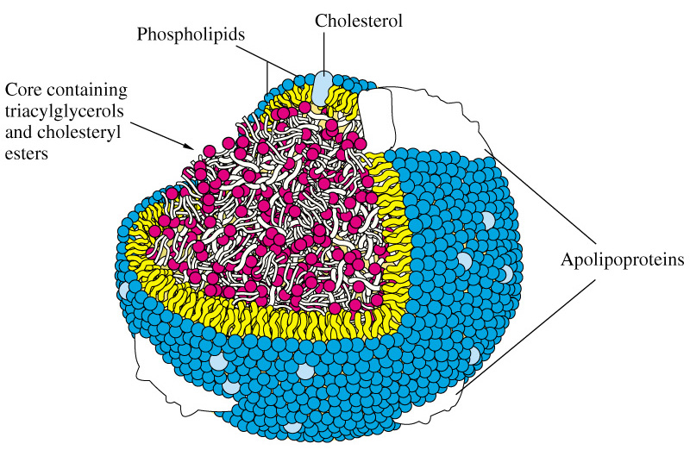
Structure of lipoprotein
Core- hydrophobic lipids
Triacylglycerol
Cholesterol-ester
Surface- amphiphilic lipids:
Phospholipids
Free cholesterol
And proteins

Slide 16
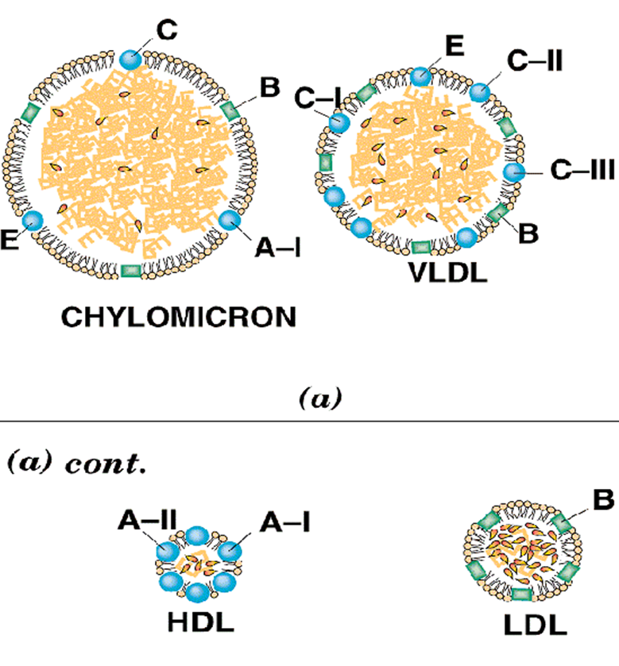
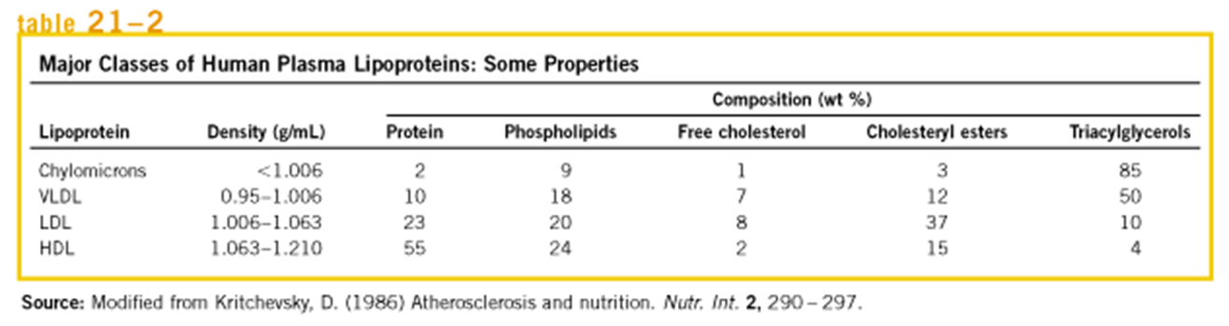

Slide 17
APOLIPOPROTEINS and their ROLES
1. ENZYME COFACTORS
2. LIPID TRANSFER PROTEINS (synthesis and excretion)
3. LIGANDS FOR INTERACTION WITH LIPOPROTEIN RECEPTOR
4. STABILIZATION OF LIPOPROTEIN SURFACE

Slide 18
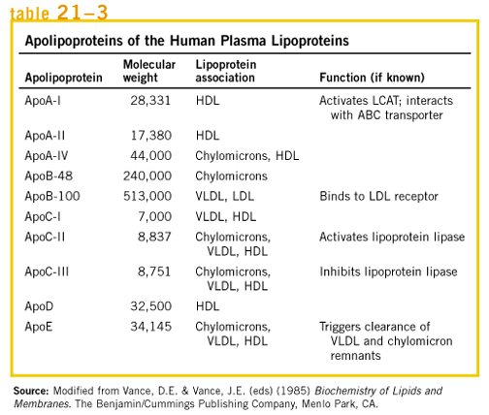

Slide 19
LIPOPROTEIN | Major lipids | APOPROTEINs | Source
chylomicrons | Triacylglycerol (nutritional) | B-48, C, E | intestine
Chylomicron remnant | Cholesterol esters | B-48, E | circulation
VLDL very low density lipoprotein | Triacylglycerol (hepatic origin) | B-100, C, E | liver
IDL intermediate-density lipoprotein | Cholesterol esters (endogenous) | B-100, E | circulation
LDL low-density lipoprotein | Cholesterol esters (endogenous) | B-100 | circulation
HDL high-density lipoprotein | Cholesterol esters (endogenous) | A | liver, intestine

Slide 20
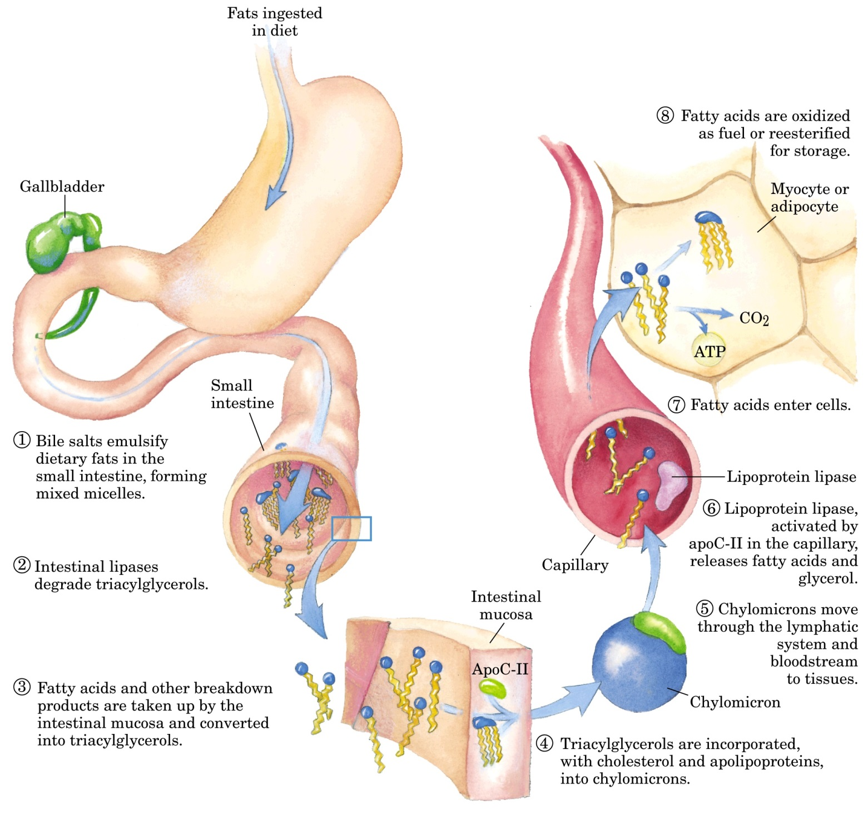

Slide 21
The major enzymes involved in lipoprotein metabolism ( in circulation)
LIPOPROTEIN-LIPASE (LPL)
  Main source: adipocytes and muscles
  substrates: triacylglycerols and phospholipids (from chylomicrons and VLDL)
HEPATIC LIPASE (HL)
  Main source: hepatocytes
  substrates: triacylglycerols and phospholipids (from VLDL, IDL, HDL)
LECITIN-CHOLESTEROL-ACYL-TRANSFERASE (LCAT)
  Main source: hepatocytes
  substrates: : cholesterol and phosphatidylcholine (HDL)

Slide 22
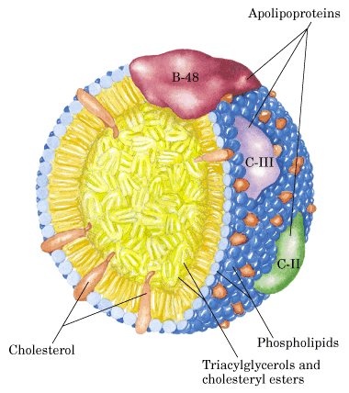
Chylomicron

Slide 23
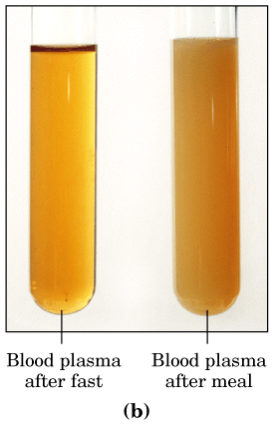

Slide 24
Triacylglycerols are is transported from the intestines in chylomicrons˛& from the liver in very low density lipoproteins

Slide 25
Metabolism of chylomicrons

Slide 26
CHYLOMICRONS
Synthesis: intestine
The major lipid: triacylglycerol (exogenous)
diameter 100 to 400 nm
structural apoprotein: B-48
apolipoprotein necessary for catabolism: apo C and apo E (from HDL)
Transport of exogenous triacylglycerols and cholesterol from intestine to the liver
intestine → lymph → plasma (contact with lipoprotein-lipase at the surface of the endothelial capillary cells) → deliberation of fatty acids and aplipoproteins A and C → Liver uptakes chylomicron remnants (apoE)

Slide 27
VLDL metabolism

Slide 28
Very low density lipoproteins (VLDL; pre-β lipoproteins)
Synthesis: liver
The major lipid: triacylglycerol (endogenous)
Diameter:Smaller than chylomicrons - 40 do 70 nm
structural apoprotein: B-100
apolipoprotein necessary for catabolism: apo C and apo E (from HDL)
Liver → plasma → (contact with lipoprotein-lipase at the surface of the endothelial capillary cells) → deliberation of fatty acids and aplipoprotein C (to HDL) → two ways:
  Liver uptakes VLDL remnants (apoE)
  Or VLDL remnants → enriched with cholesterol esters → IDL →LDL →LDL receptors (liver, different tissues) (apoB100)→cell uptake

Slide 30
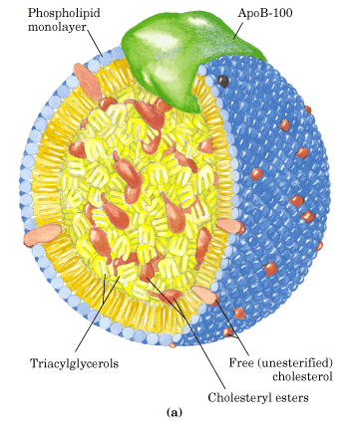
Low density lipoprotein
LDL particles are the result of the rearangement of lipoprotein’s lipids inside circulation.
They are important for delivering of the cholesterol-esters to different type of cells ( i. E. for mebrane structure, steroidigenesis, bile acid formation)

Slide 31
Low density lipoproteins (LDL; β-lipoproteins)
Cholesterol transport
Major lipid: cholesterol ester
diameter 22,5 do 27,5 nm
Apoprotein: apo B-100
Quantity of LDL depends on VLDL from liver and VLDl-remnant
Fates of LDL:
a) uptake by liver (75%),
b) uptake by extrahepatc tissues (25%)

Slide 32
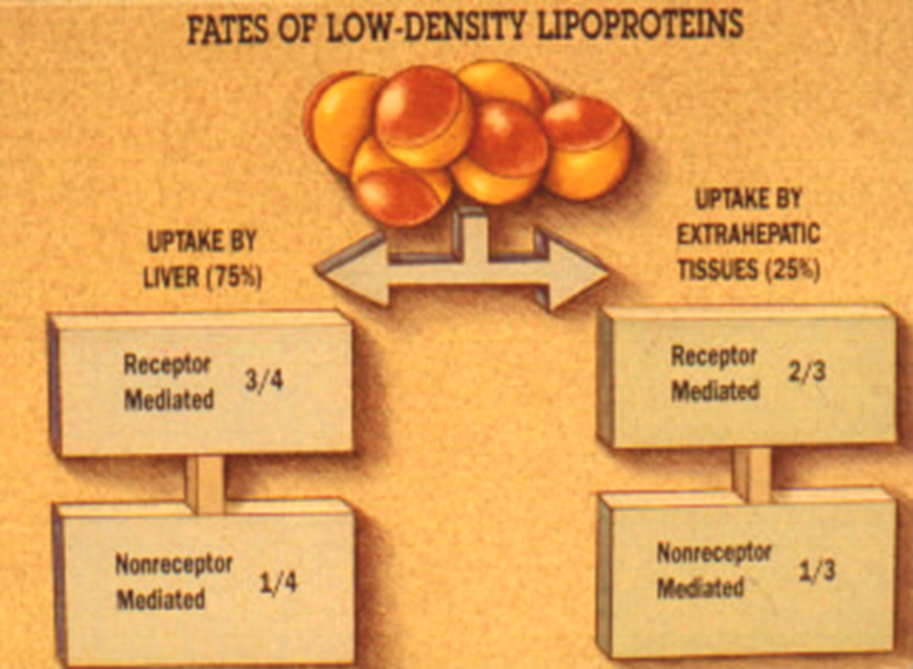

Slide 33
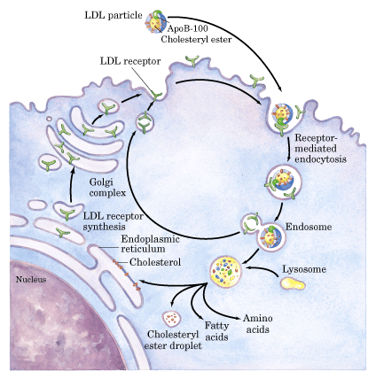
Cholesterol intake by receptor-mediated endocytosis
LDL-receptor recognize apolipoprotein B-100 in LDL.
Nobel prize for medicine and physiology 1985 – investigation of regulation of cholesterol metabolism

Slide 34
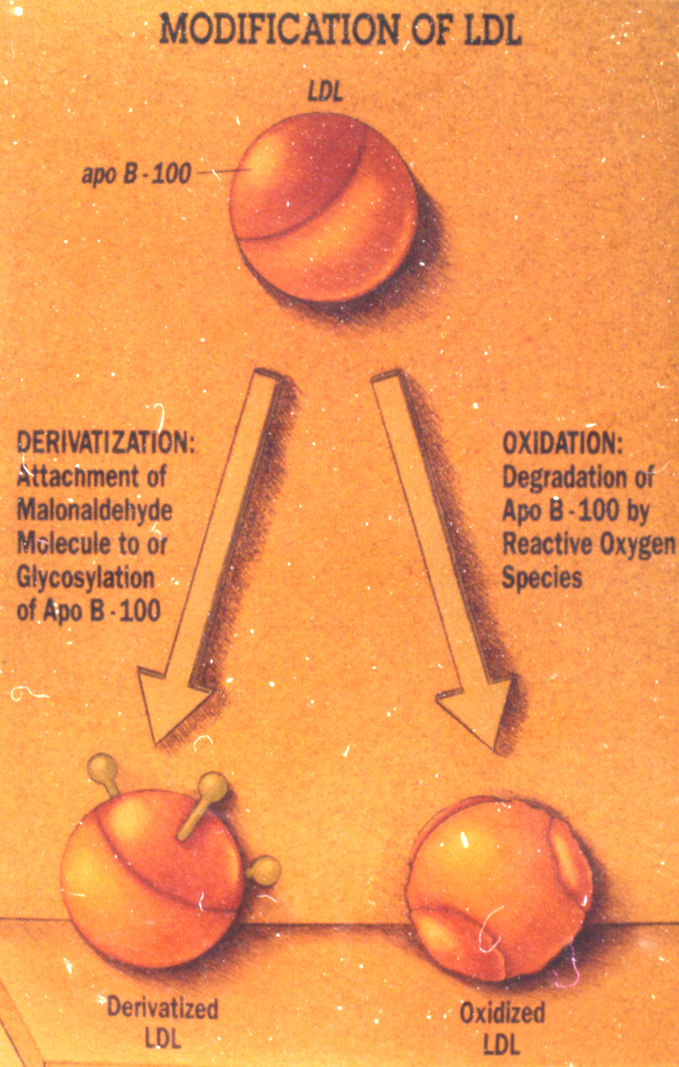

Slide 35
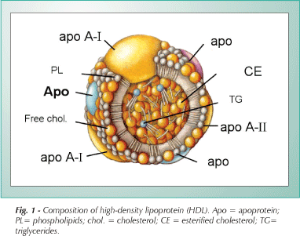
High density lipoprotein

Slide 36
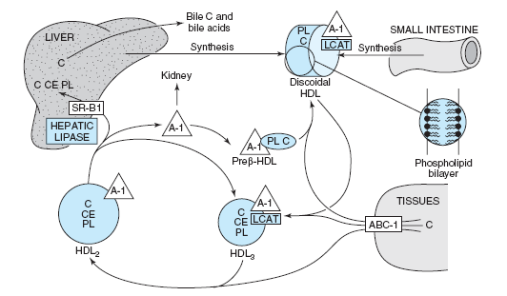
Metabolism of high-density lipoprotein and reverse cholesterol transport

Slide 37
High density lipoproteins (HDL; α-lipoproteins)
Diameter: 7,5 -10 nm
Transfers apoproteins apo A-I, apo A-II, apo C and apo E onto VLDL and chylomicrins
Cholesterol ester
nascent HDL: synthetised in liver and intestine
lecitin-cholesterol acyltransferase (LCAT) converts it to HDL₃ and HDL₂

Slide 38
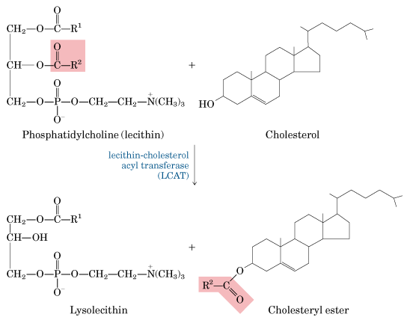
Extracellular esterification of cholesterol

Slide 39
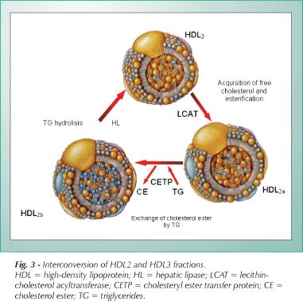

Slide 40
HDL-Cholesterol uptake and intake
Receptor mediated endocytosis
SR-B1
  Delivering of cholesterol to steroidegenic tissues
  Picking up the cholesterol stored in exreahepatic tissues (passive movement from the cell surface)
ABC1
  Active transporter in cholesterol rich cell (endocytosis and resecretion with a load of cholesterol

Slide 41
Classification of hyperlipoproteinemia
PRIMARY | SECONDARY
Hypercholesterolemia: Familial hypercholesterolemia Familial defect of Apo B Polygenic hypercholesterolemia Familial hyperalphalipoproteinemia Accumulation of cholesterol esters Hypertriglyceridemia: Familial deficiency of Lipoprotein lipase Familial deficiency of Apo C II Familial deficiency of hepatic lipase Familial hypertriglyceridema Combined hyperlipoproteinemia: Hyperlipoproteinemia Type III Familial combined hyperlipoproteinemia | Hypercholesterolemia: Hypothyroidism Nephritic syndrome Cholestasis Drugs (cycklosporin, antiepileptic) Hypertriglyceridemia: Diabetes Chronicle kidney diseases Obesity Alcohol Drugs (estrogens, corticosteroid, β-blockators) Combined hyperlipoproteinemia: Hypothyroidism Nephritic syndrome Drugs (thiazide diuretics)

Slide 42
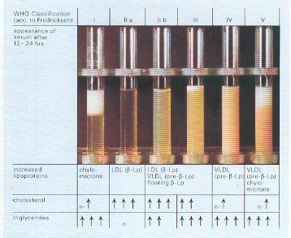
Classification of lipoprotein abnormality according to Frederickson-WHO

Slide 43
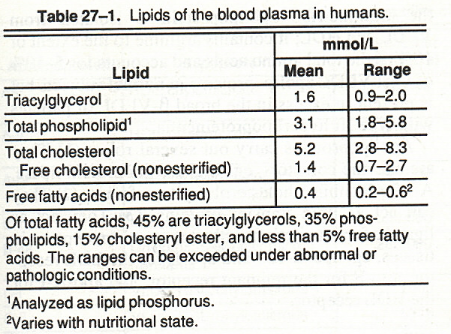

Slide 44
Type | metabolic defect | LP abnormality | predominant hyperlipidemia
I | deficient lipoprotein lipase | fasting chylomicrons | hypertriglyceridemia
IIa | deficient apoB receptors | increased LDL | hypercholesterolemia
IIb | deficient apoB receptors and deficient HDL | increased LDL | hypercholesterolemia hypertriglyceridemia
III | defective apoE | increased IDL and chylomicron remnants | hypercholesterolemia hypertriglyceridemia
IV | deficient HDL | increased VLDL | hypertriglyceridemia
V | deficient lipoproteinlipase and deficient HDL | fasting chylomicrons and increased VLDL | hypertriglyceridemia

Slide 45
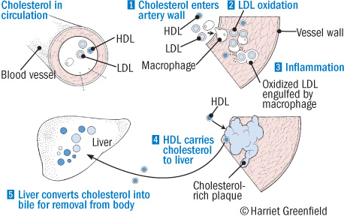
Atherosclerosis as a consequence of hypercholesterolemia
www.hmiworld.org/hmi/issues/sept-oct07/hdl.php

Slide 46
http://www.namrata.co/cholesterol-and-lipoproteins-multiple-choice-questions-set-2/

Slide 47
Excercises
List ans describe different types of apolipoproteins and indicate their role in metabolism!
List and describe different types of lipoproteins and indicate their role in metabolism!
Display the composition of different lipoproteins and indicate the place of their creation (occurrence)!

